Slide 2
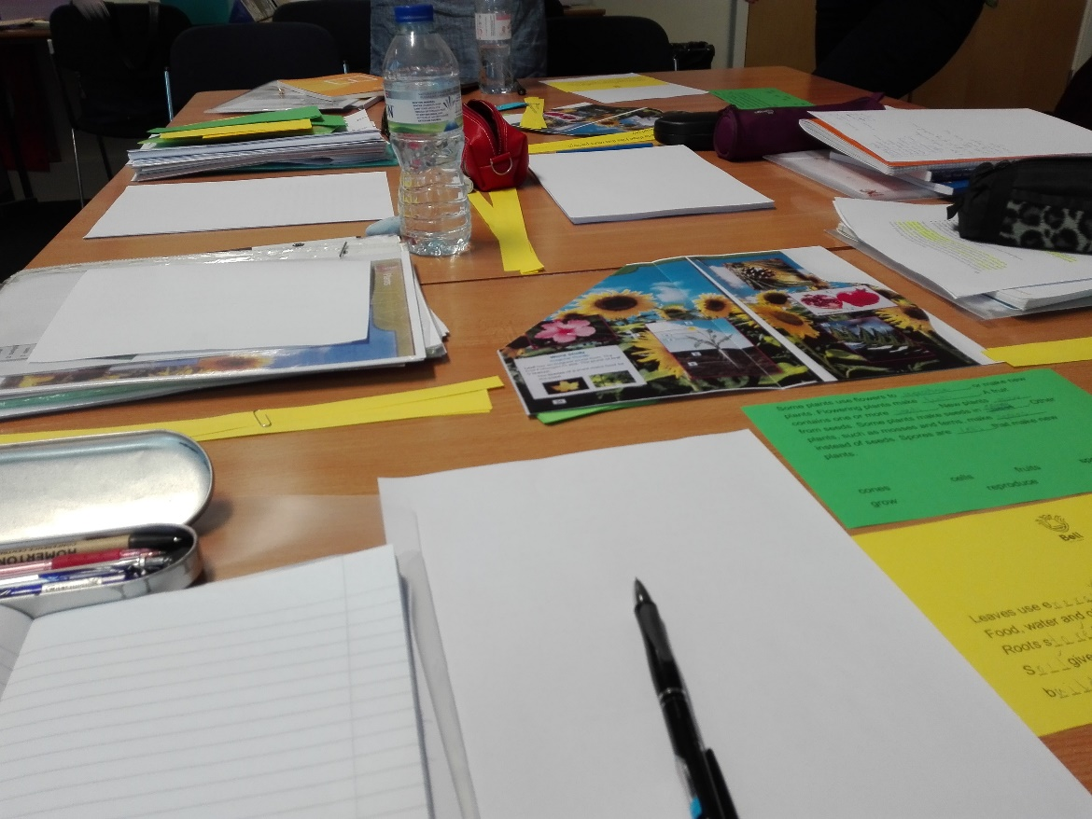
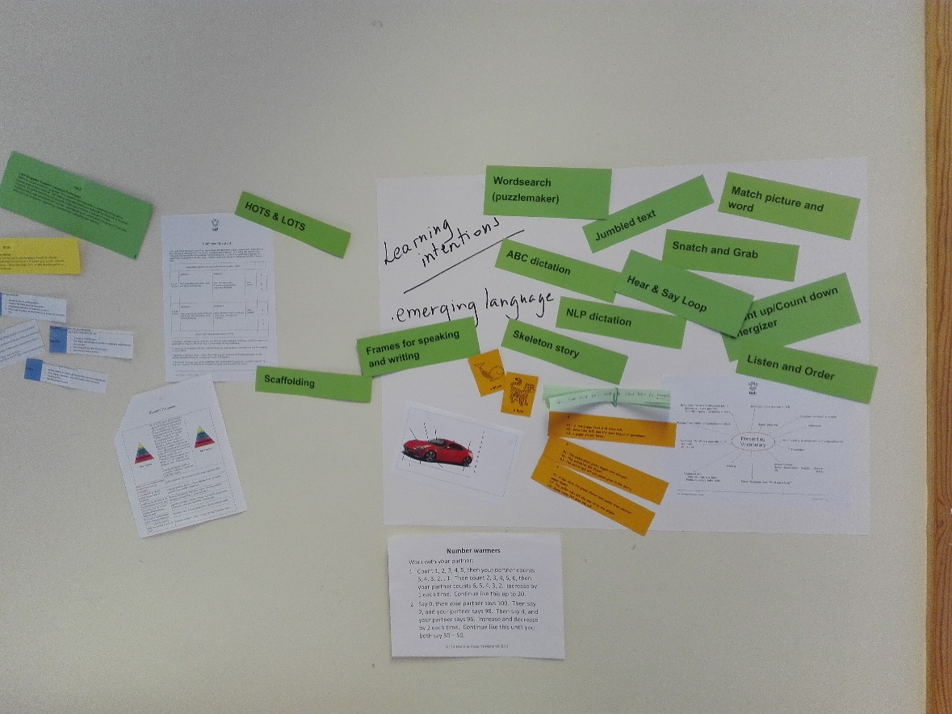
Štrukturovaný kurz CLIL Primary (Content and Language Integrated Learning)
Cieľ: oboznámiť sa s pojmami, formami práce a praktickými ukážkami práce CLIL vo vyučovacom procese.
Porozumieť jadru vlastností CLIL prístupu k vyučovaniu angličtiny. Plánovať, učiť a sprístupniť učenie na CLIL hodinách.

Slide 3
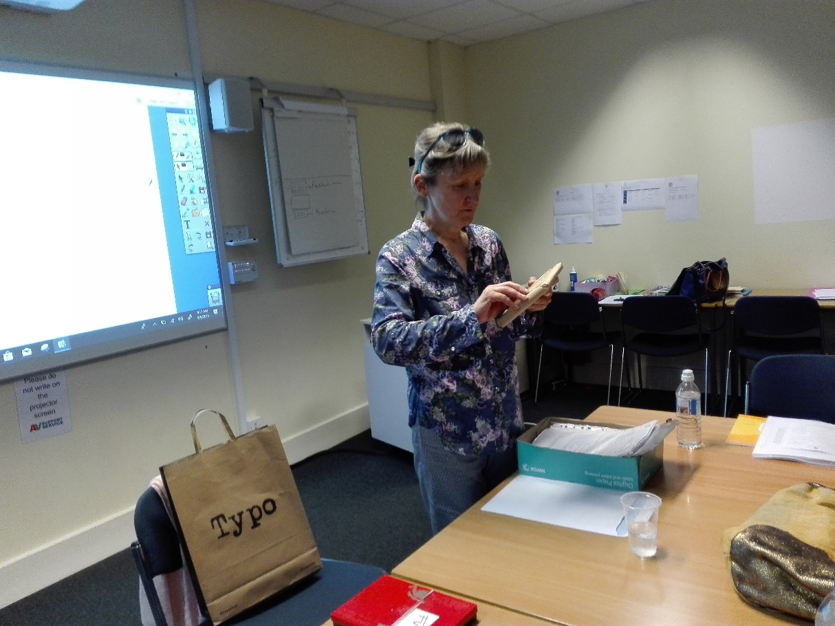
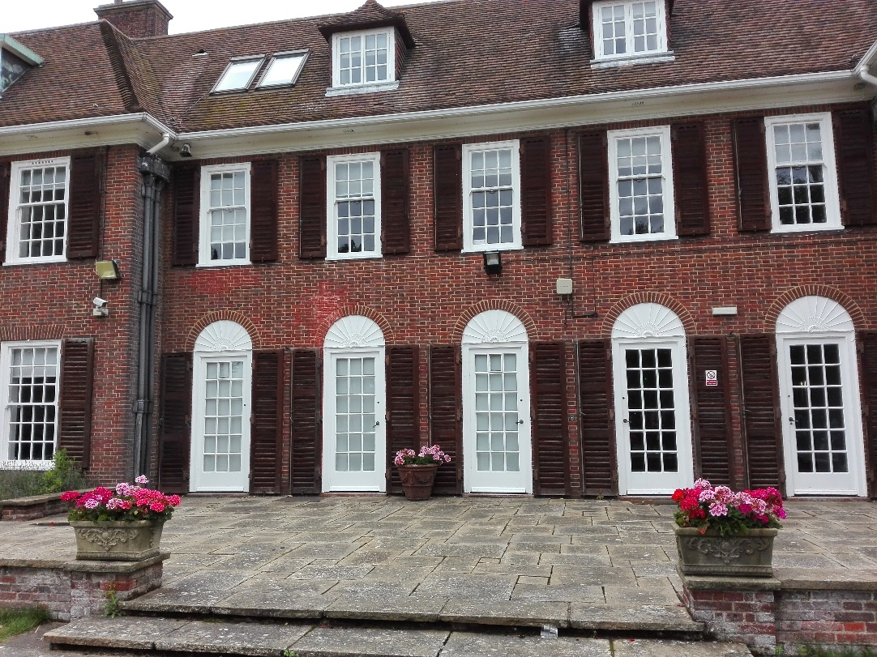
Lektor kurzu: Françoise Votocek
Françoise je trénerom kvalifikovaným pre Delta a je vysoko rešpektovaným lektorom CELTA. Françoise tiež vyučuje v areáli učiteľov Bell, vrátane kurzov „CLIL pre základné a stredné školy“, „Kreativita v triede“ a „Jazyk a metodika“ pre učiteľov stredných škôl.

Slide 4
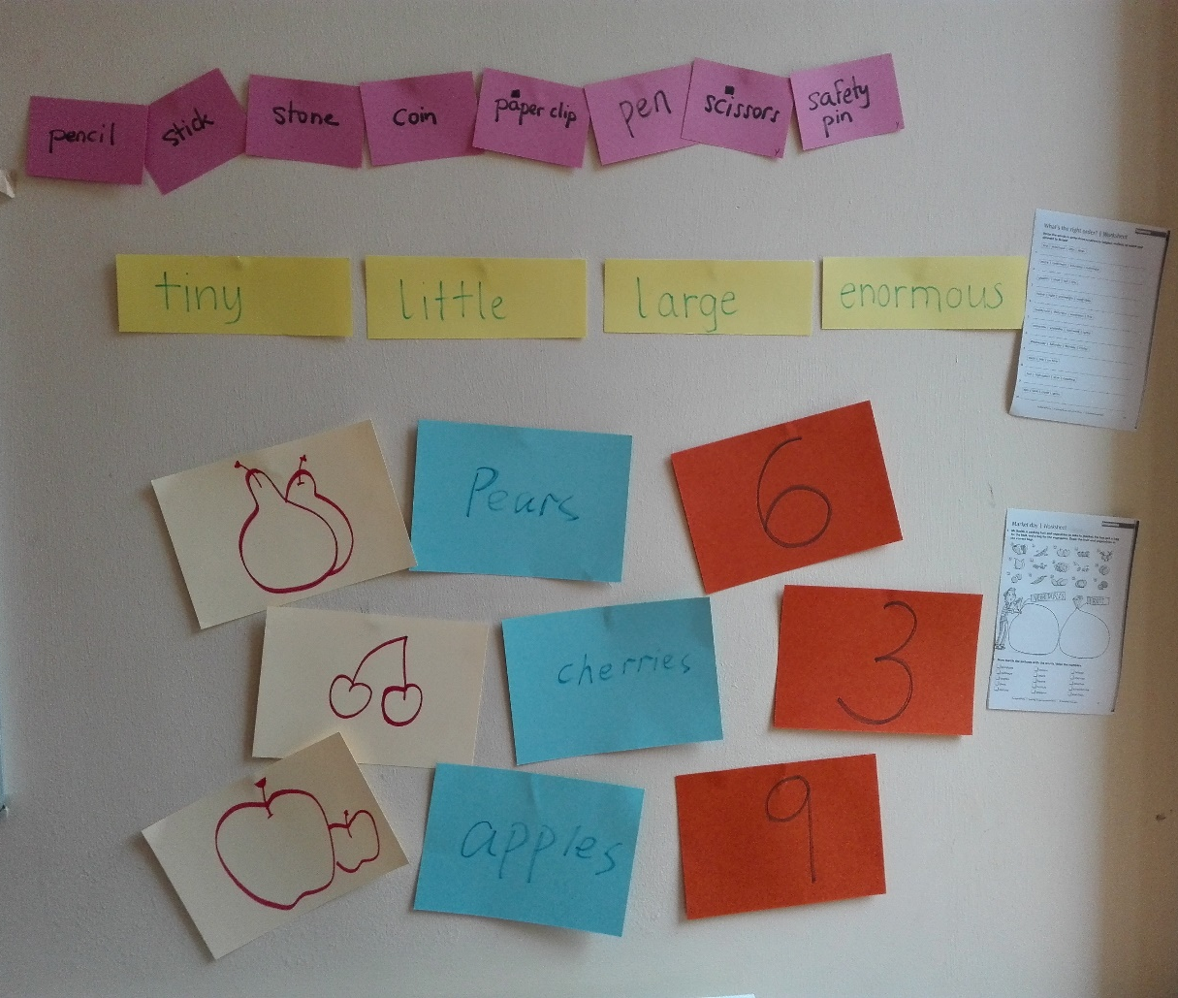
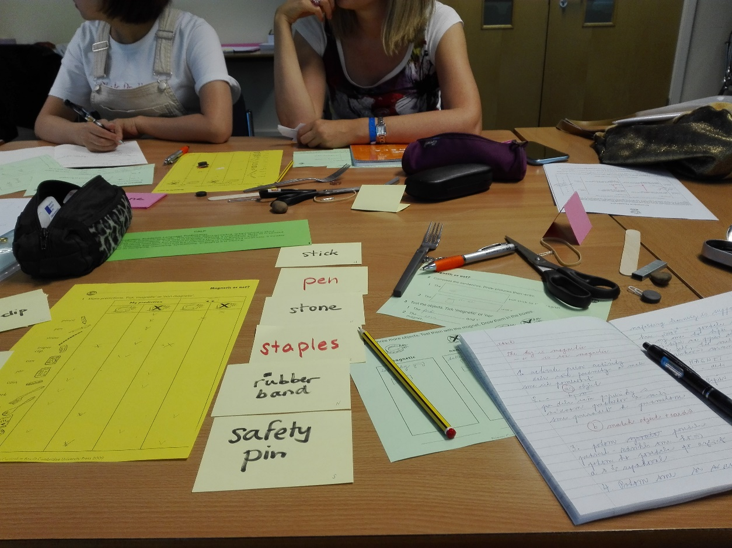
Hlavný prínos kurzu : obohatenie vedomostí o inováciách v jazykovom vzdelávaní, obohatenie repertoáru zaužívaných didaktických postupov a metód, využitie cudzojazyčných zručností v tematickom vyučovaní, rozvoj jazykových kompetencií.

Slide 5
CLIL –Content and Language Integrated Learning is an approach that involves using a language that is not the
students´ native language as the medium of instruction and learning for primary, secondary and vocational
level subjects , such as science, art or business studies. However, CLIL is not about „translating“ first language
teaching and learning into another language in the hope that learners will learn in another language.
CLIL is combination of both language education and subject education, with a focus not only on content, and
not only on language. Subject learning and language learning are integrated, even if the emphasis is greater on one or the other at a given time.

Slide 6
1.Language learning is included in subject classes. This means presenting information and subject – specific terminology in a way that students can undesrtand using charts, diagrams, drawings...etc.
CLIL requires subject teachers to teach some language, as subject teachers need to support the learning of those parts of language knowledge that students are missing and that may be preventing them understanding and learning the subject content.
2. Content from subjects is used in language learning classes. The language teacher , working together with teachers of other subjects, incorporates the vocabulary, terminology and texts from other subjects into their classes. Students learn the language they need to understand and use the content.
Different teachers have different challenges: language teachers need to learn more about subject content, subject teachers need to learn about the language needed for their subjects. This, however, does not mean adopting the role of a language teacher.

Slide 7
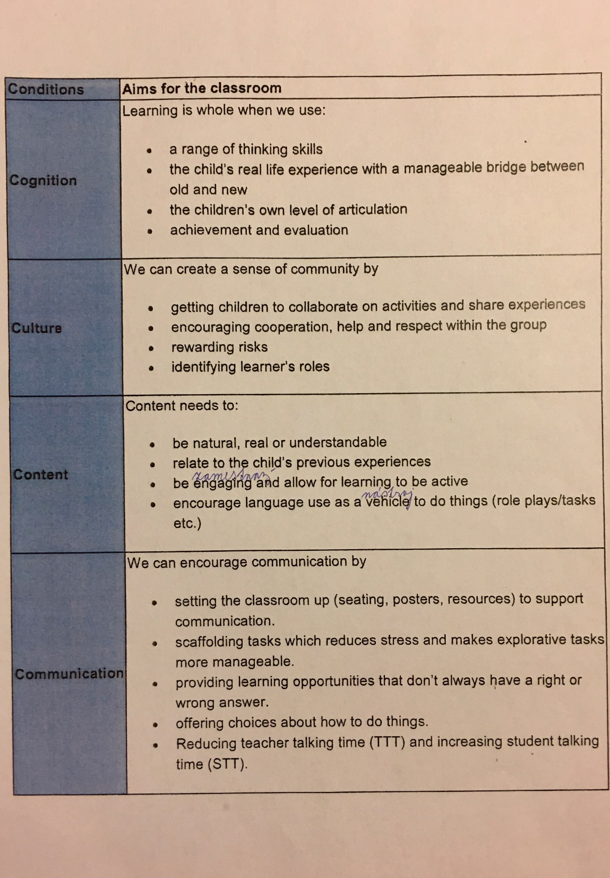
CLIL principles in action

Slide 8
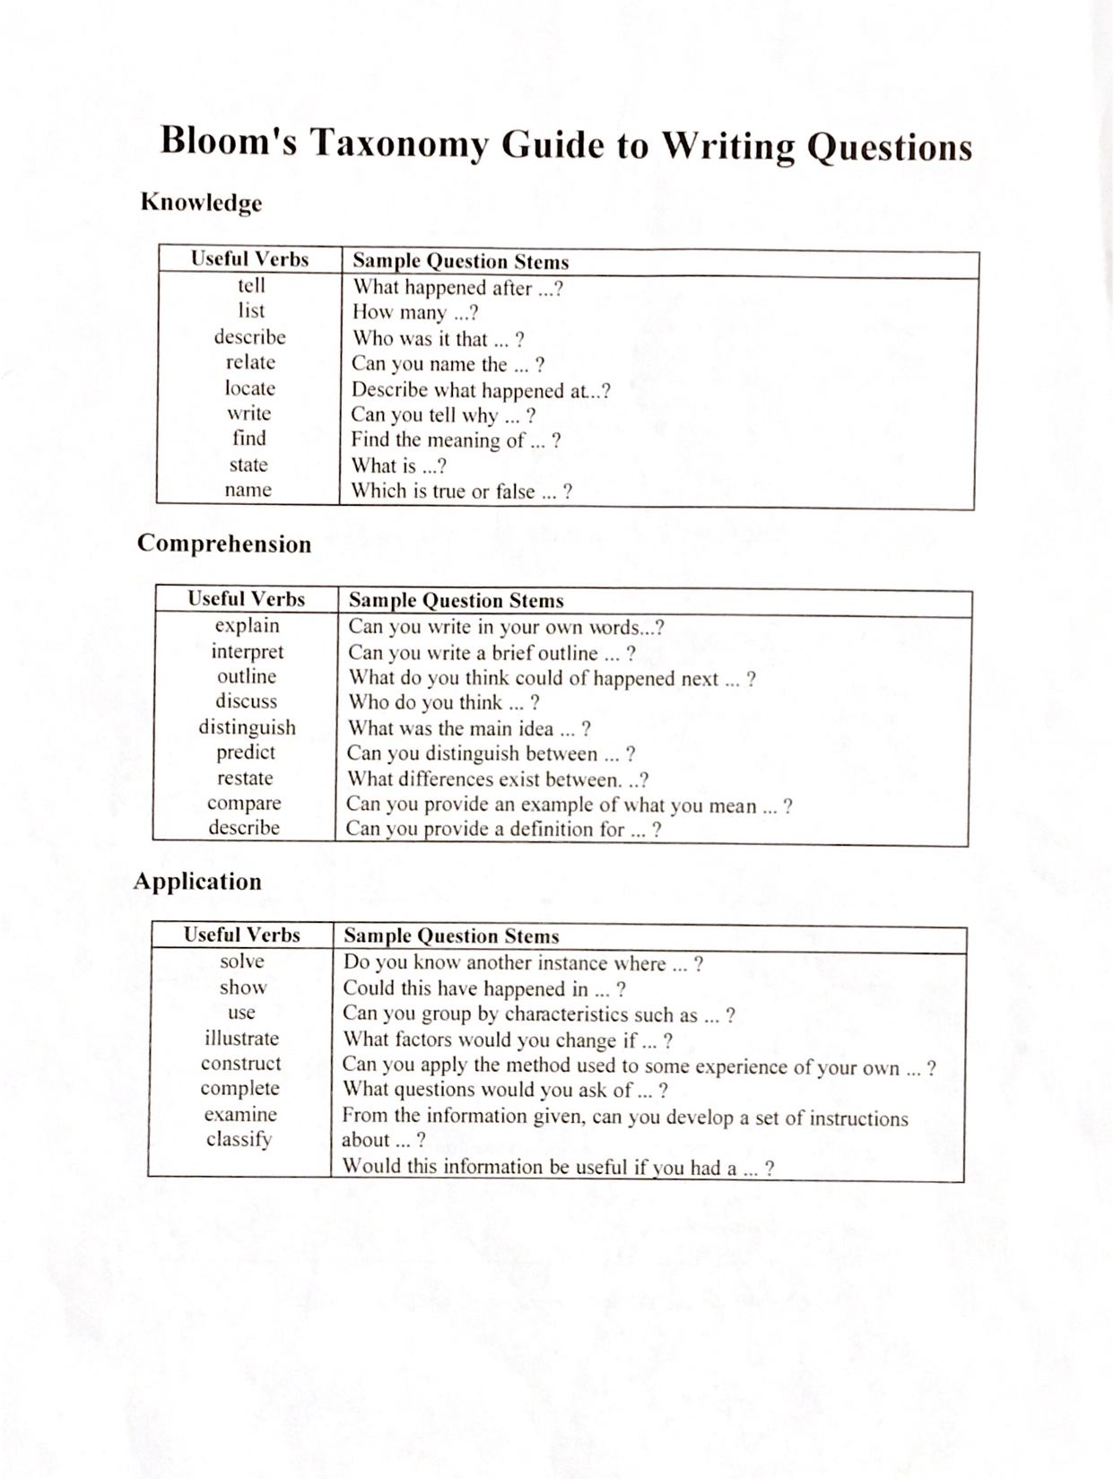
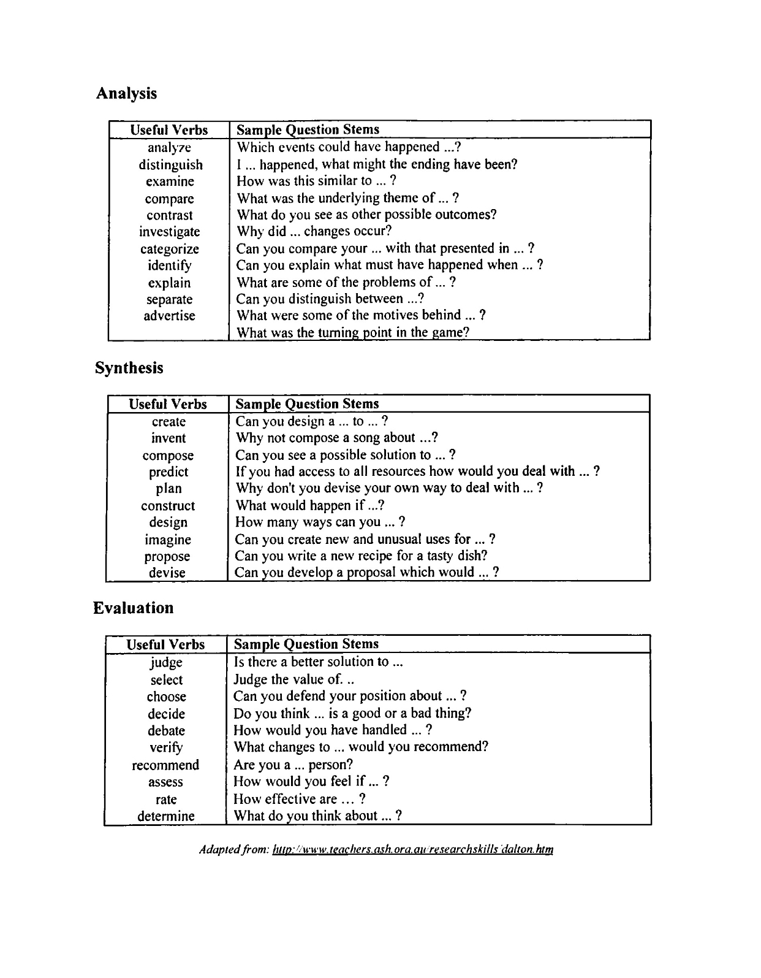

Slide 9
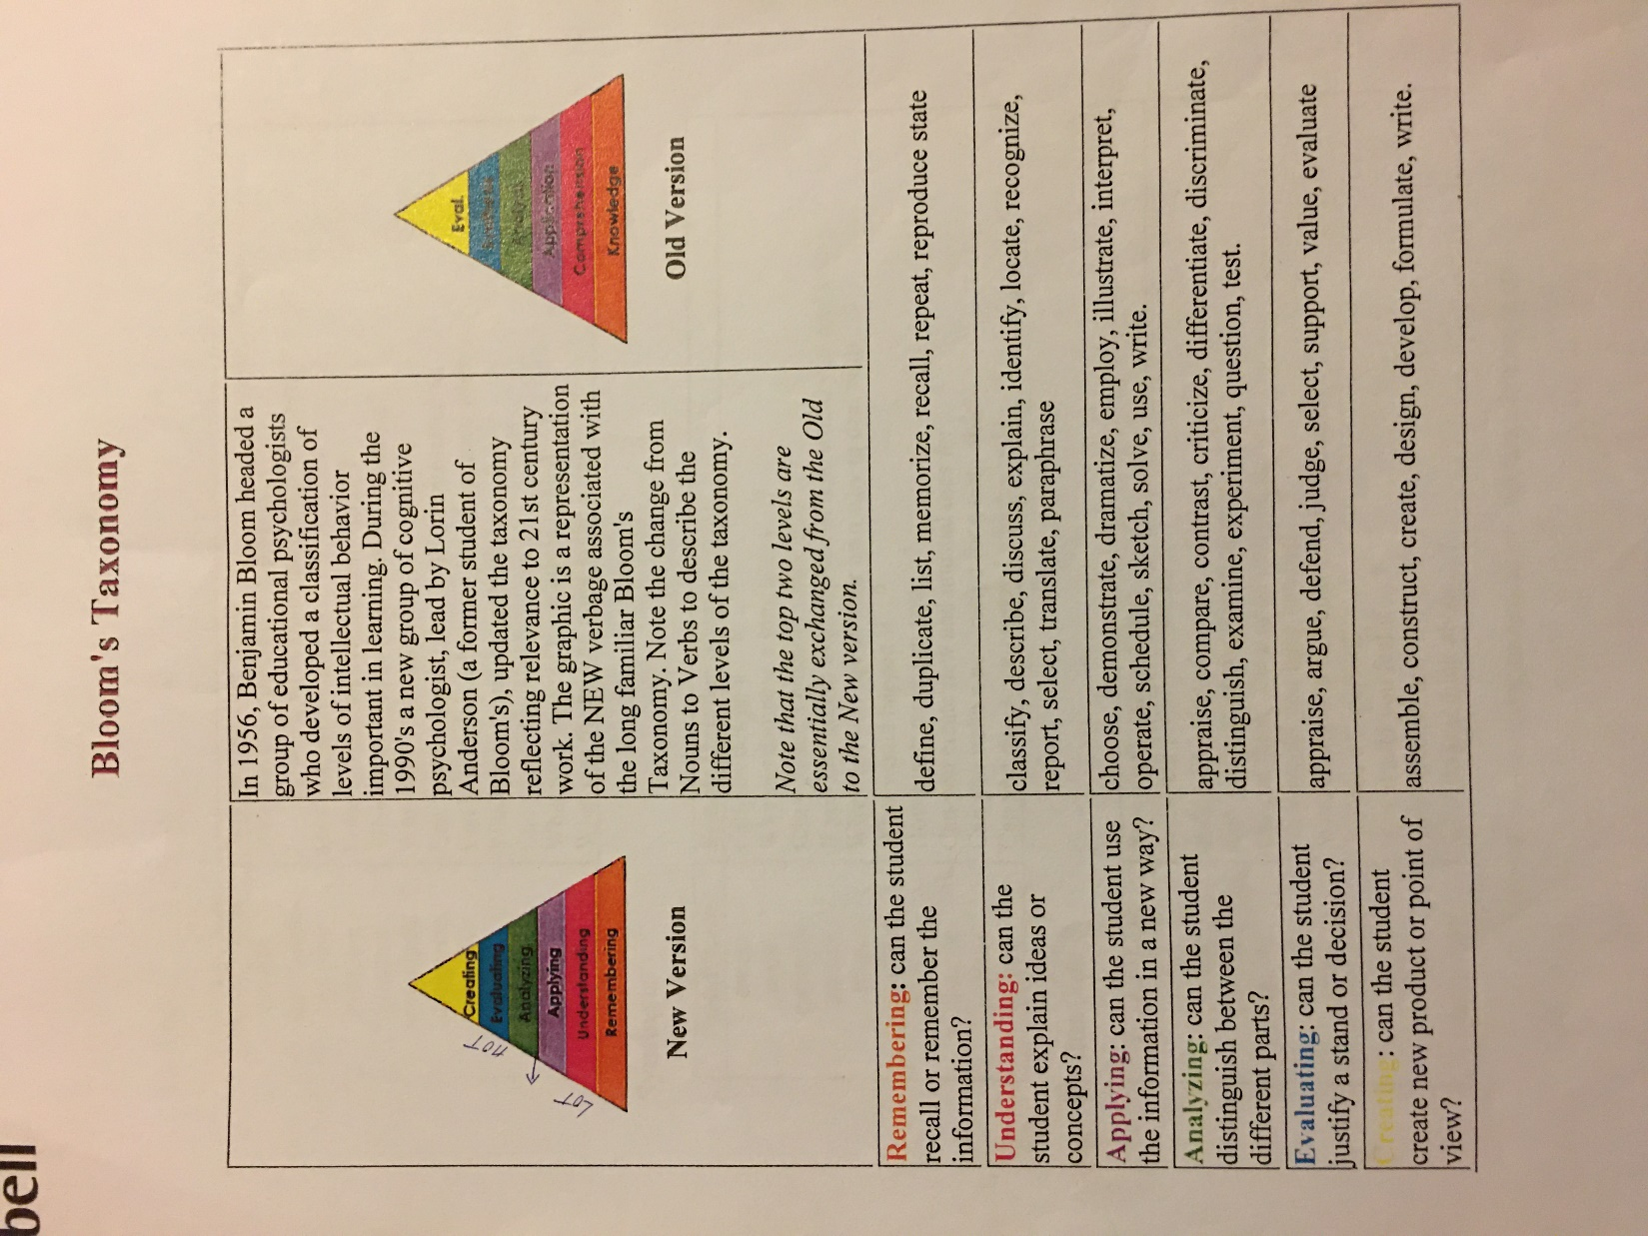

Slide 10
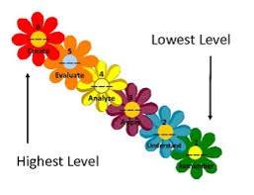
LOTS
HOTS

Slide 11
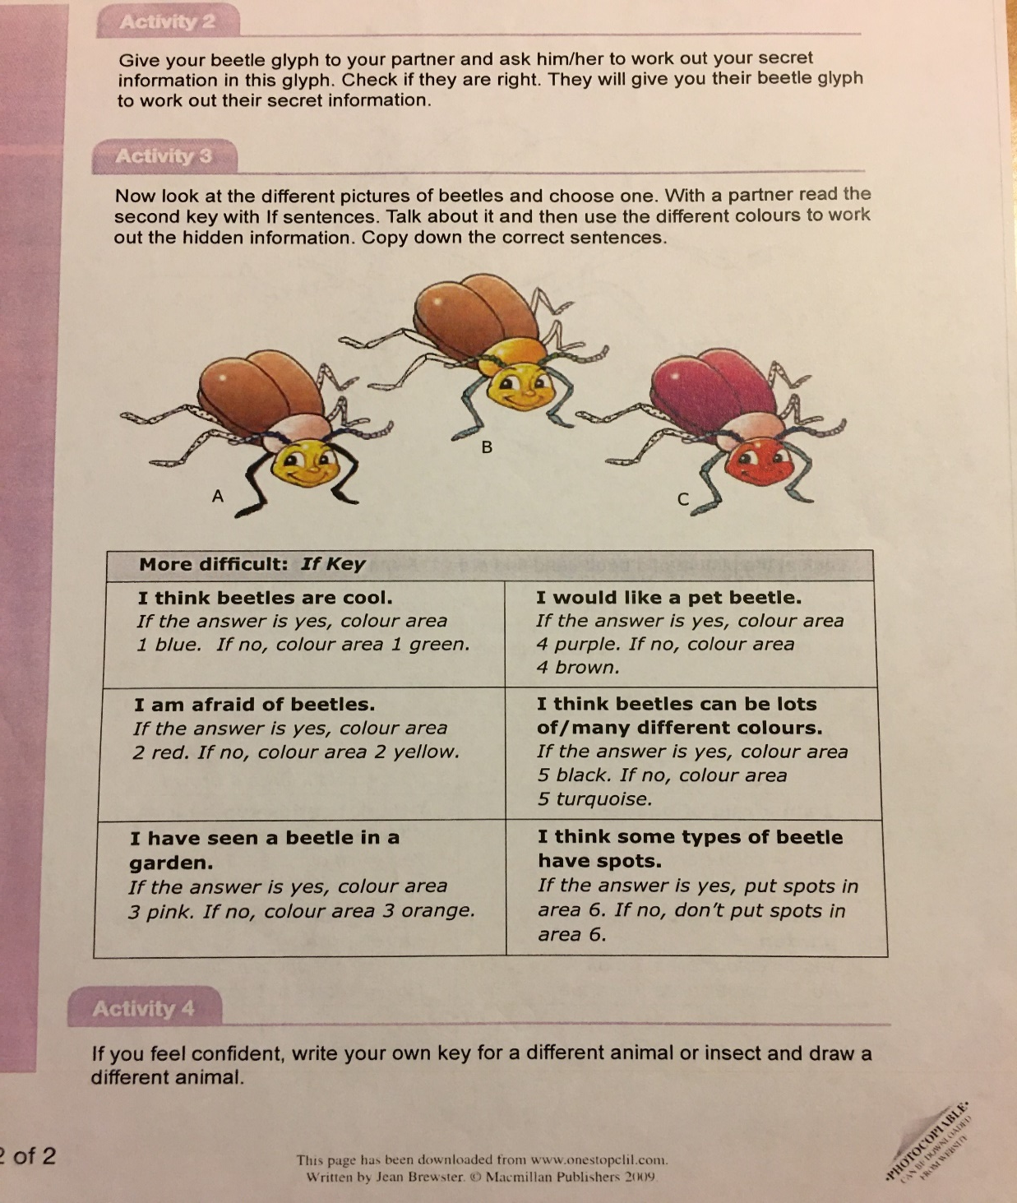
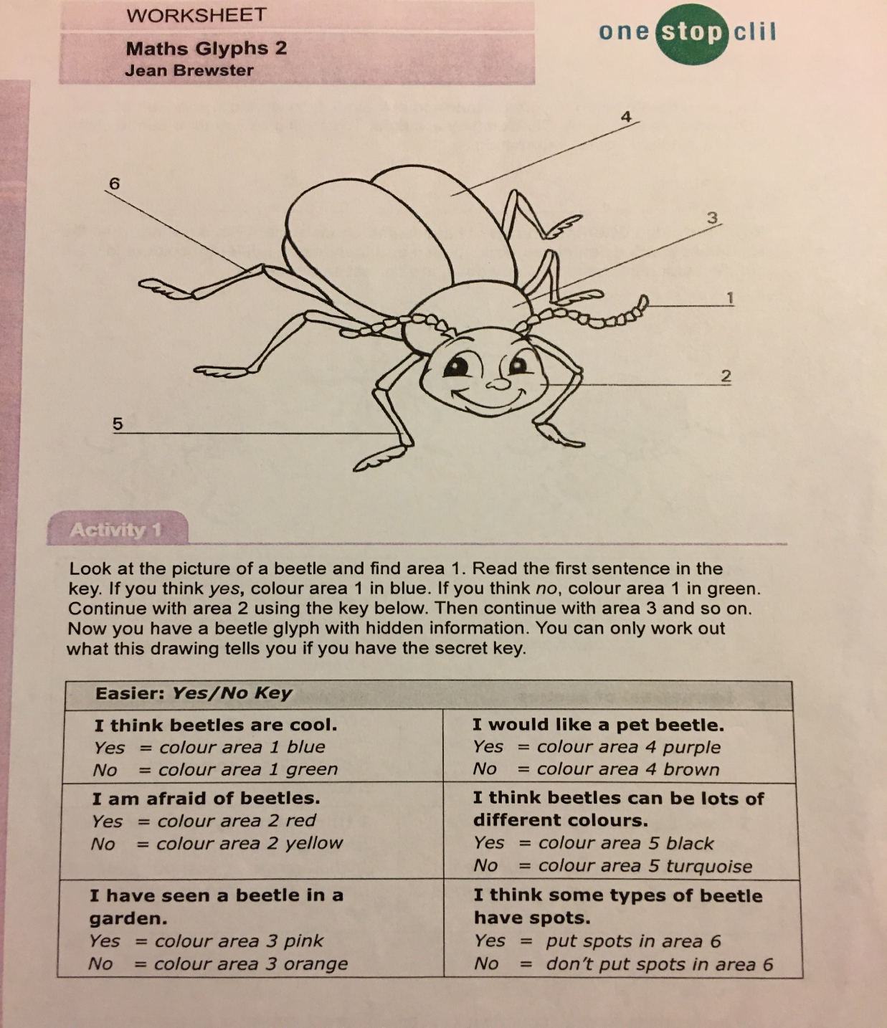
A GLYPH

Slide 12
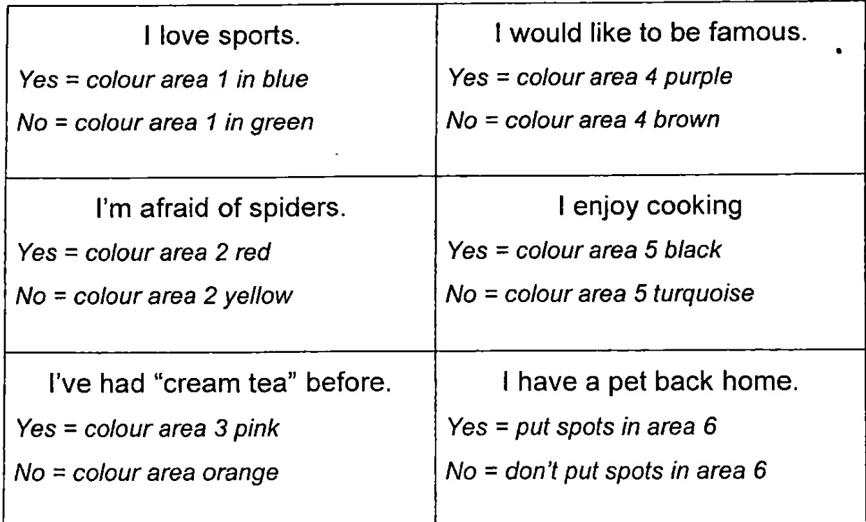

Slide 13
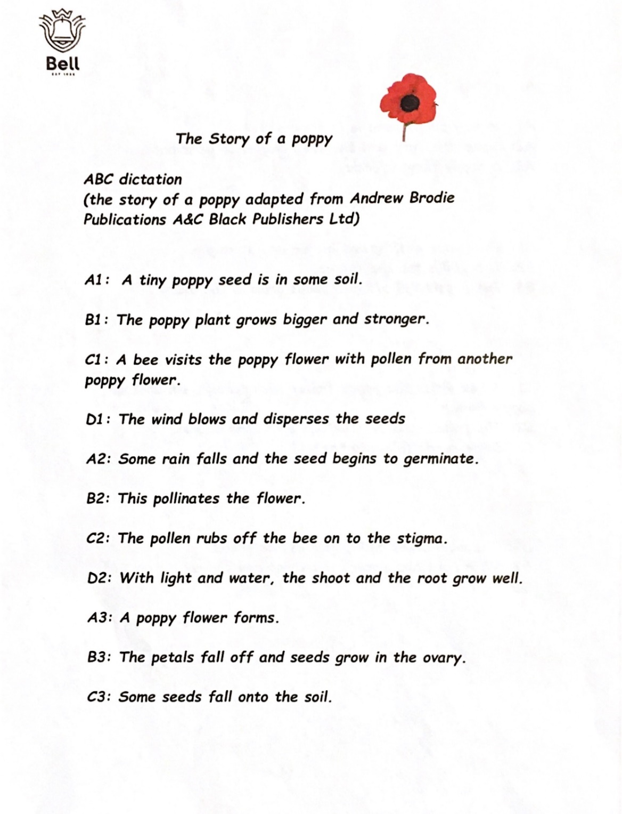
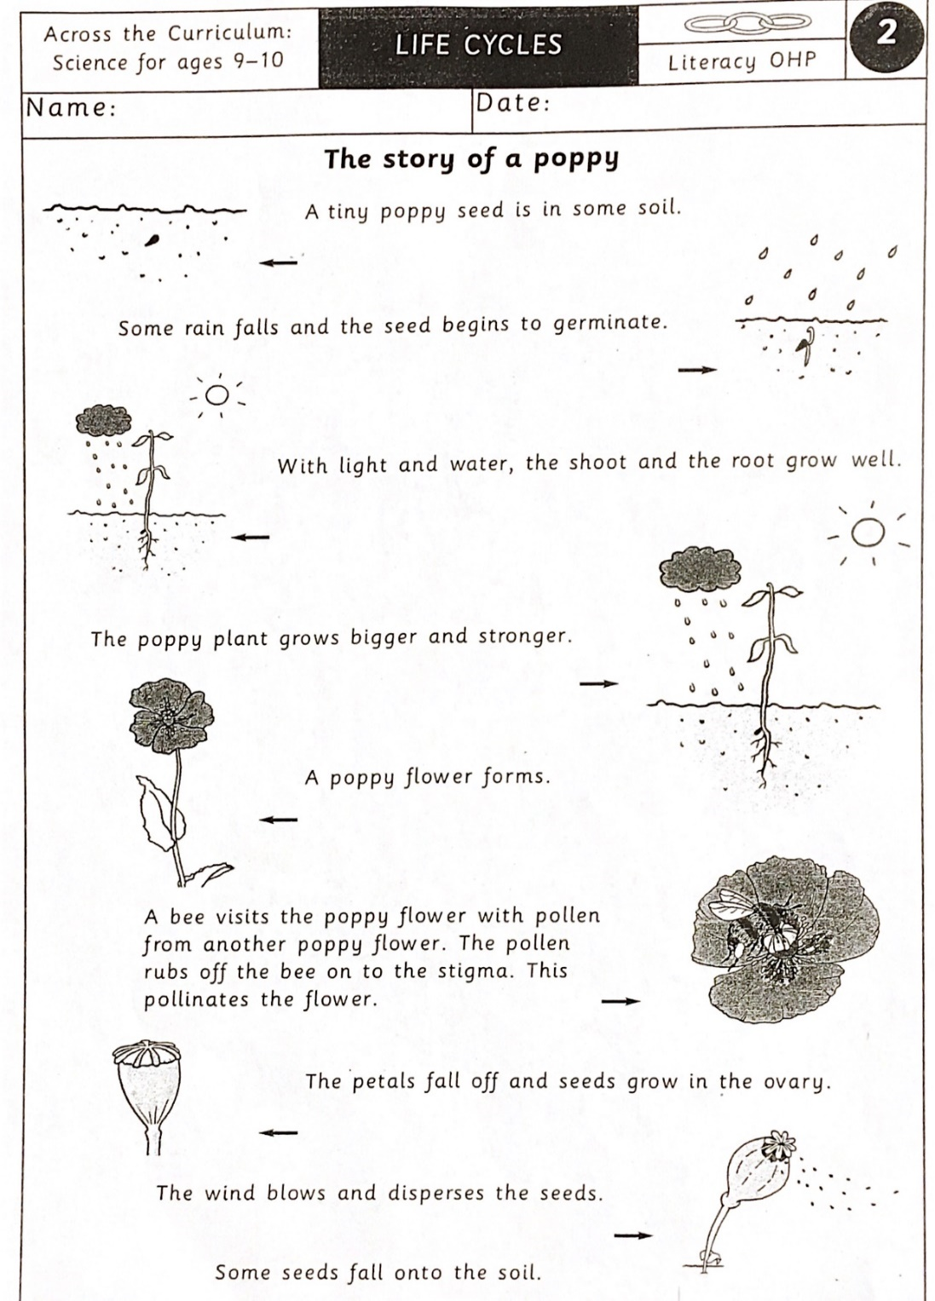
ABC
DICTATION

Slide 14
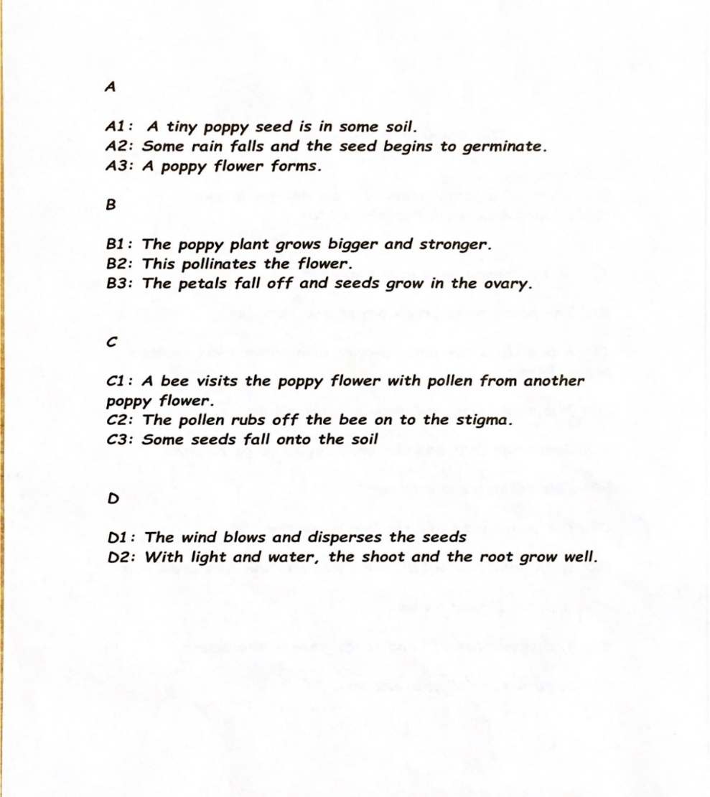

Slide 16
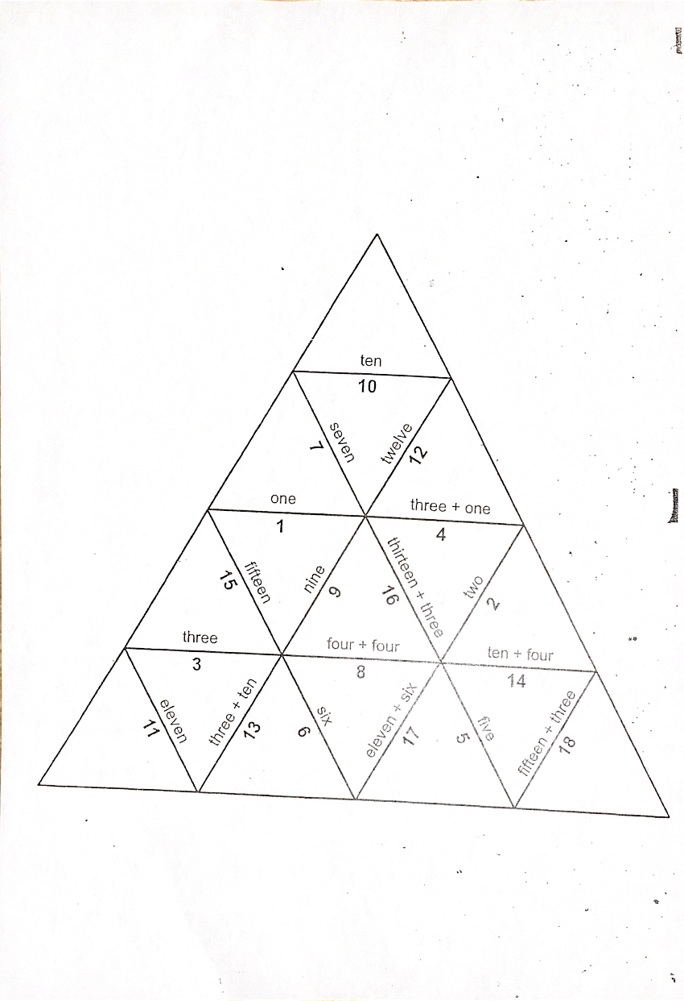
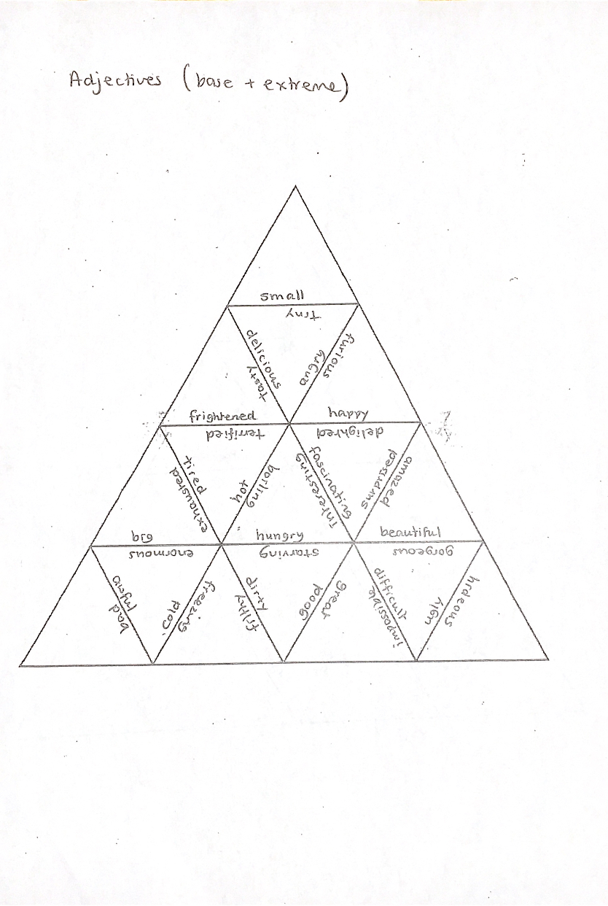
TRIANGLE PUZZLE

Slide 17
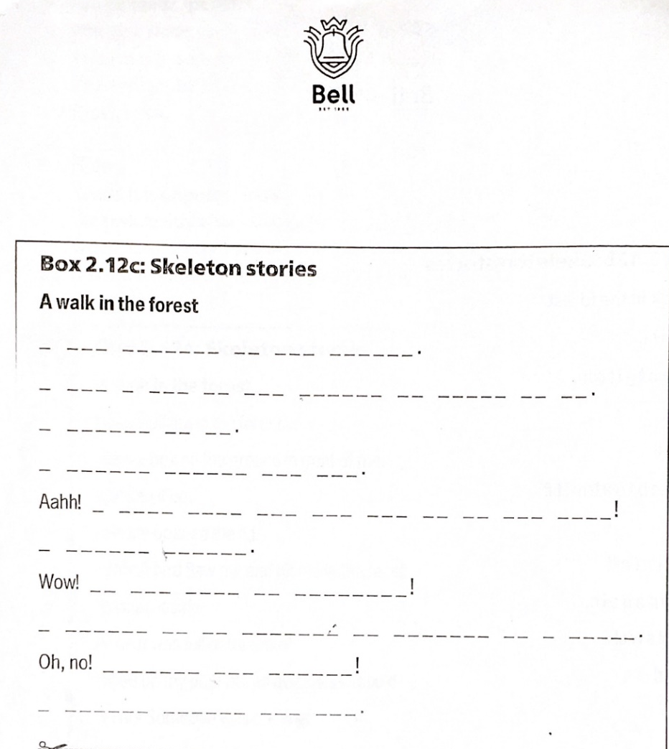
SKELETON STORIES

Slide 18
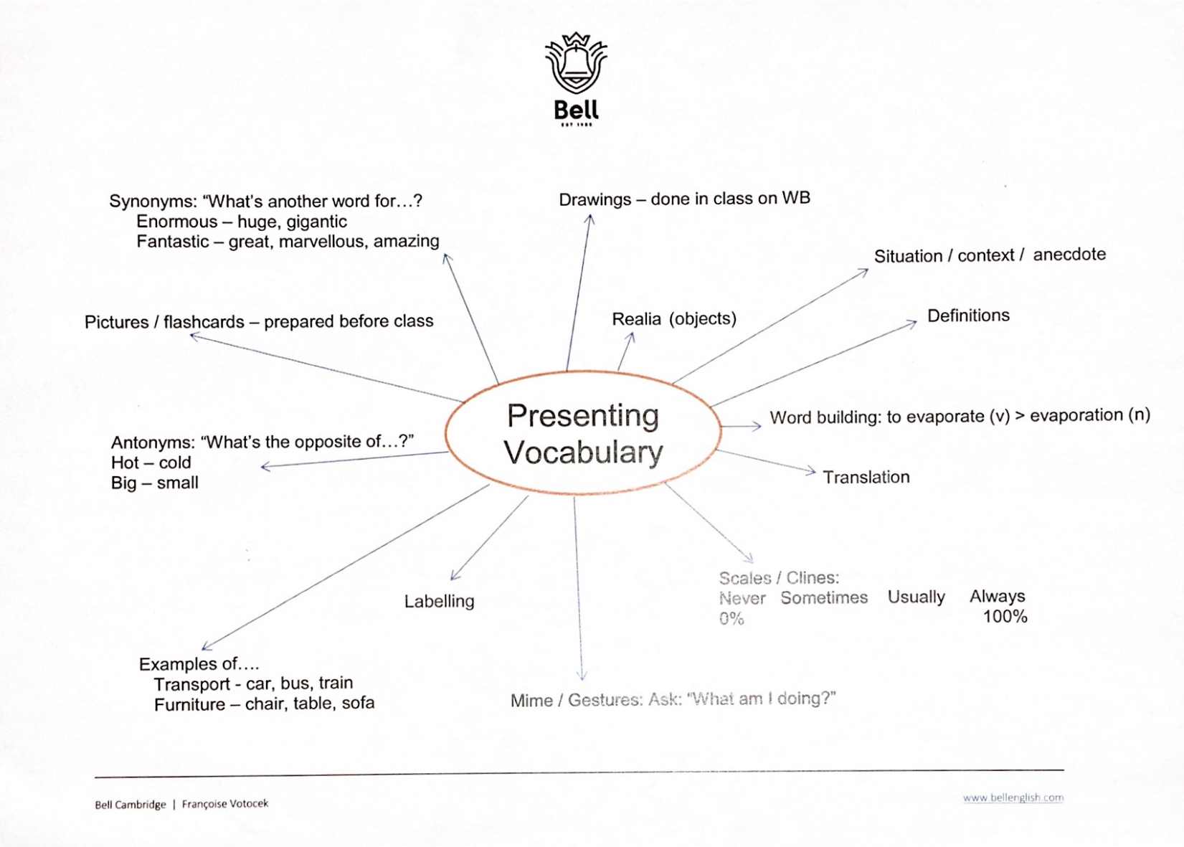

Slide 19
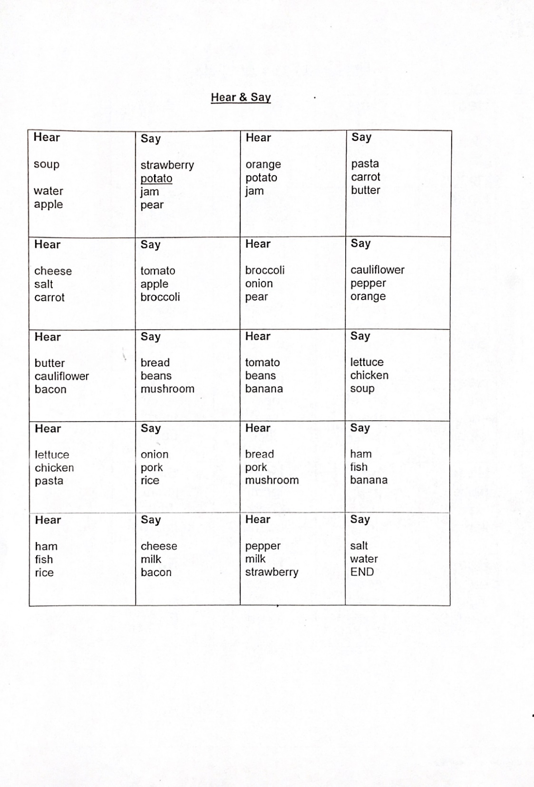
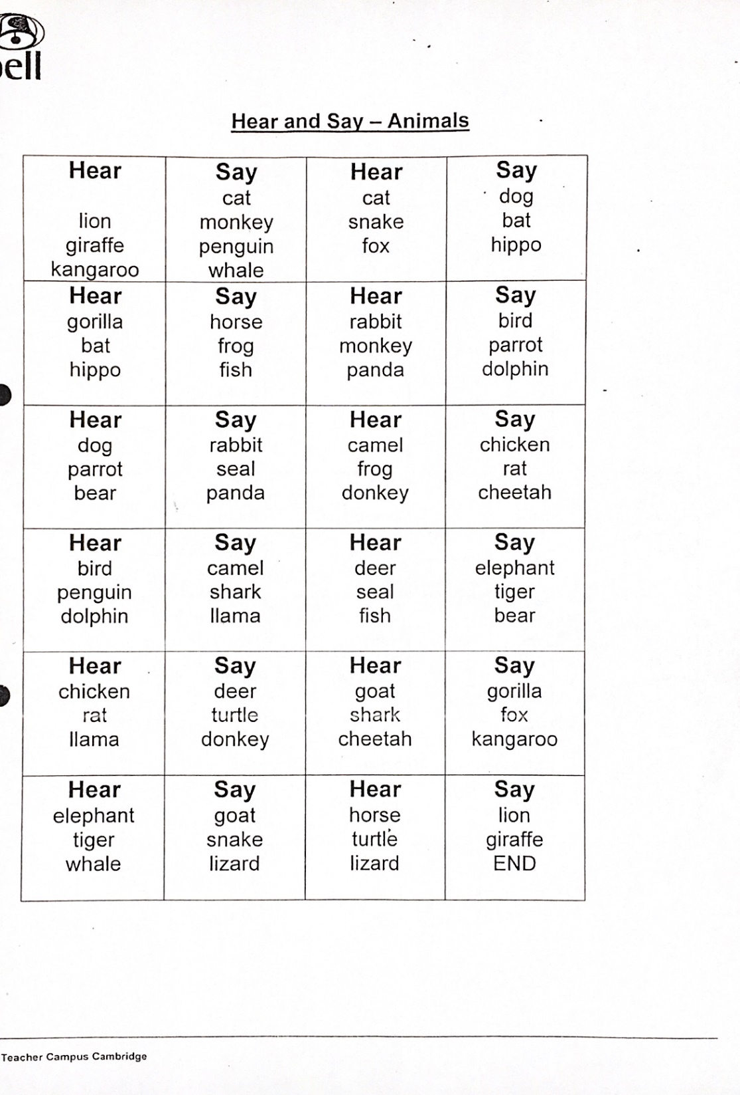
LOOP
ACTIVITIES

Slide 20
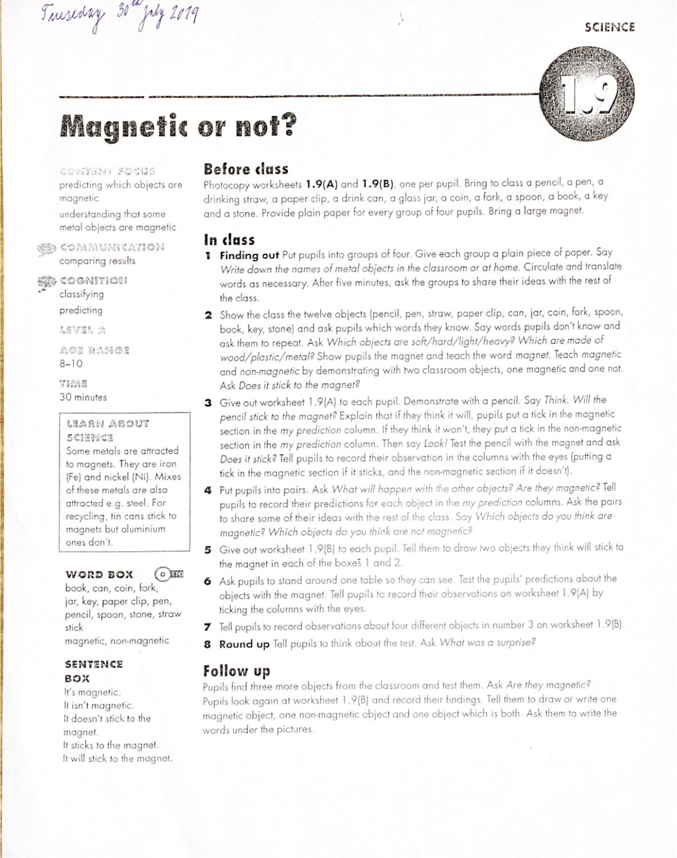
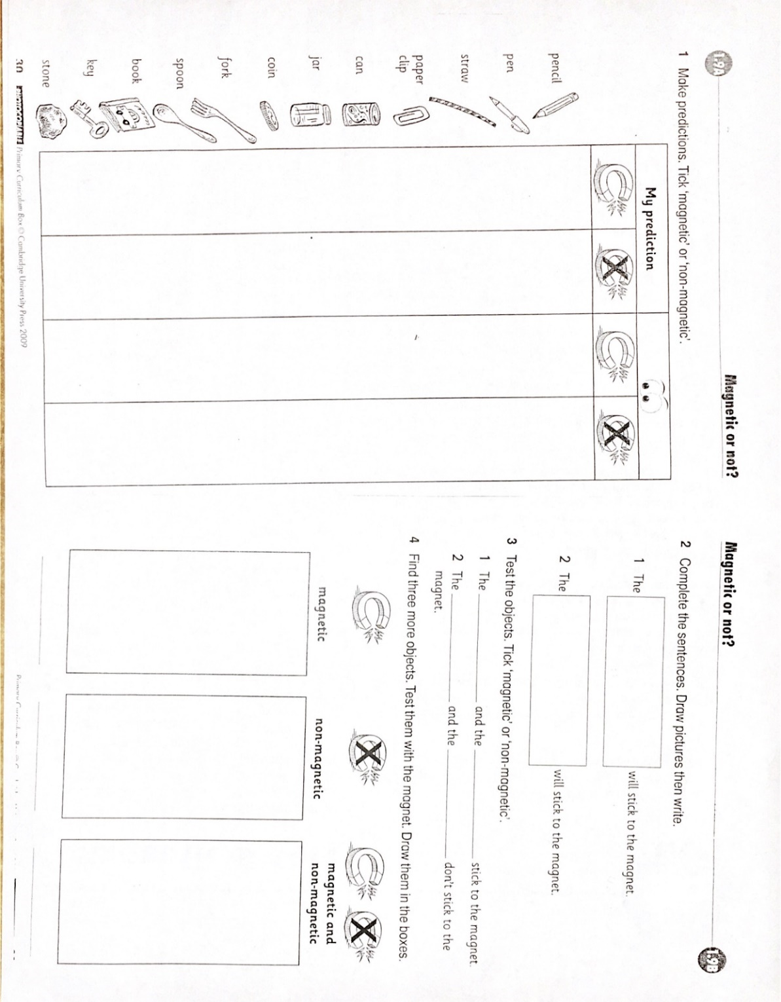

Slide 21
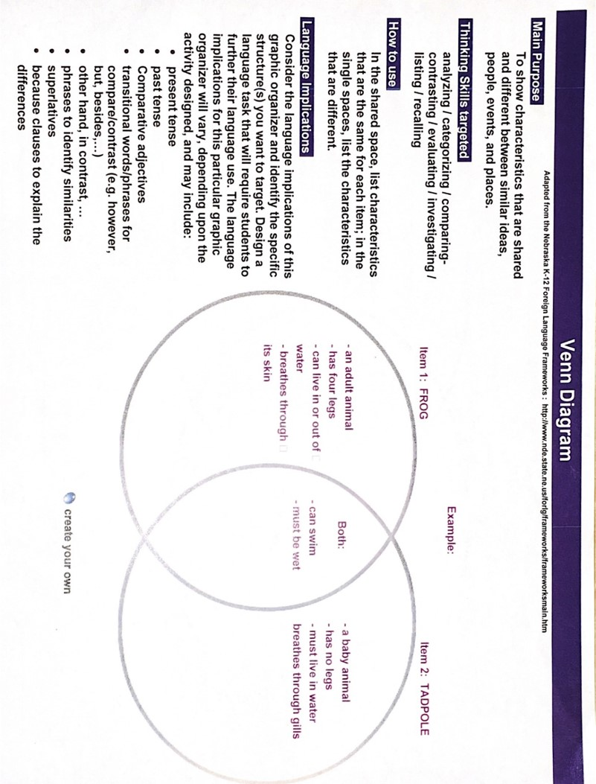

Slide 22
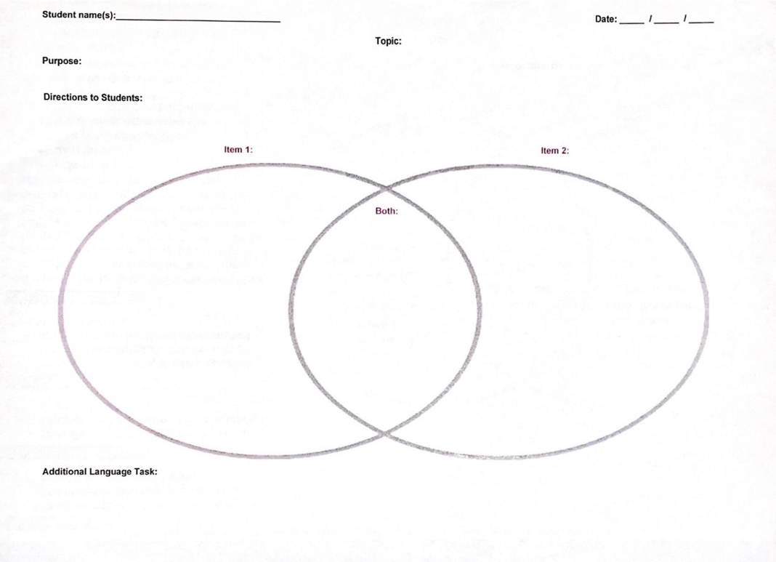

Slide 24
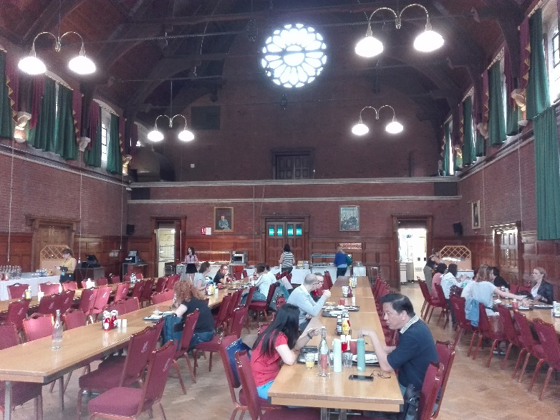
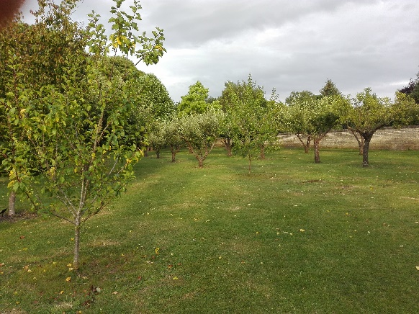
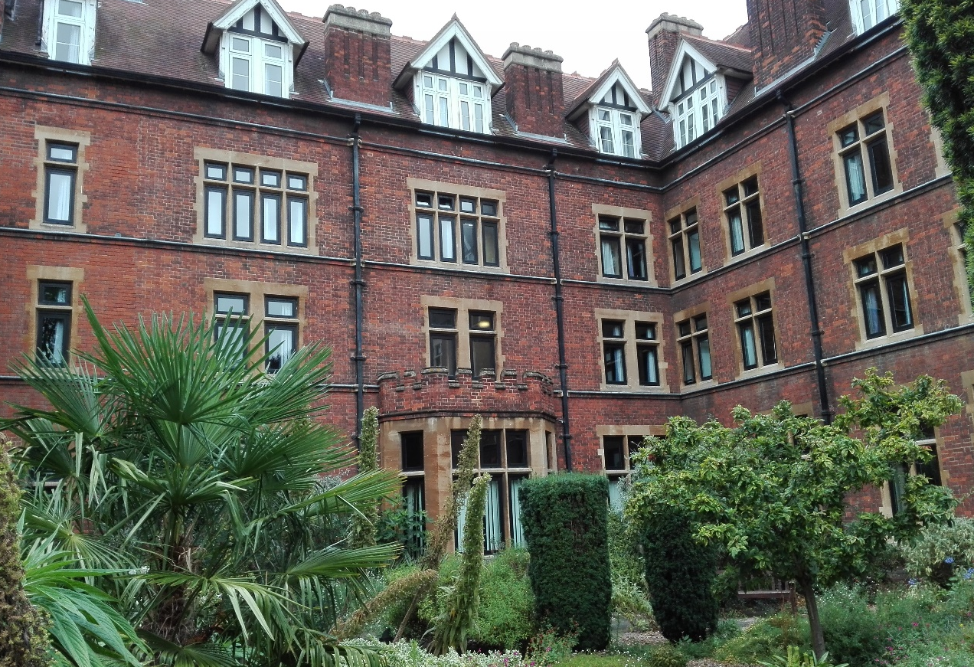
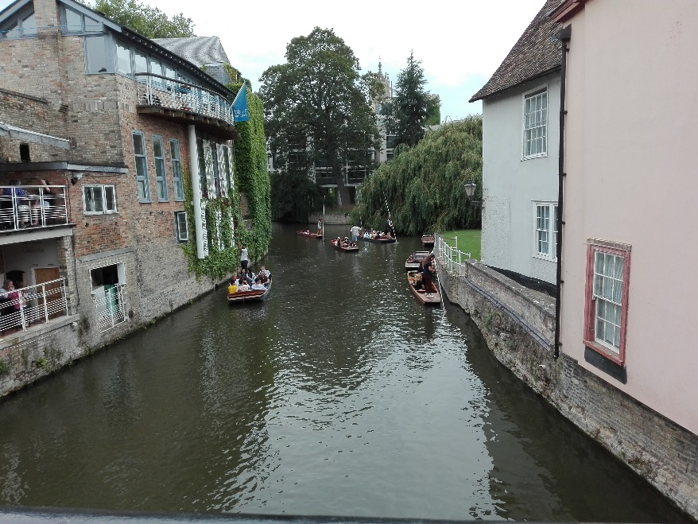
I LOVE CAMBRIDGE

Slide 25
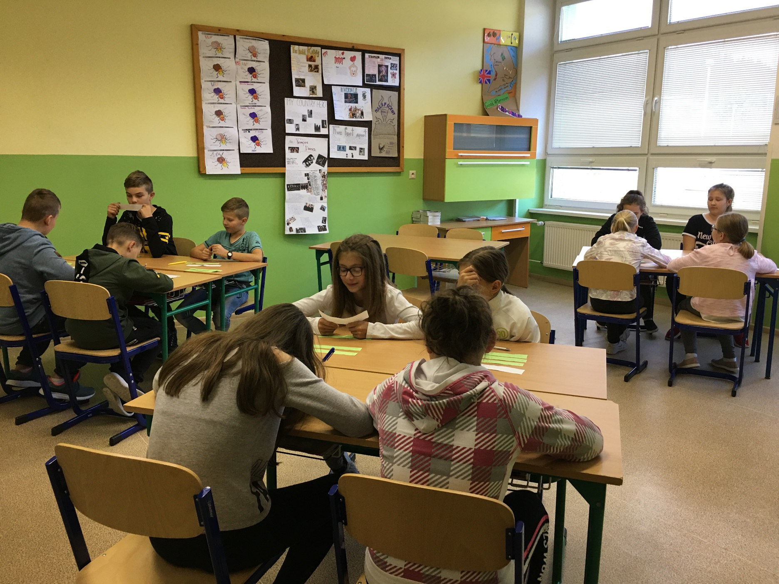
...TO BE A TEACHER WHO CAN HELP LEARNERS BE MORE
ACTIVE AND BE ABLE TO DO THINGS ON HIS OR HER OWN...
This is a challenge for me
Alena Košutová, ZŠ s MŠ Krušetnica

Slide 26
