Slide 1
PI DAY
Primaryschoolinbiesal
Poland

Slide 2
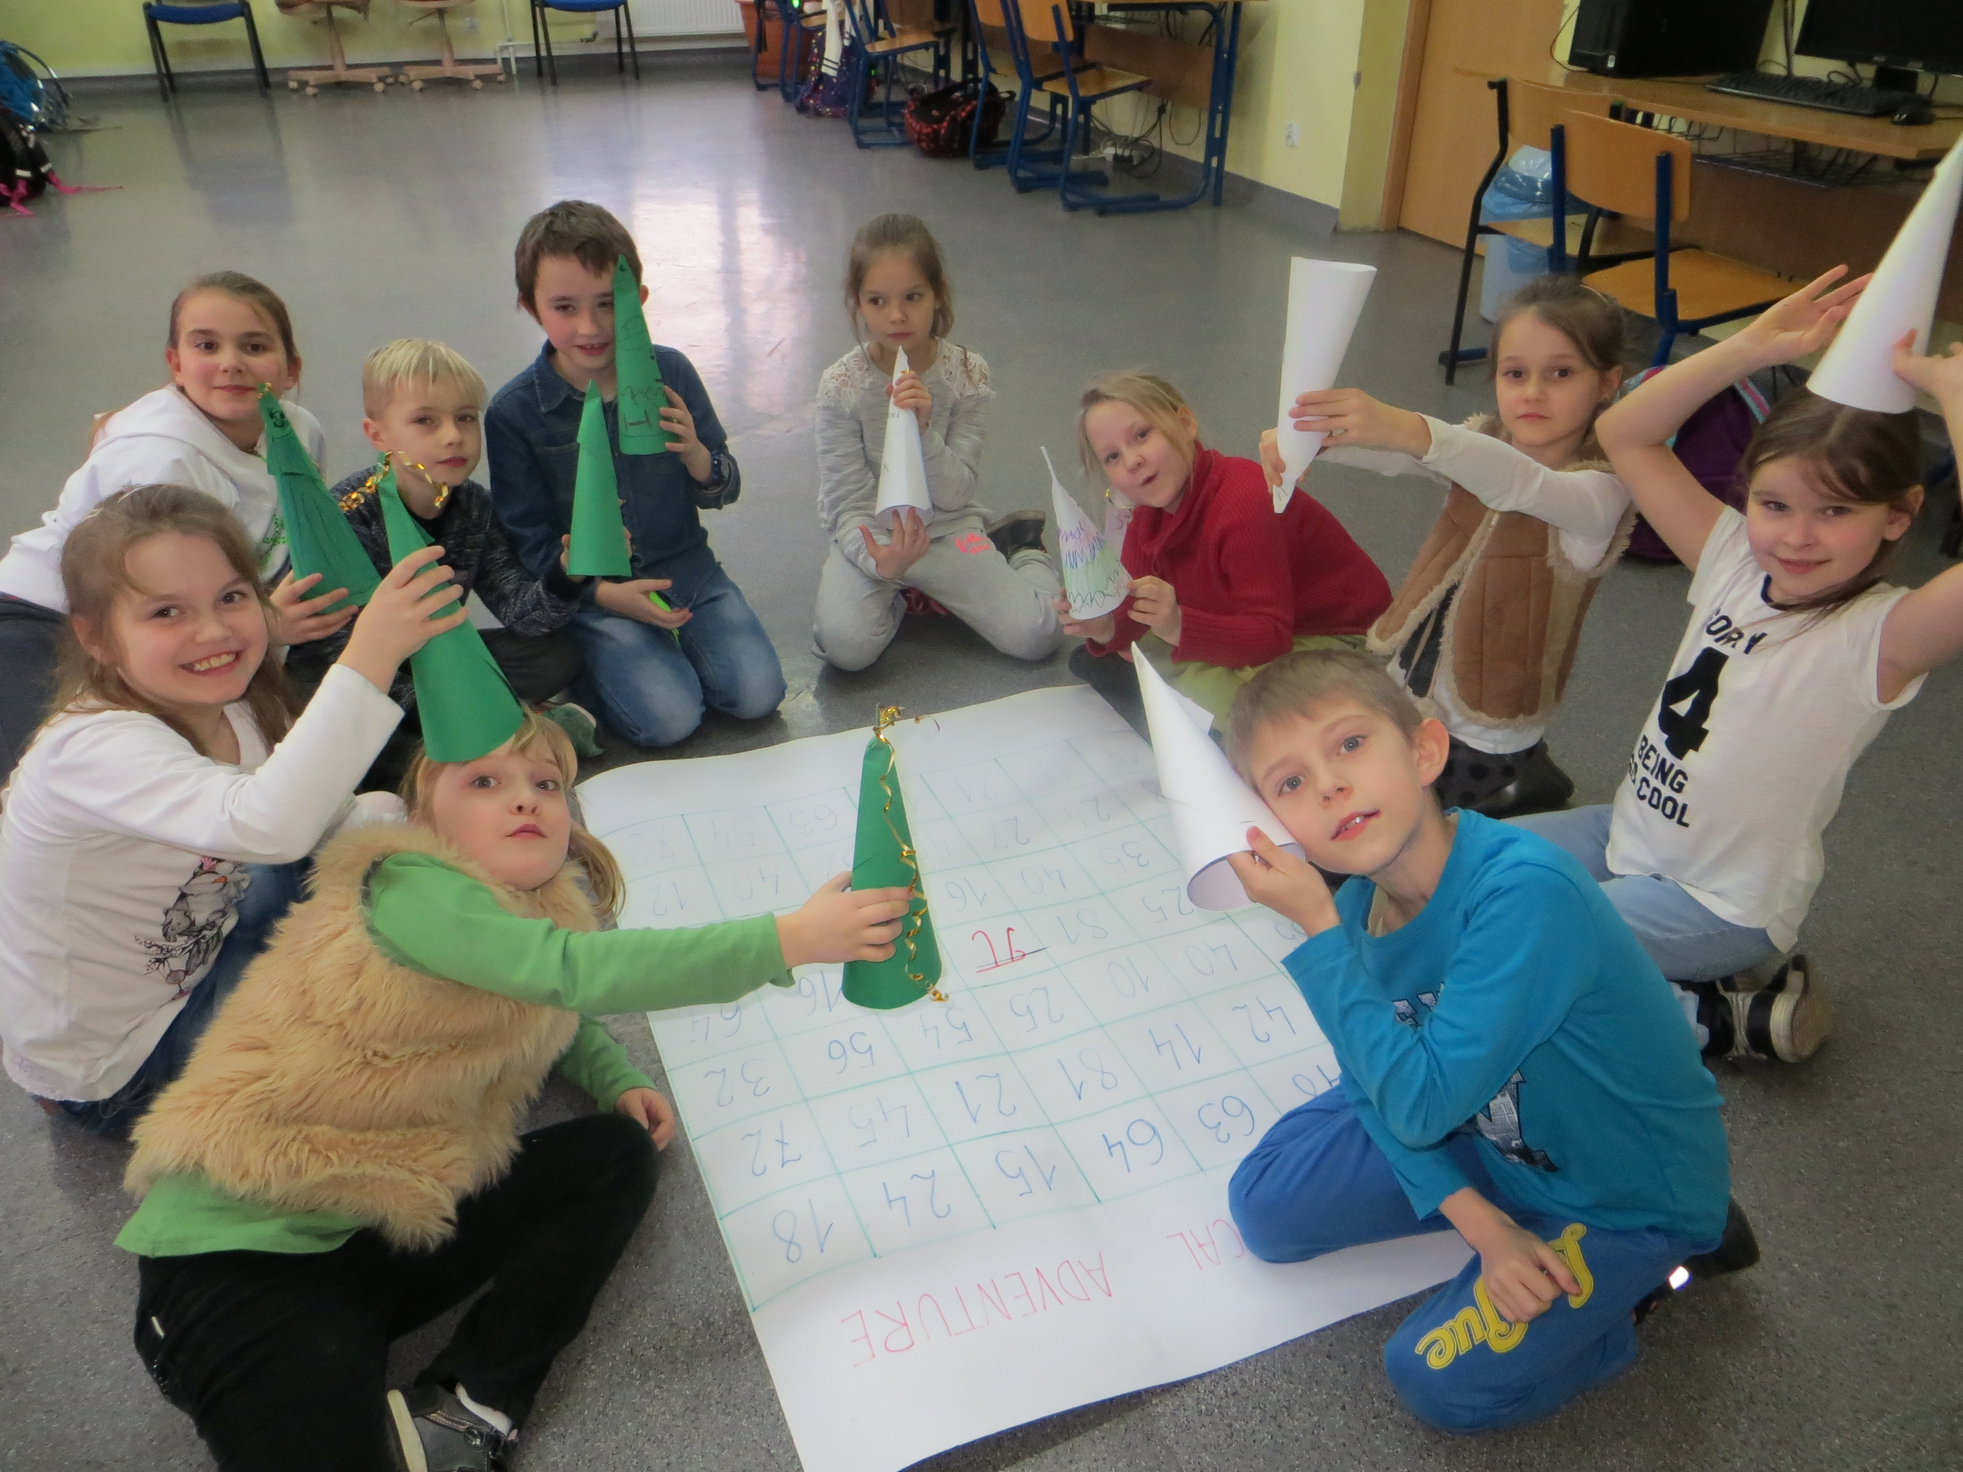
MY TEAM

Slide 3
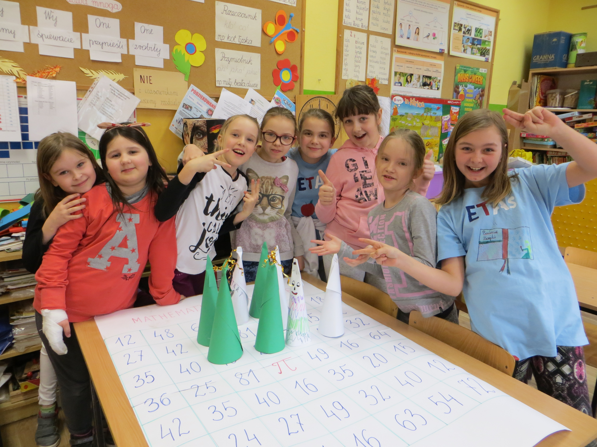
AND … MY TEAM

Slide 4
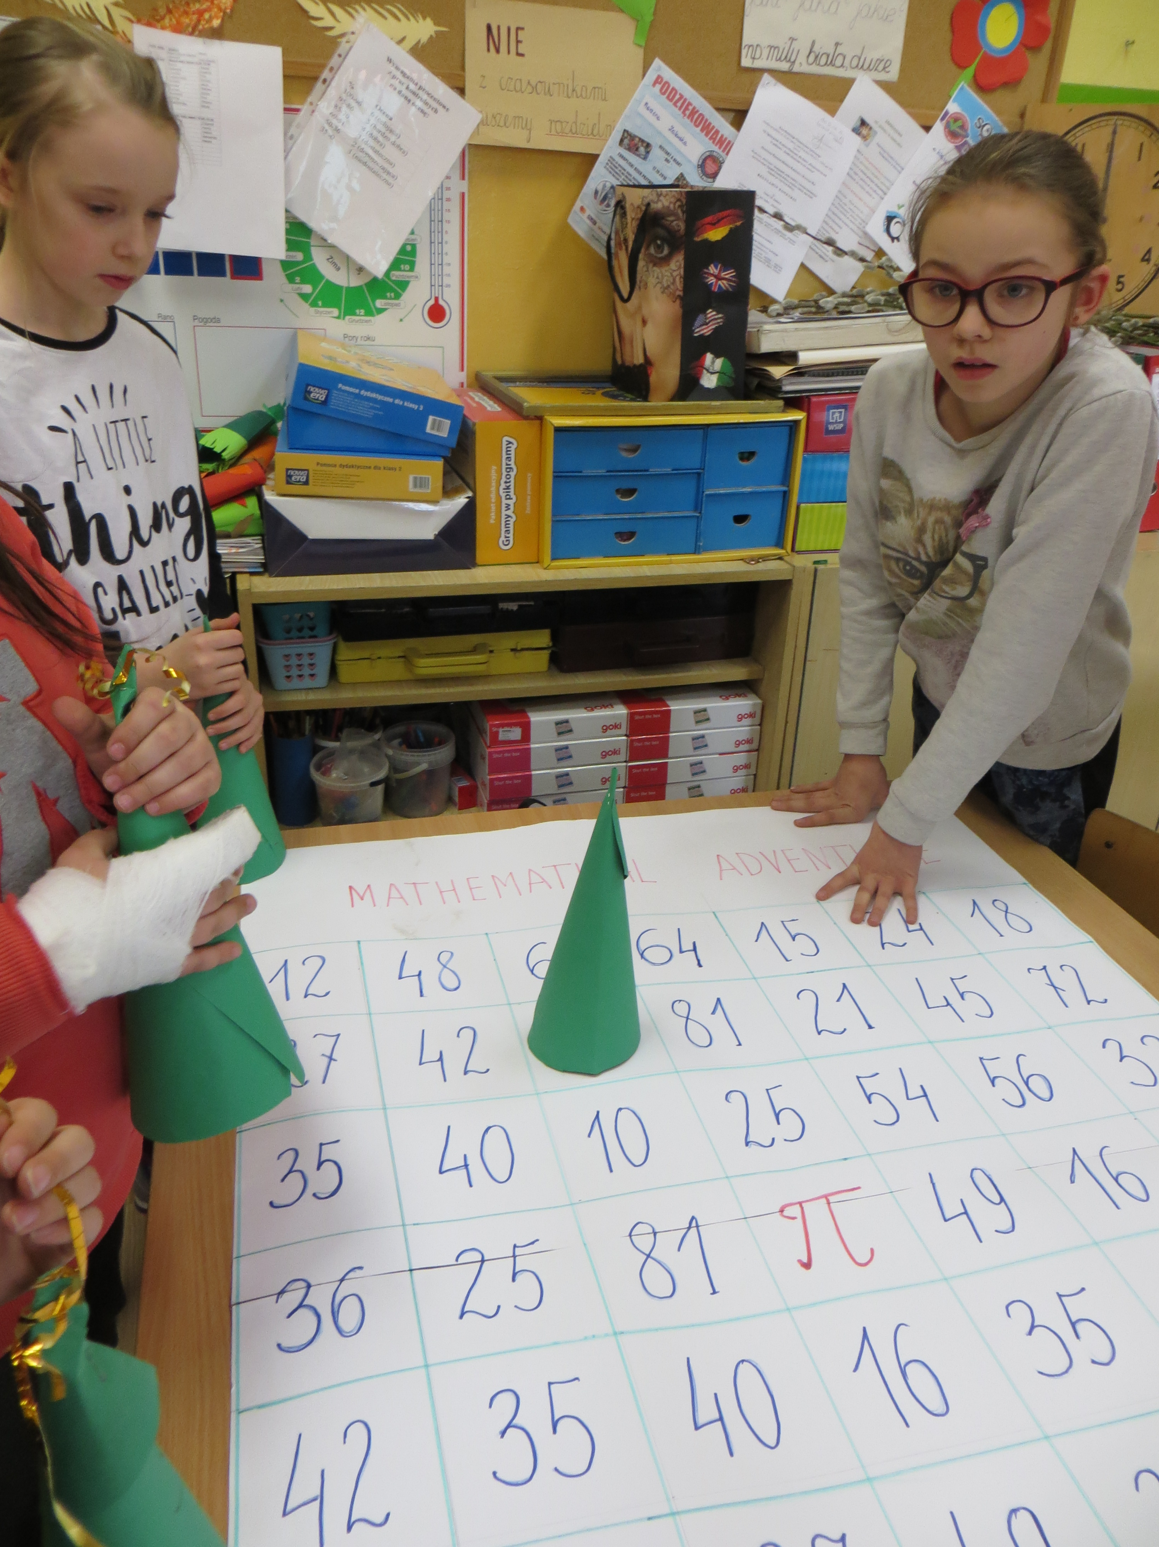
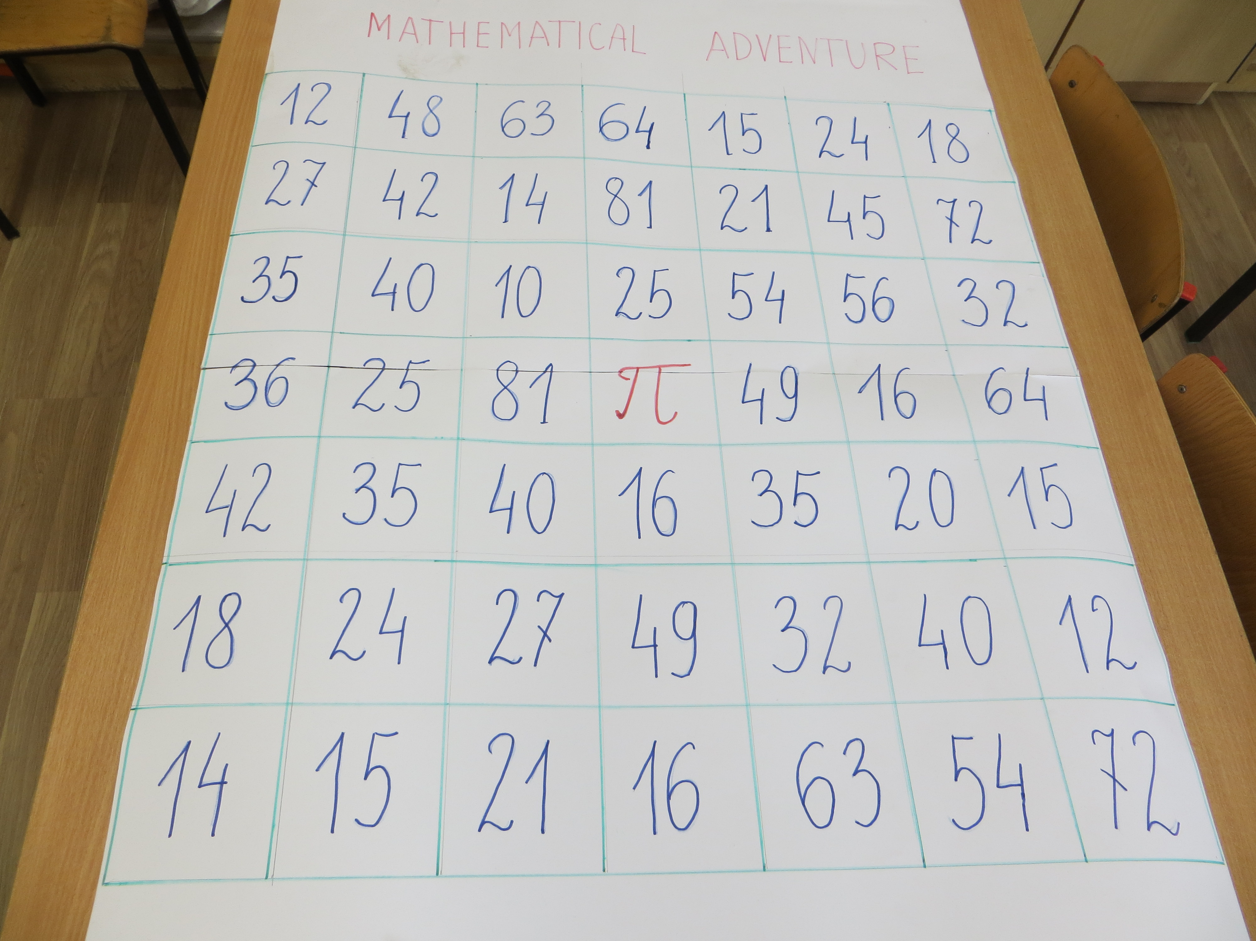
OUR MATHEMATICAL ADVENTURE

Slide 5
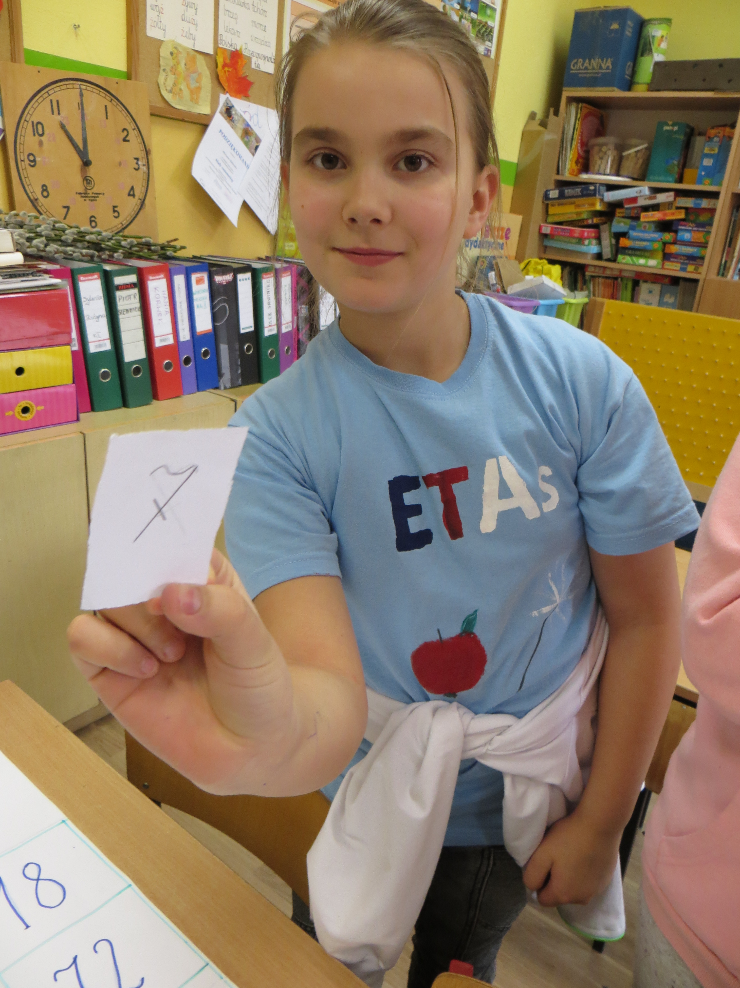
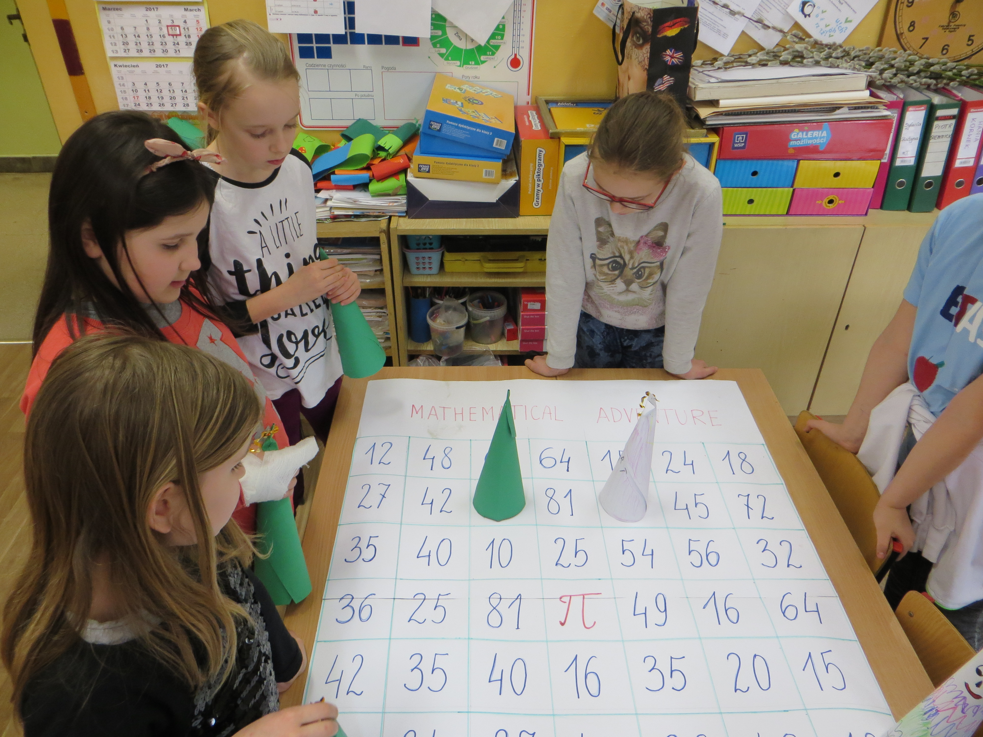
WE`RE HAVING FUN

Slide 6
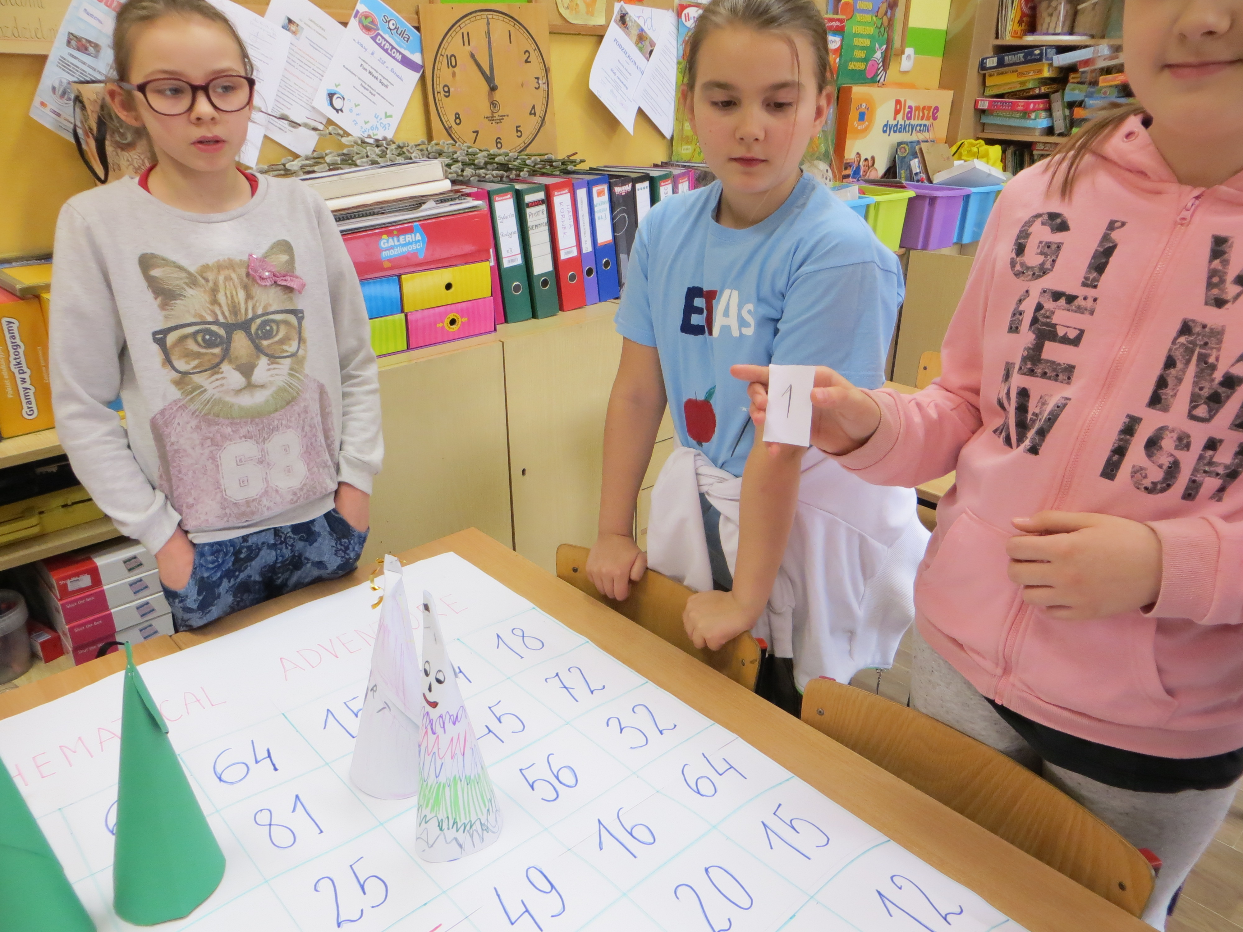
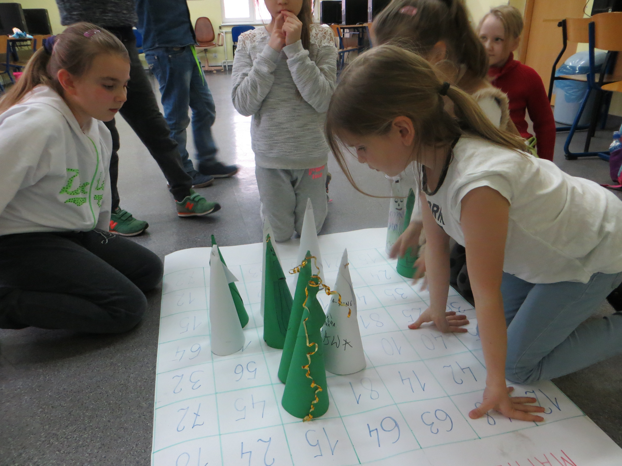
WepracticeMULTIPLICATION

Slide 7
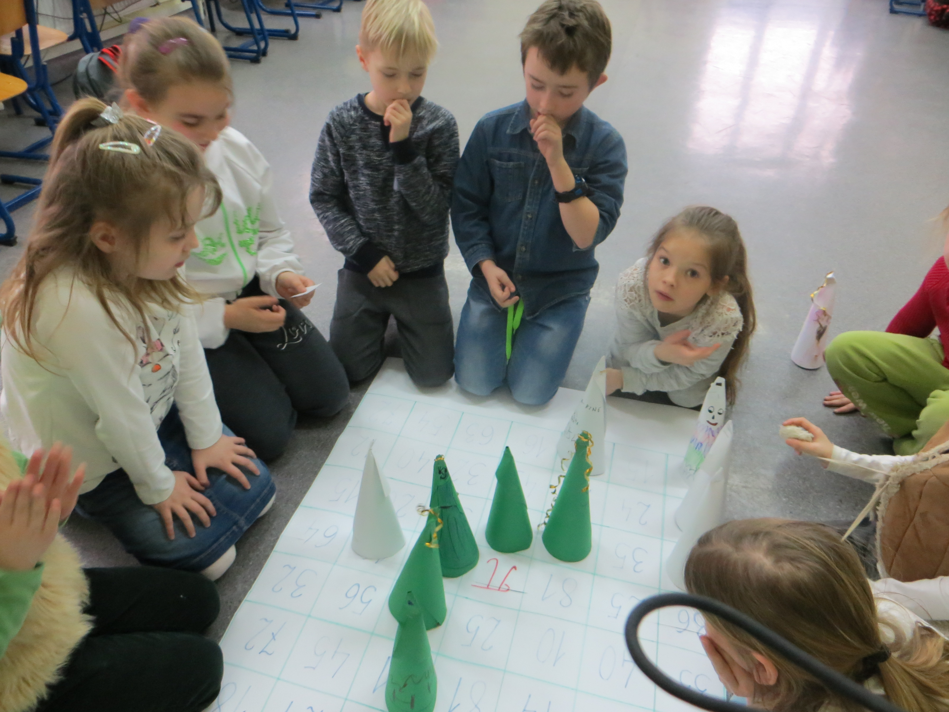
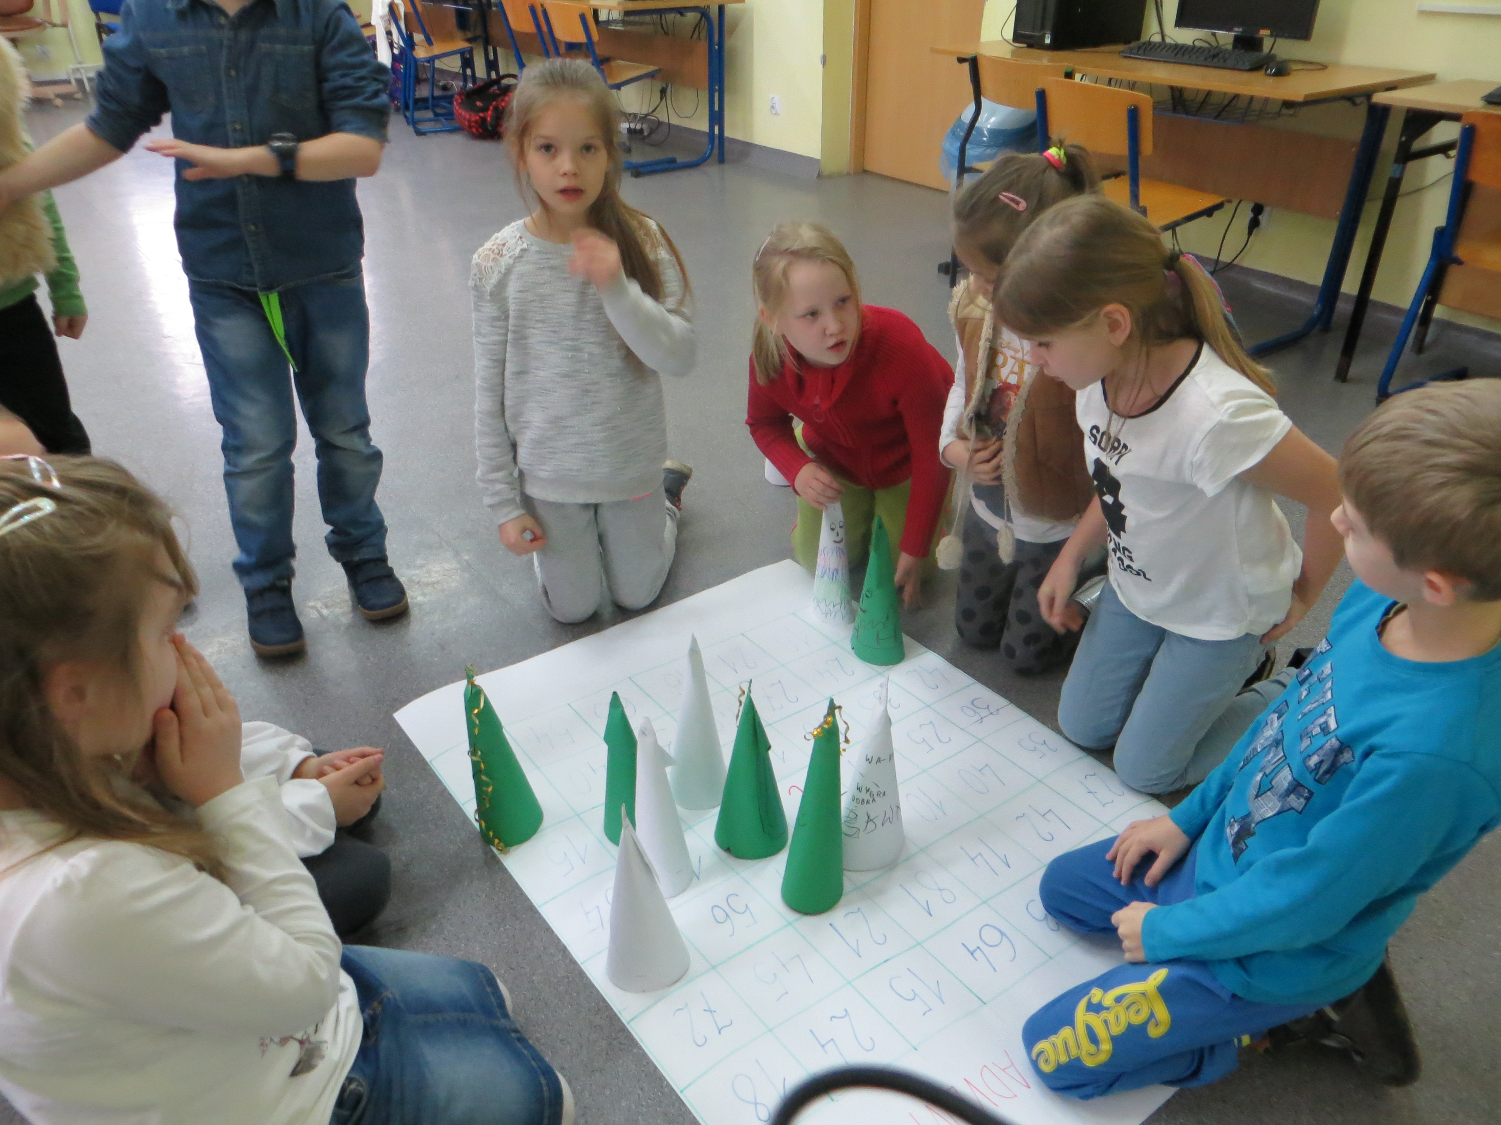
How to get the point ?

Slide 8
We say~hello~to our project friends
Students-class3 andteacher-marzenaZalewska

