Slide 1
Creating and developing your future
Erasmus+

Slide 2
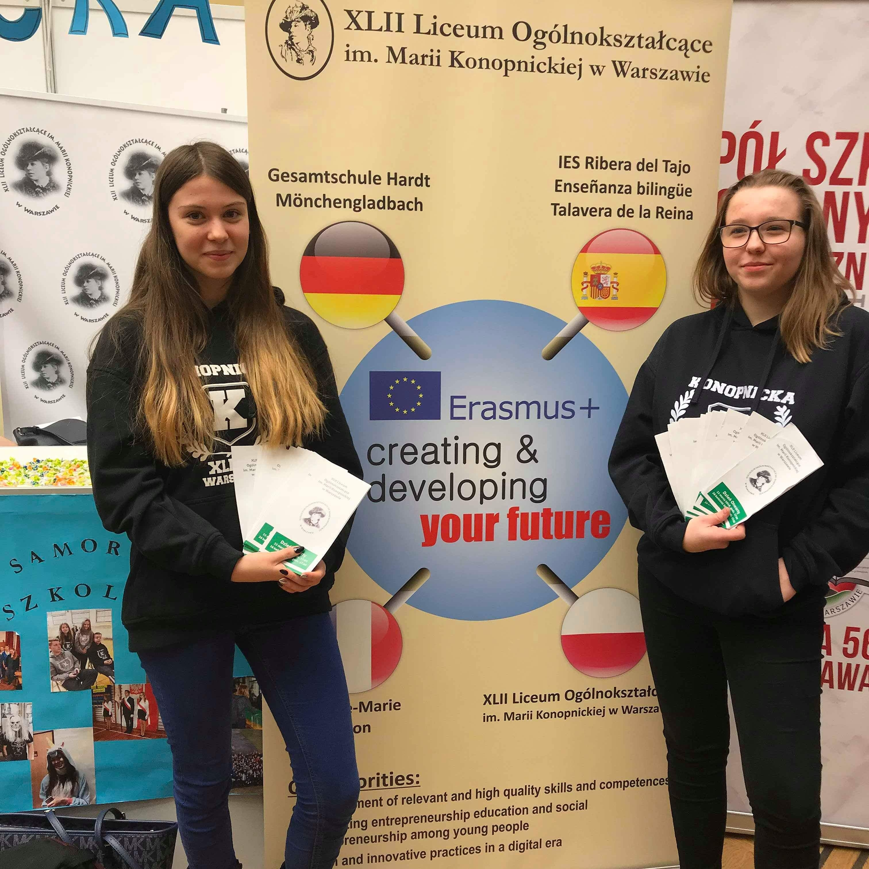
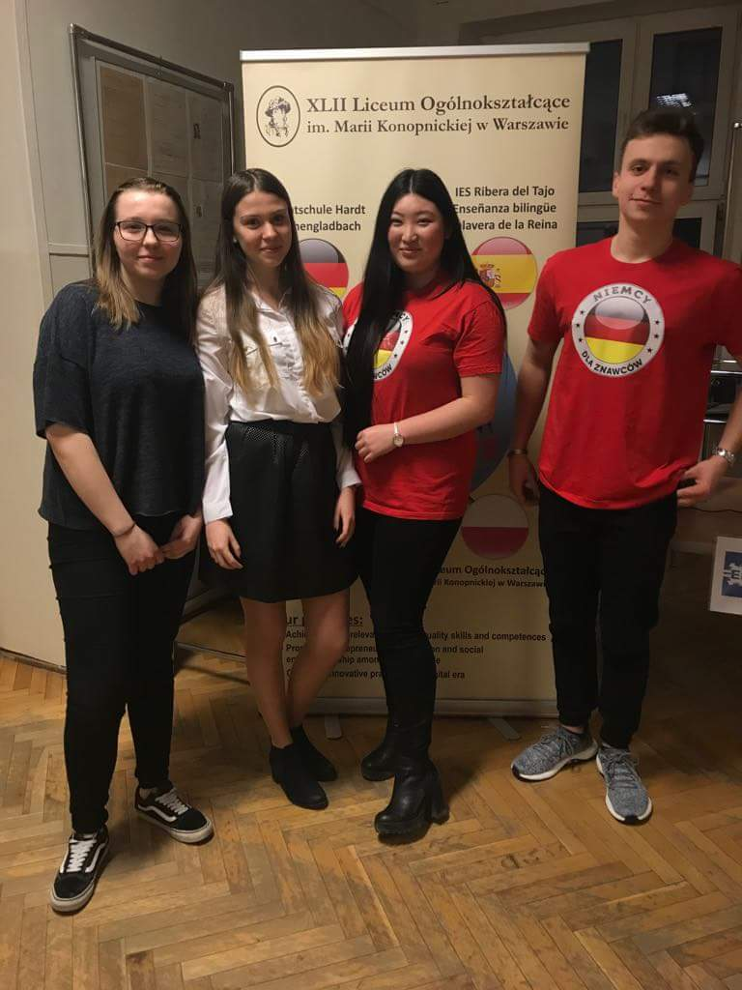
The project „Creating and developing your future” has been promoted by the participants and the teachers on the several occasions.

Slide 3
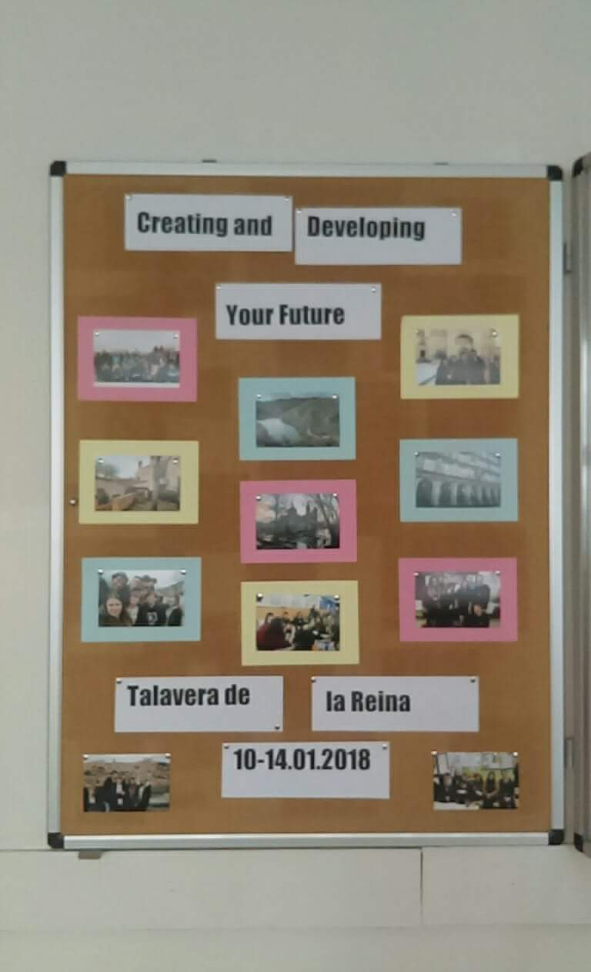
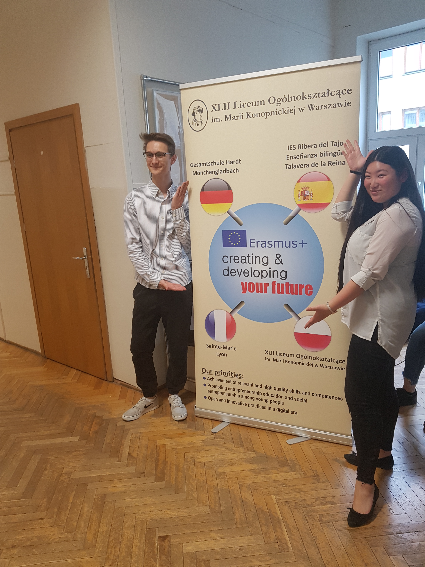
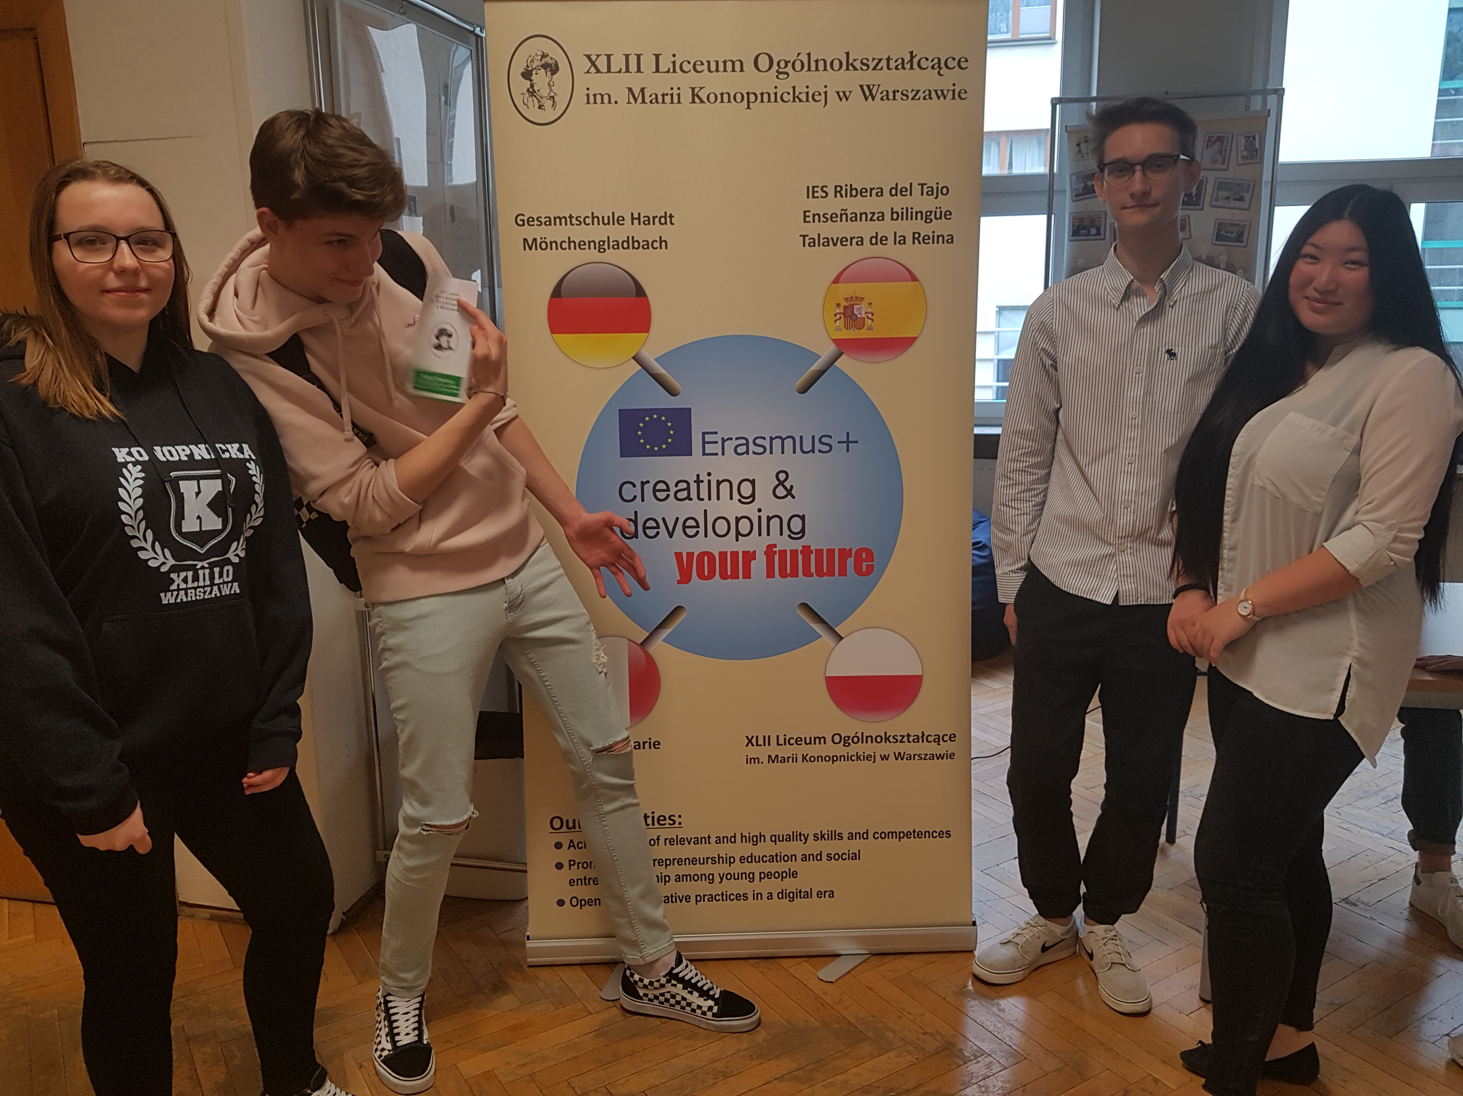
First of all, we have created a unique design of the roll-up and prepared some posters, presentations and leaflets. In our school, we have prepared some decorations on the corridors including the brief descriptions of the workshops in Spain, Poland, France and Germany.

Slide 4
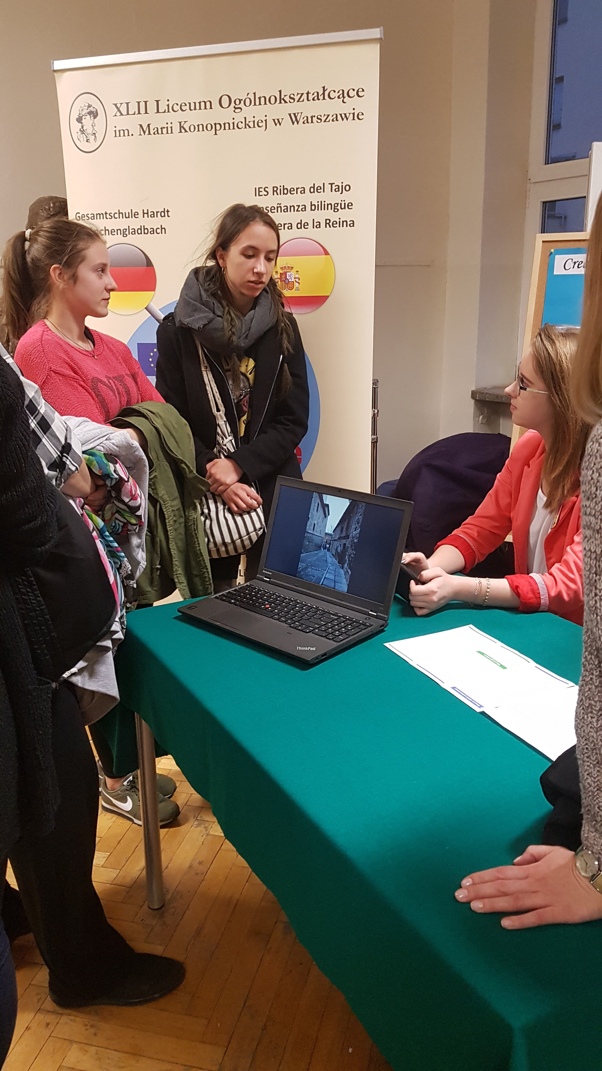
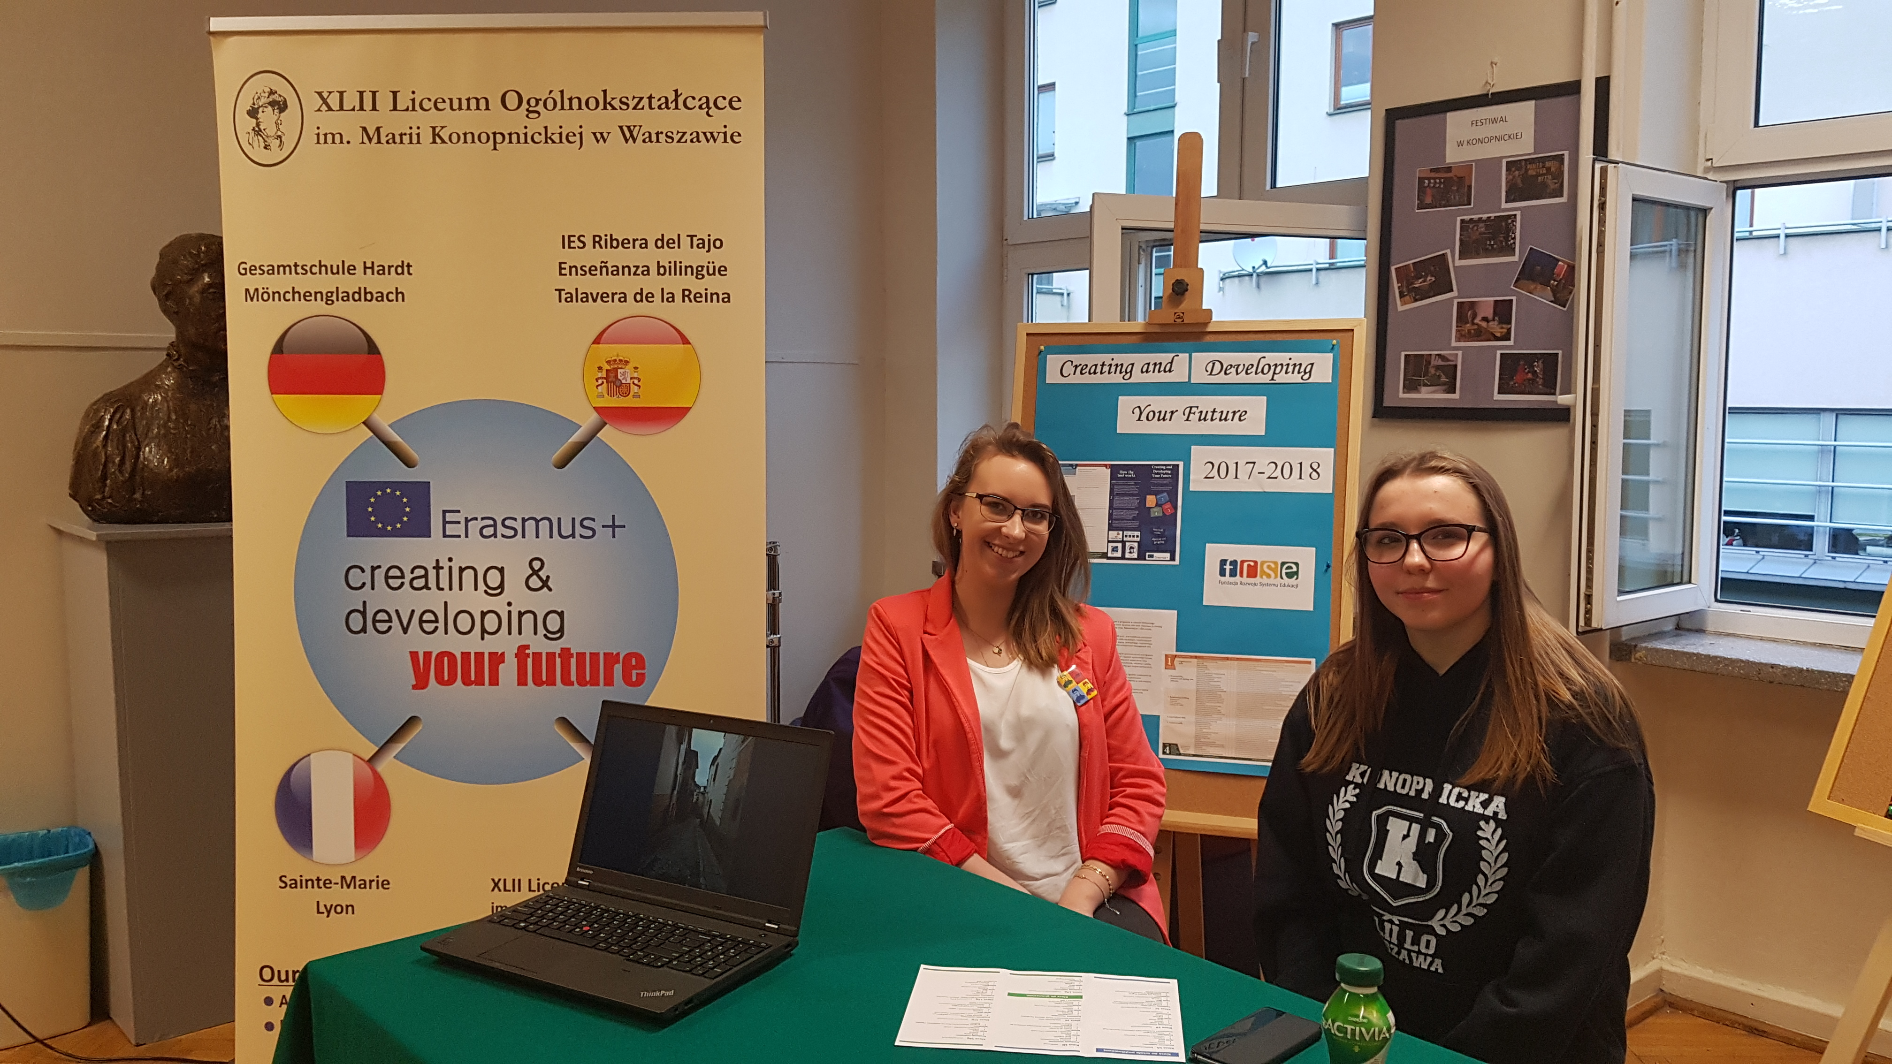
We have promoted the project during our School Open Days in Konopnicka High. Some students were very interested in the project. They had had some previous experience of Erasmus+ projects in their schools and they wanted to get to know some details so that they asked a plenty of questions.

Slide 5
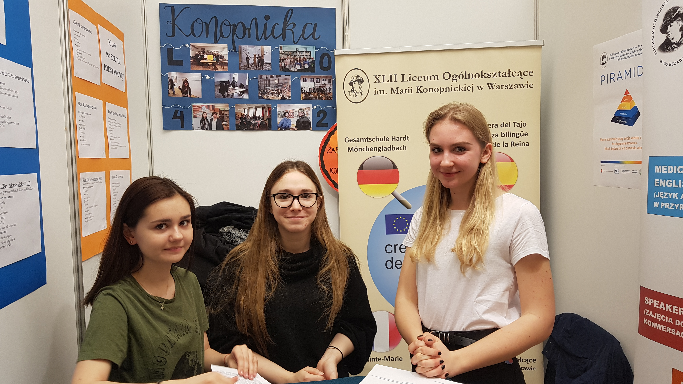
The Warsaw Fair of High Schools is held in April in the Palace of Science and Culture. It is a great opportunity to promote the school, the students’ achievements and the Erasmus+ project to the public.

Slide 6
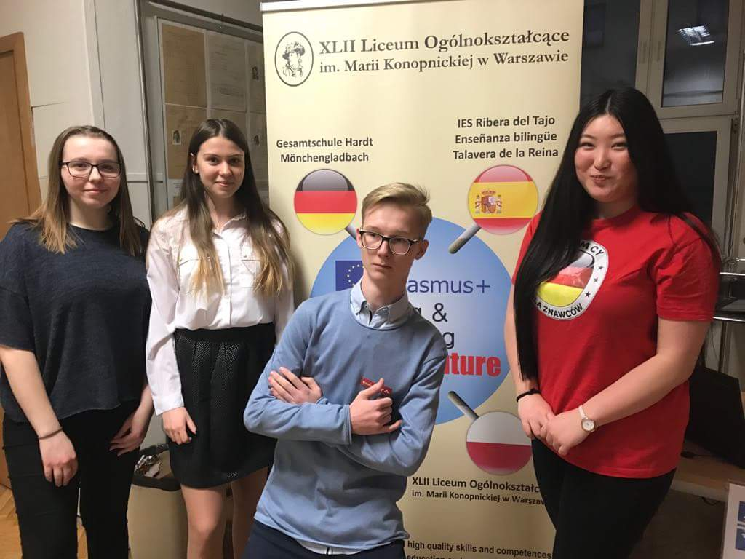
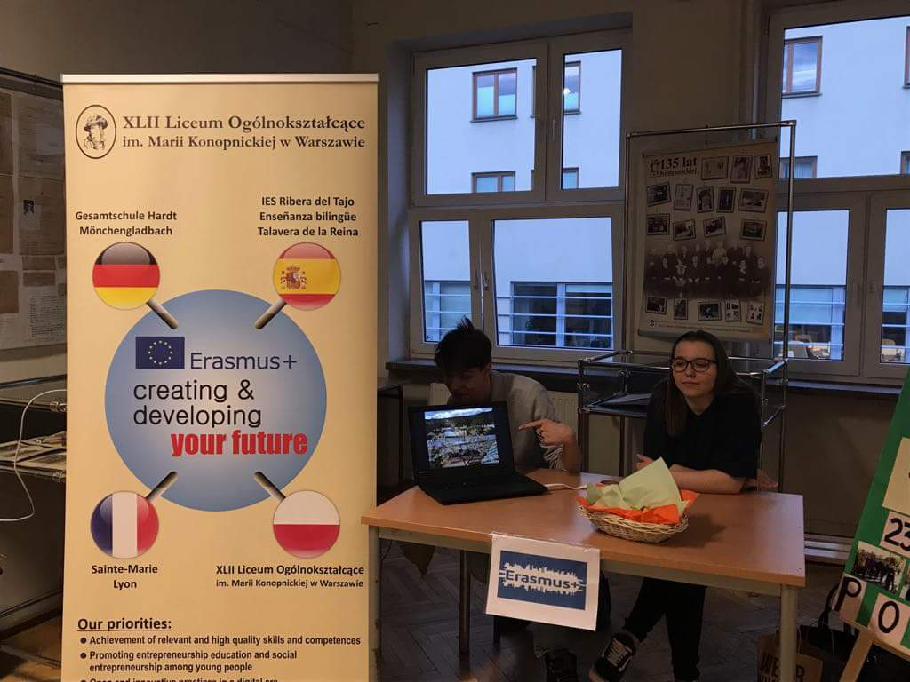
From our point of view it was a terrific experience because we could talk to our peers, improve our communication skills and advertise the Erasmus+ project in a very efficient way.

Slide 7
Thank you for your attention ☺

