Slide 1
Phenology
Chestnut
Martyna Gajda

Slide 2
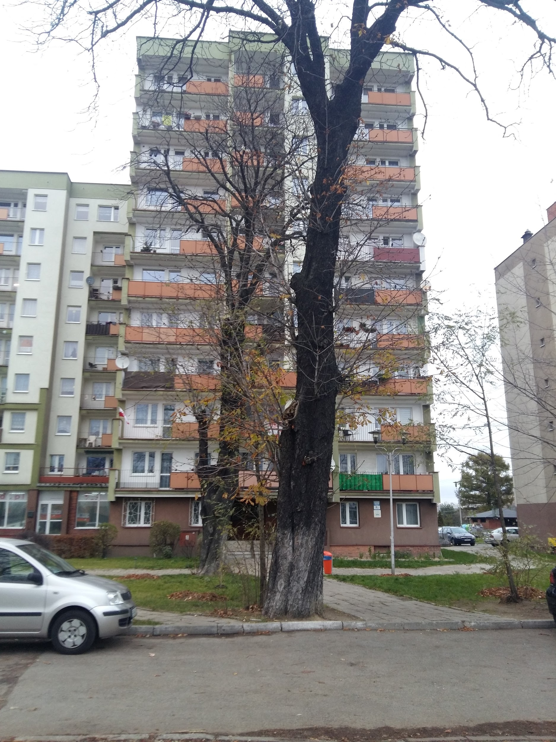
Date: 15.11.2018
Time: 15:25
Temp: 6°C

Slide 3
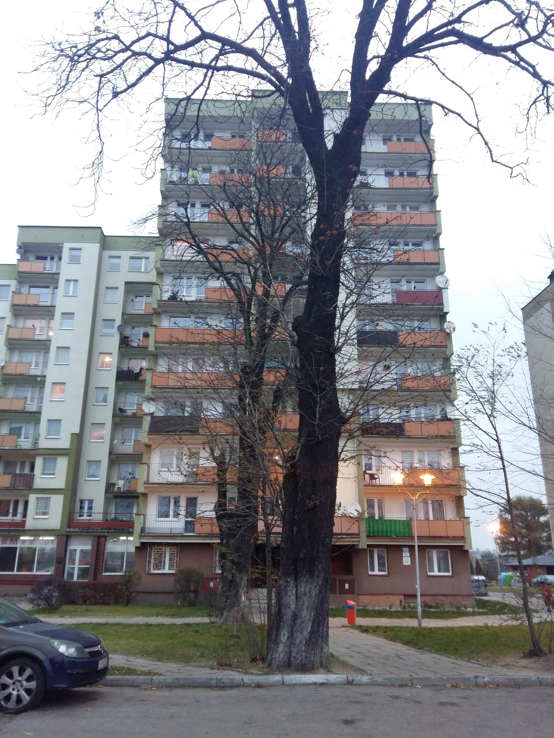
Date: 20.11.2018
Time: 15:46
Temp: 5°C

Slide 4
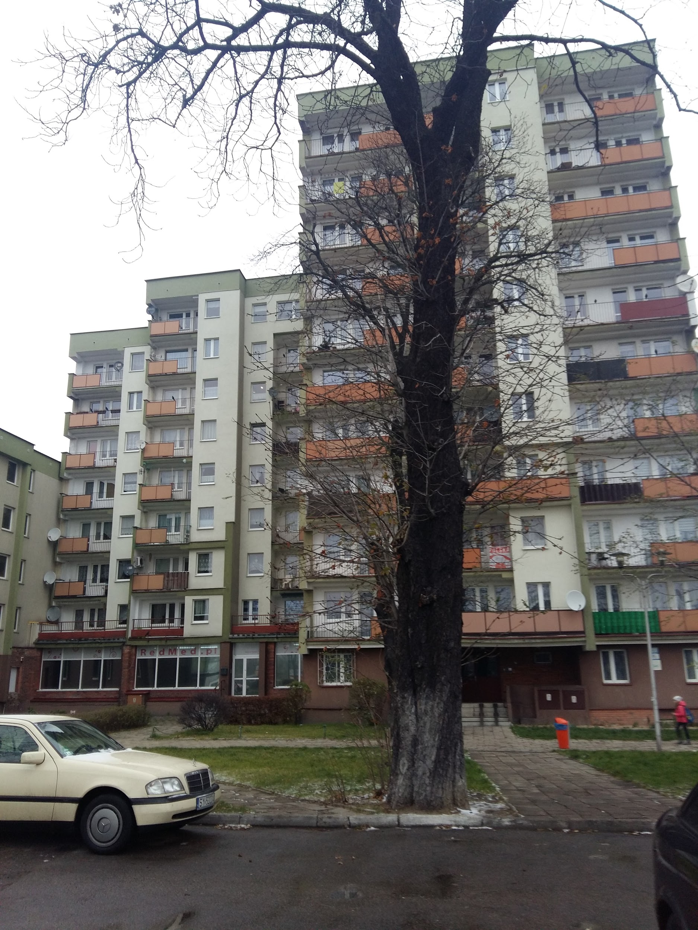
Date: 25.11.2018
Time: 13.47
Temp: 4°C

Slide 5
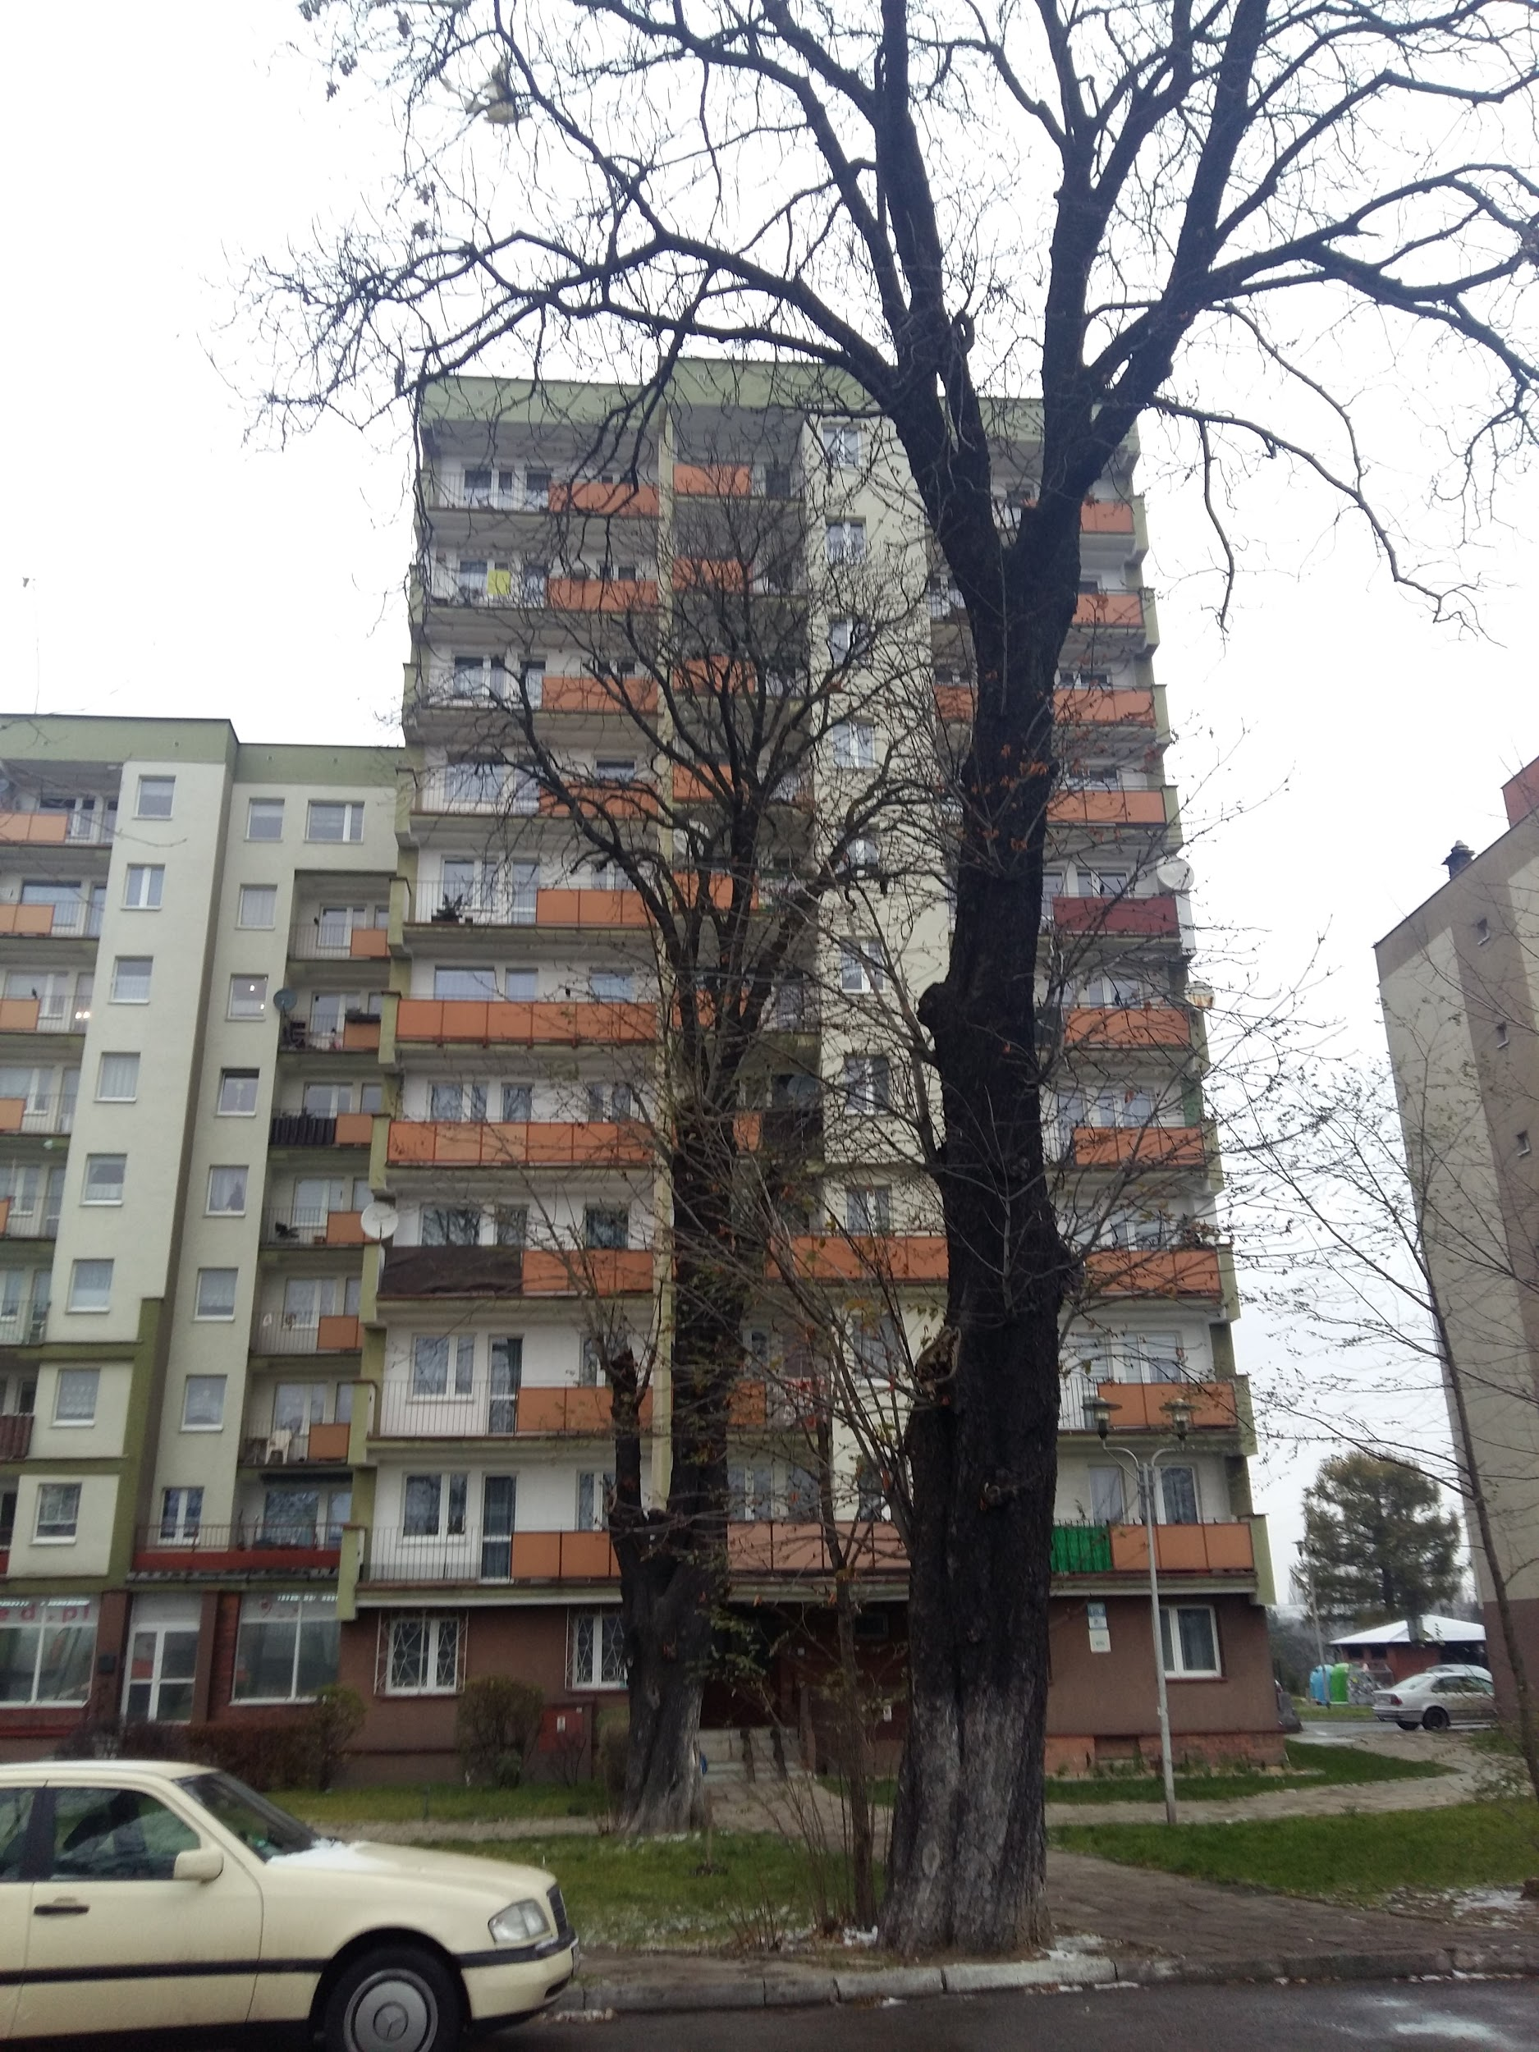
Date: 30.11.2018
Time: 14:00
Temp: 3°C

Slide 6
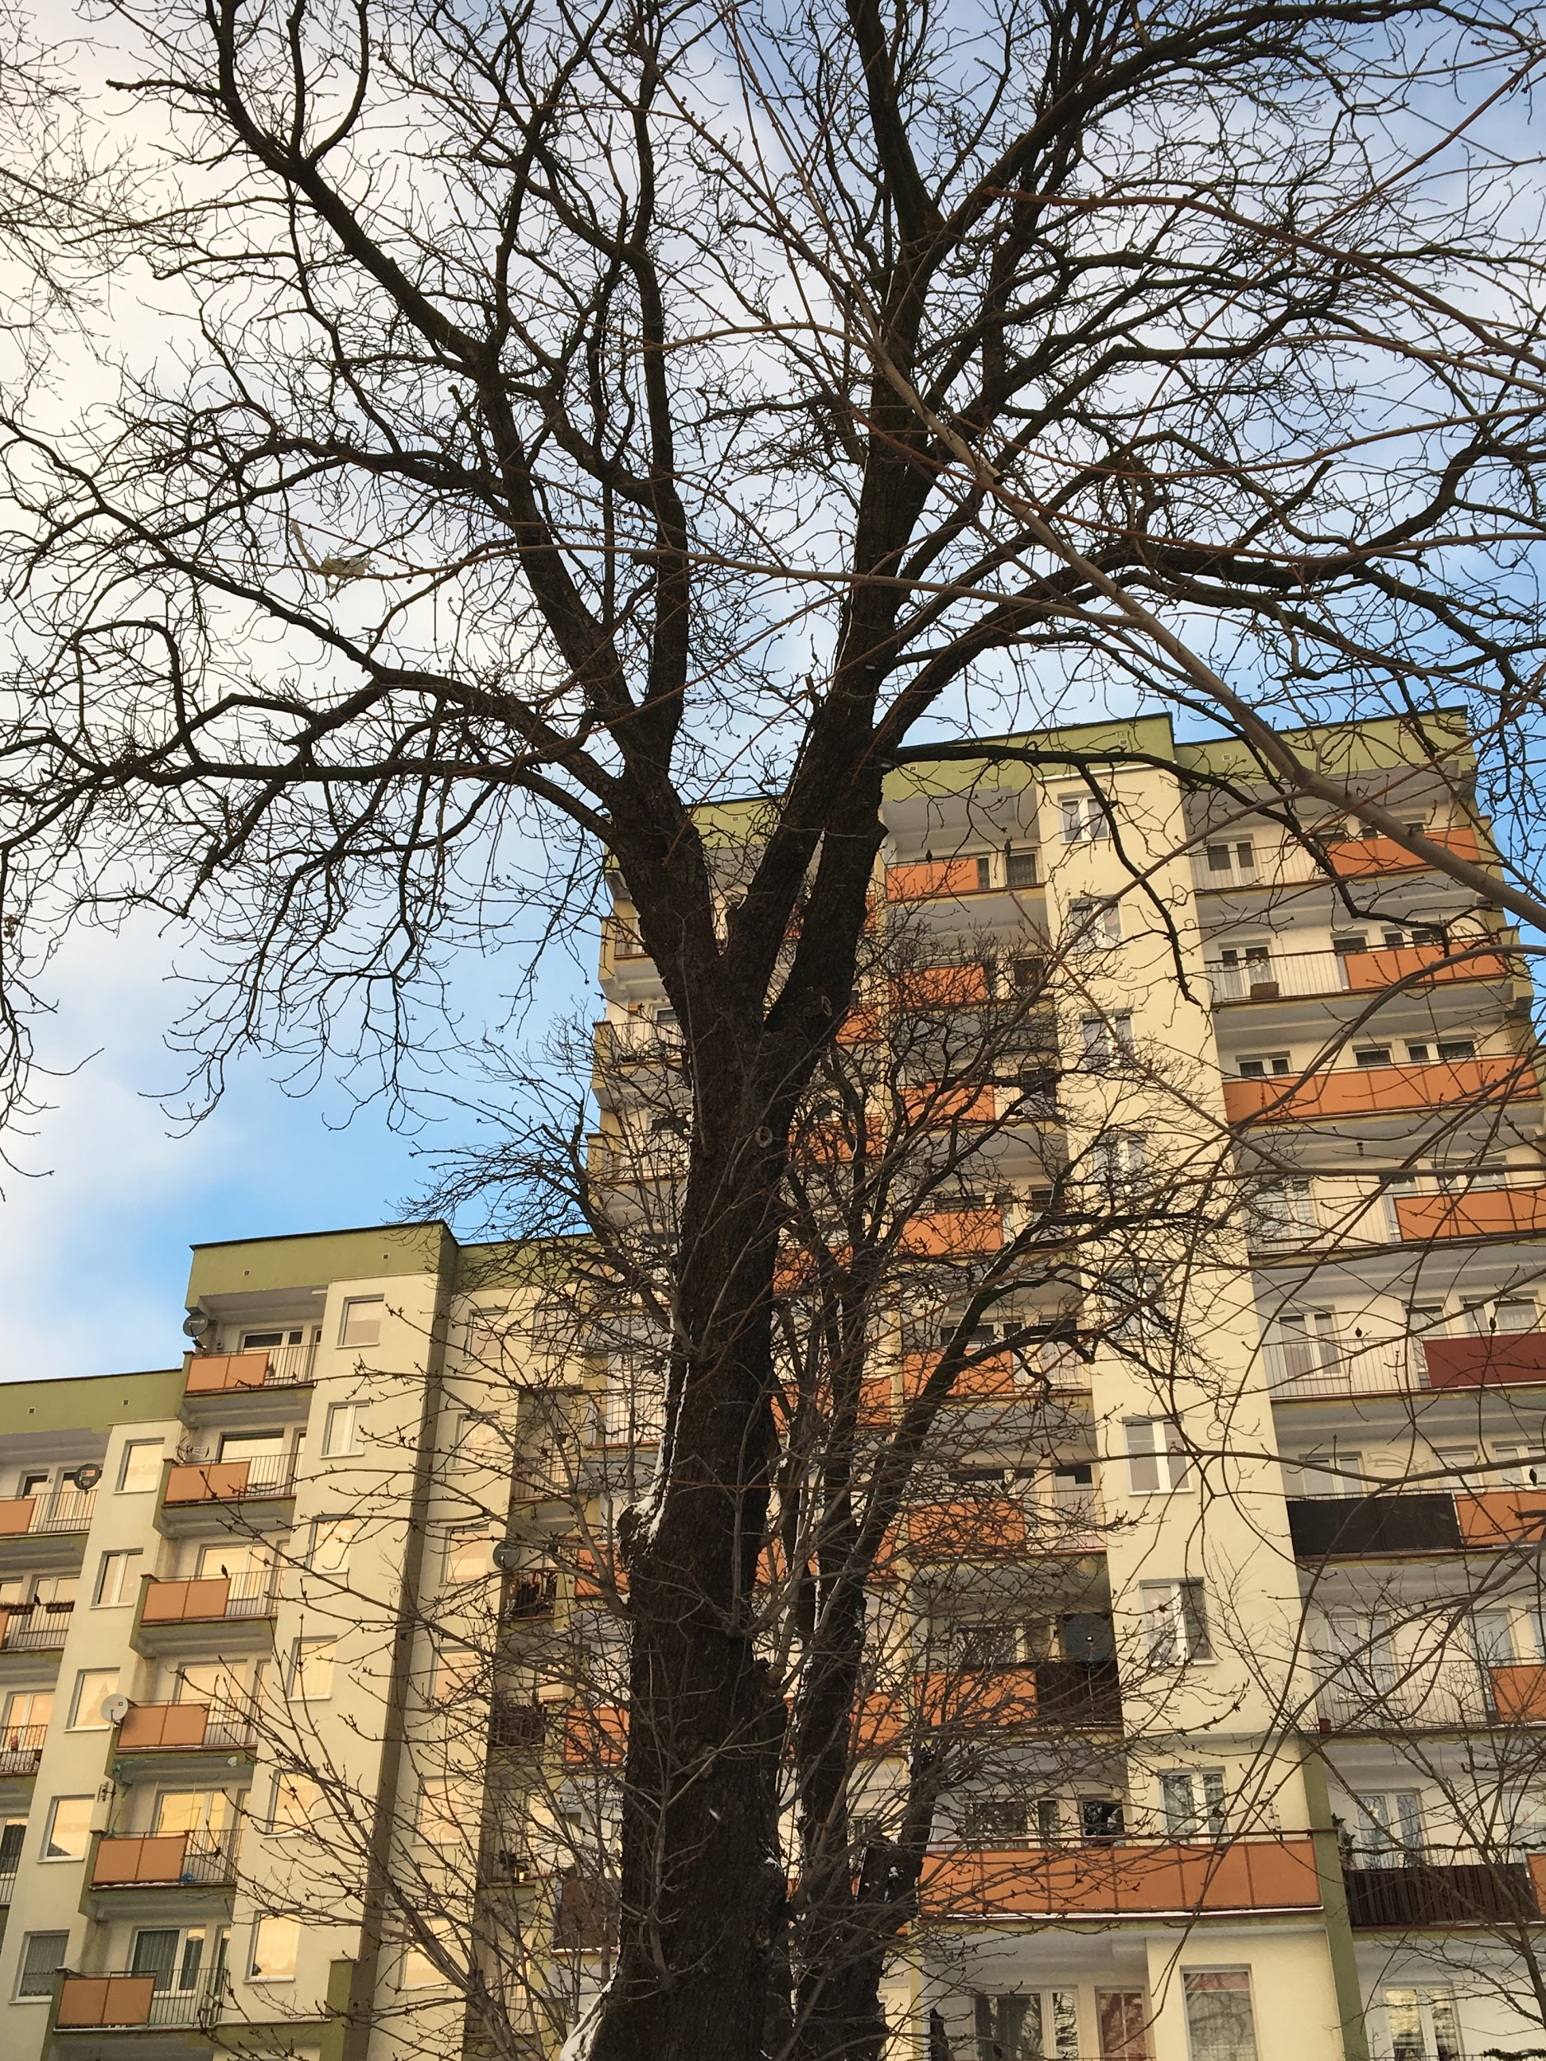
Date: 08.12.2018
Time: 15:10
Temp: 5°C

Slide 7
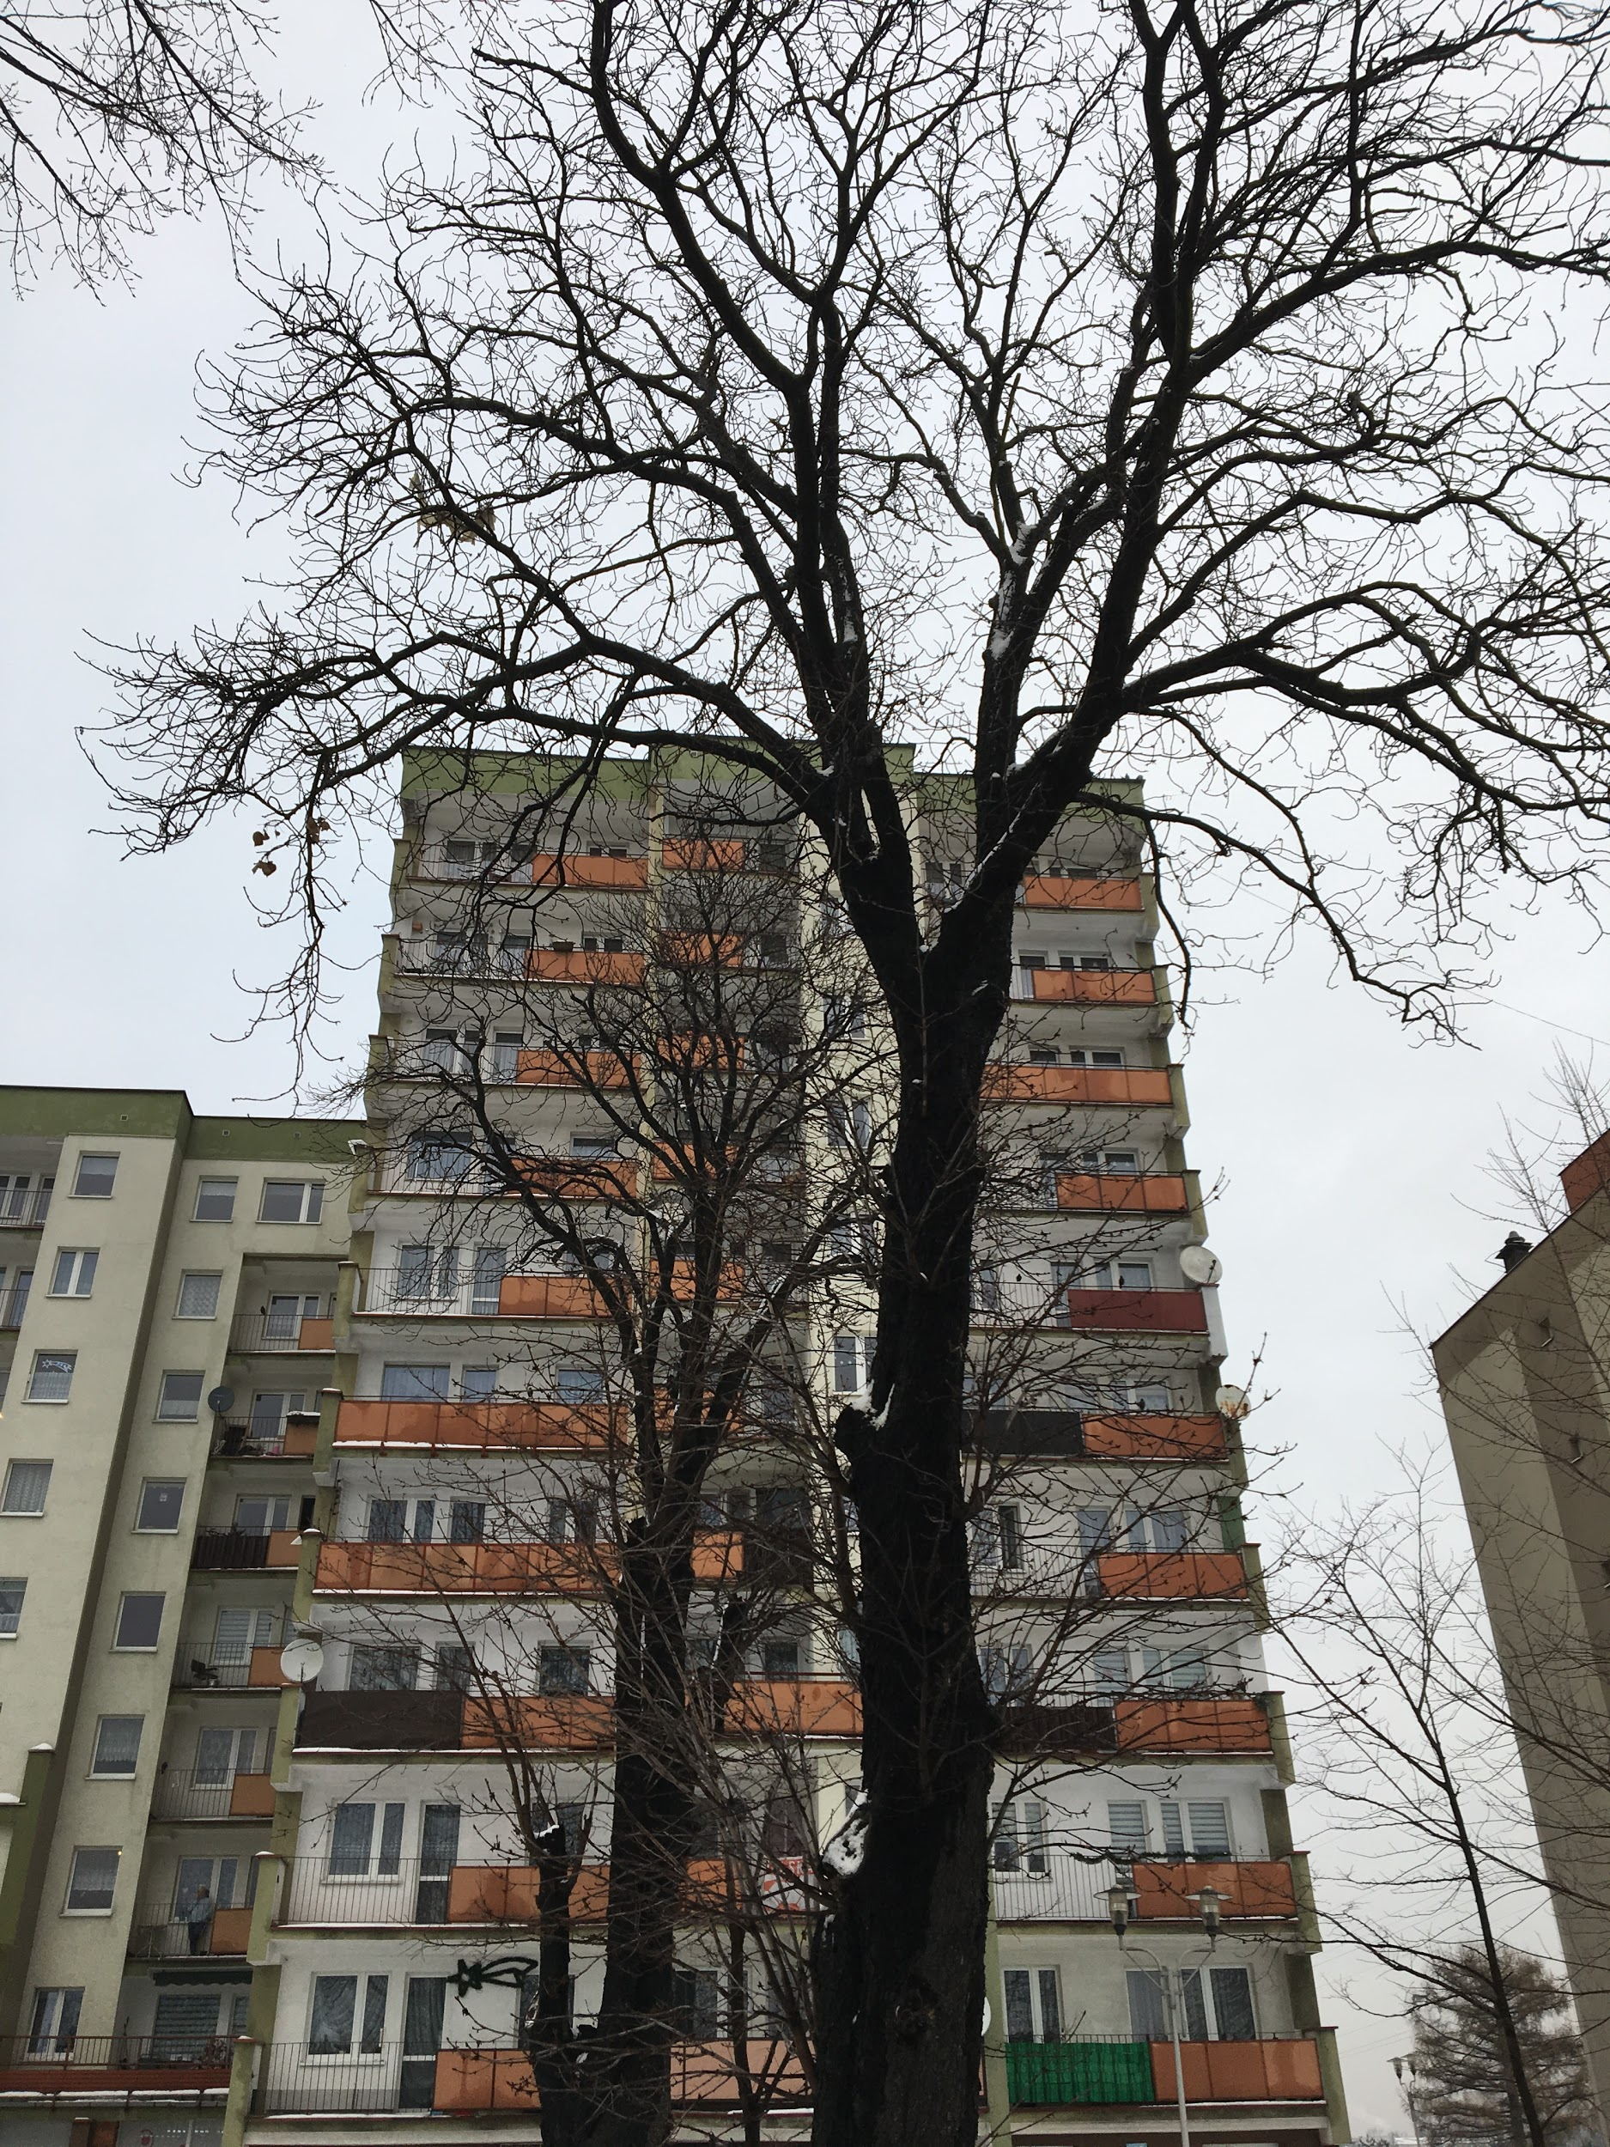
Date: 14.12.2018
Time: 15:00
Temp: -1°C

Slide 8
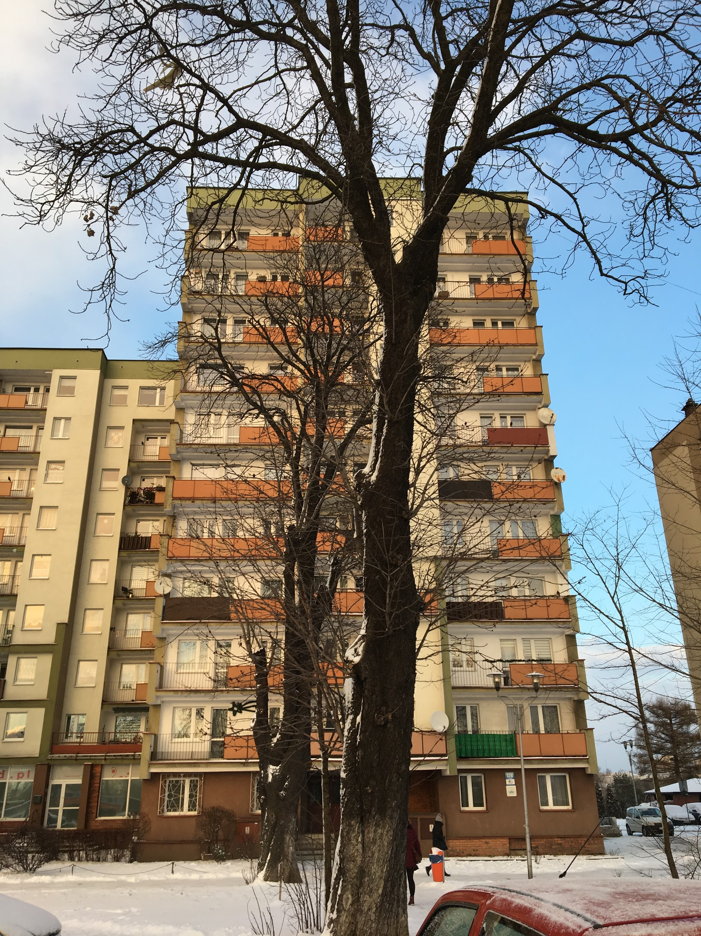
Date: 3.01.2019
Time: 15:14
Temp: -3°C

Slide 9
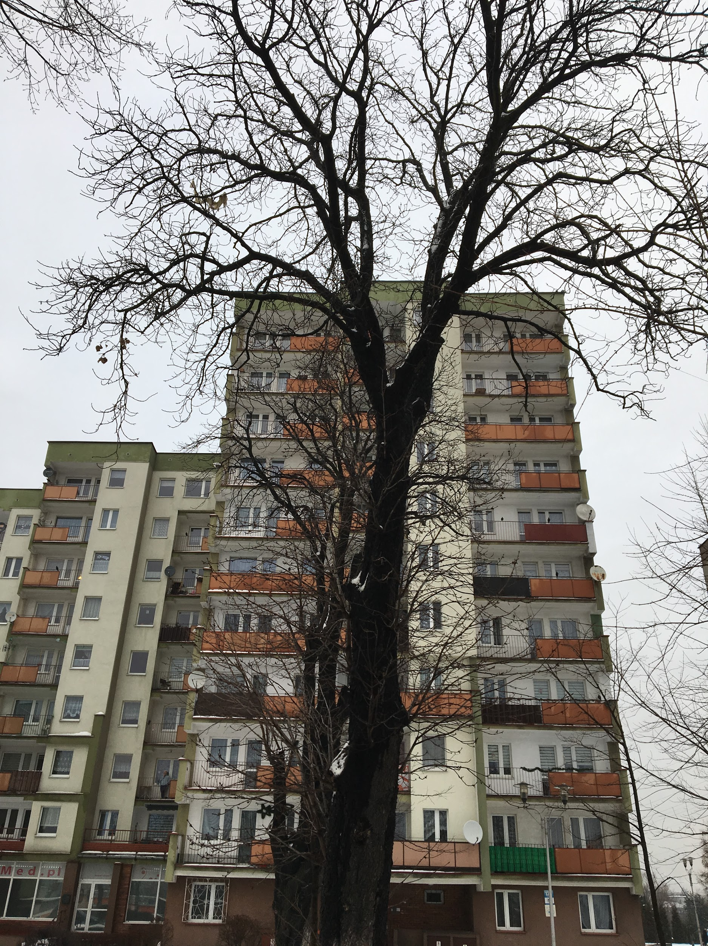
Date: 9.01.2019
Time: 14:58
Temp: 0°C

Slide 10
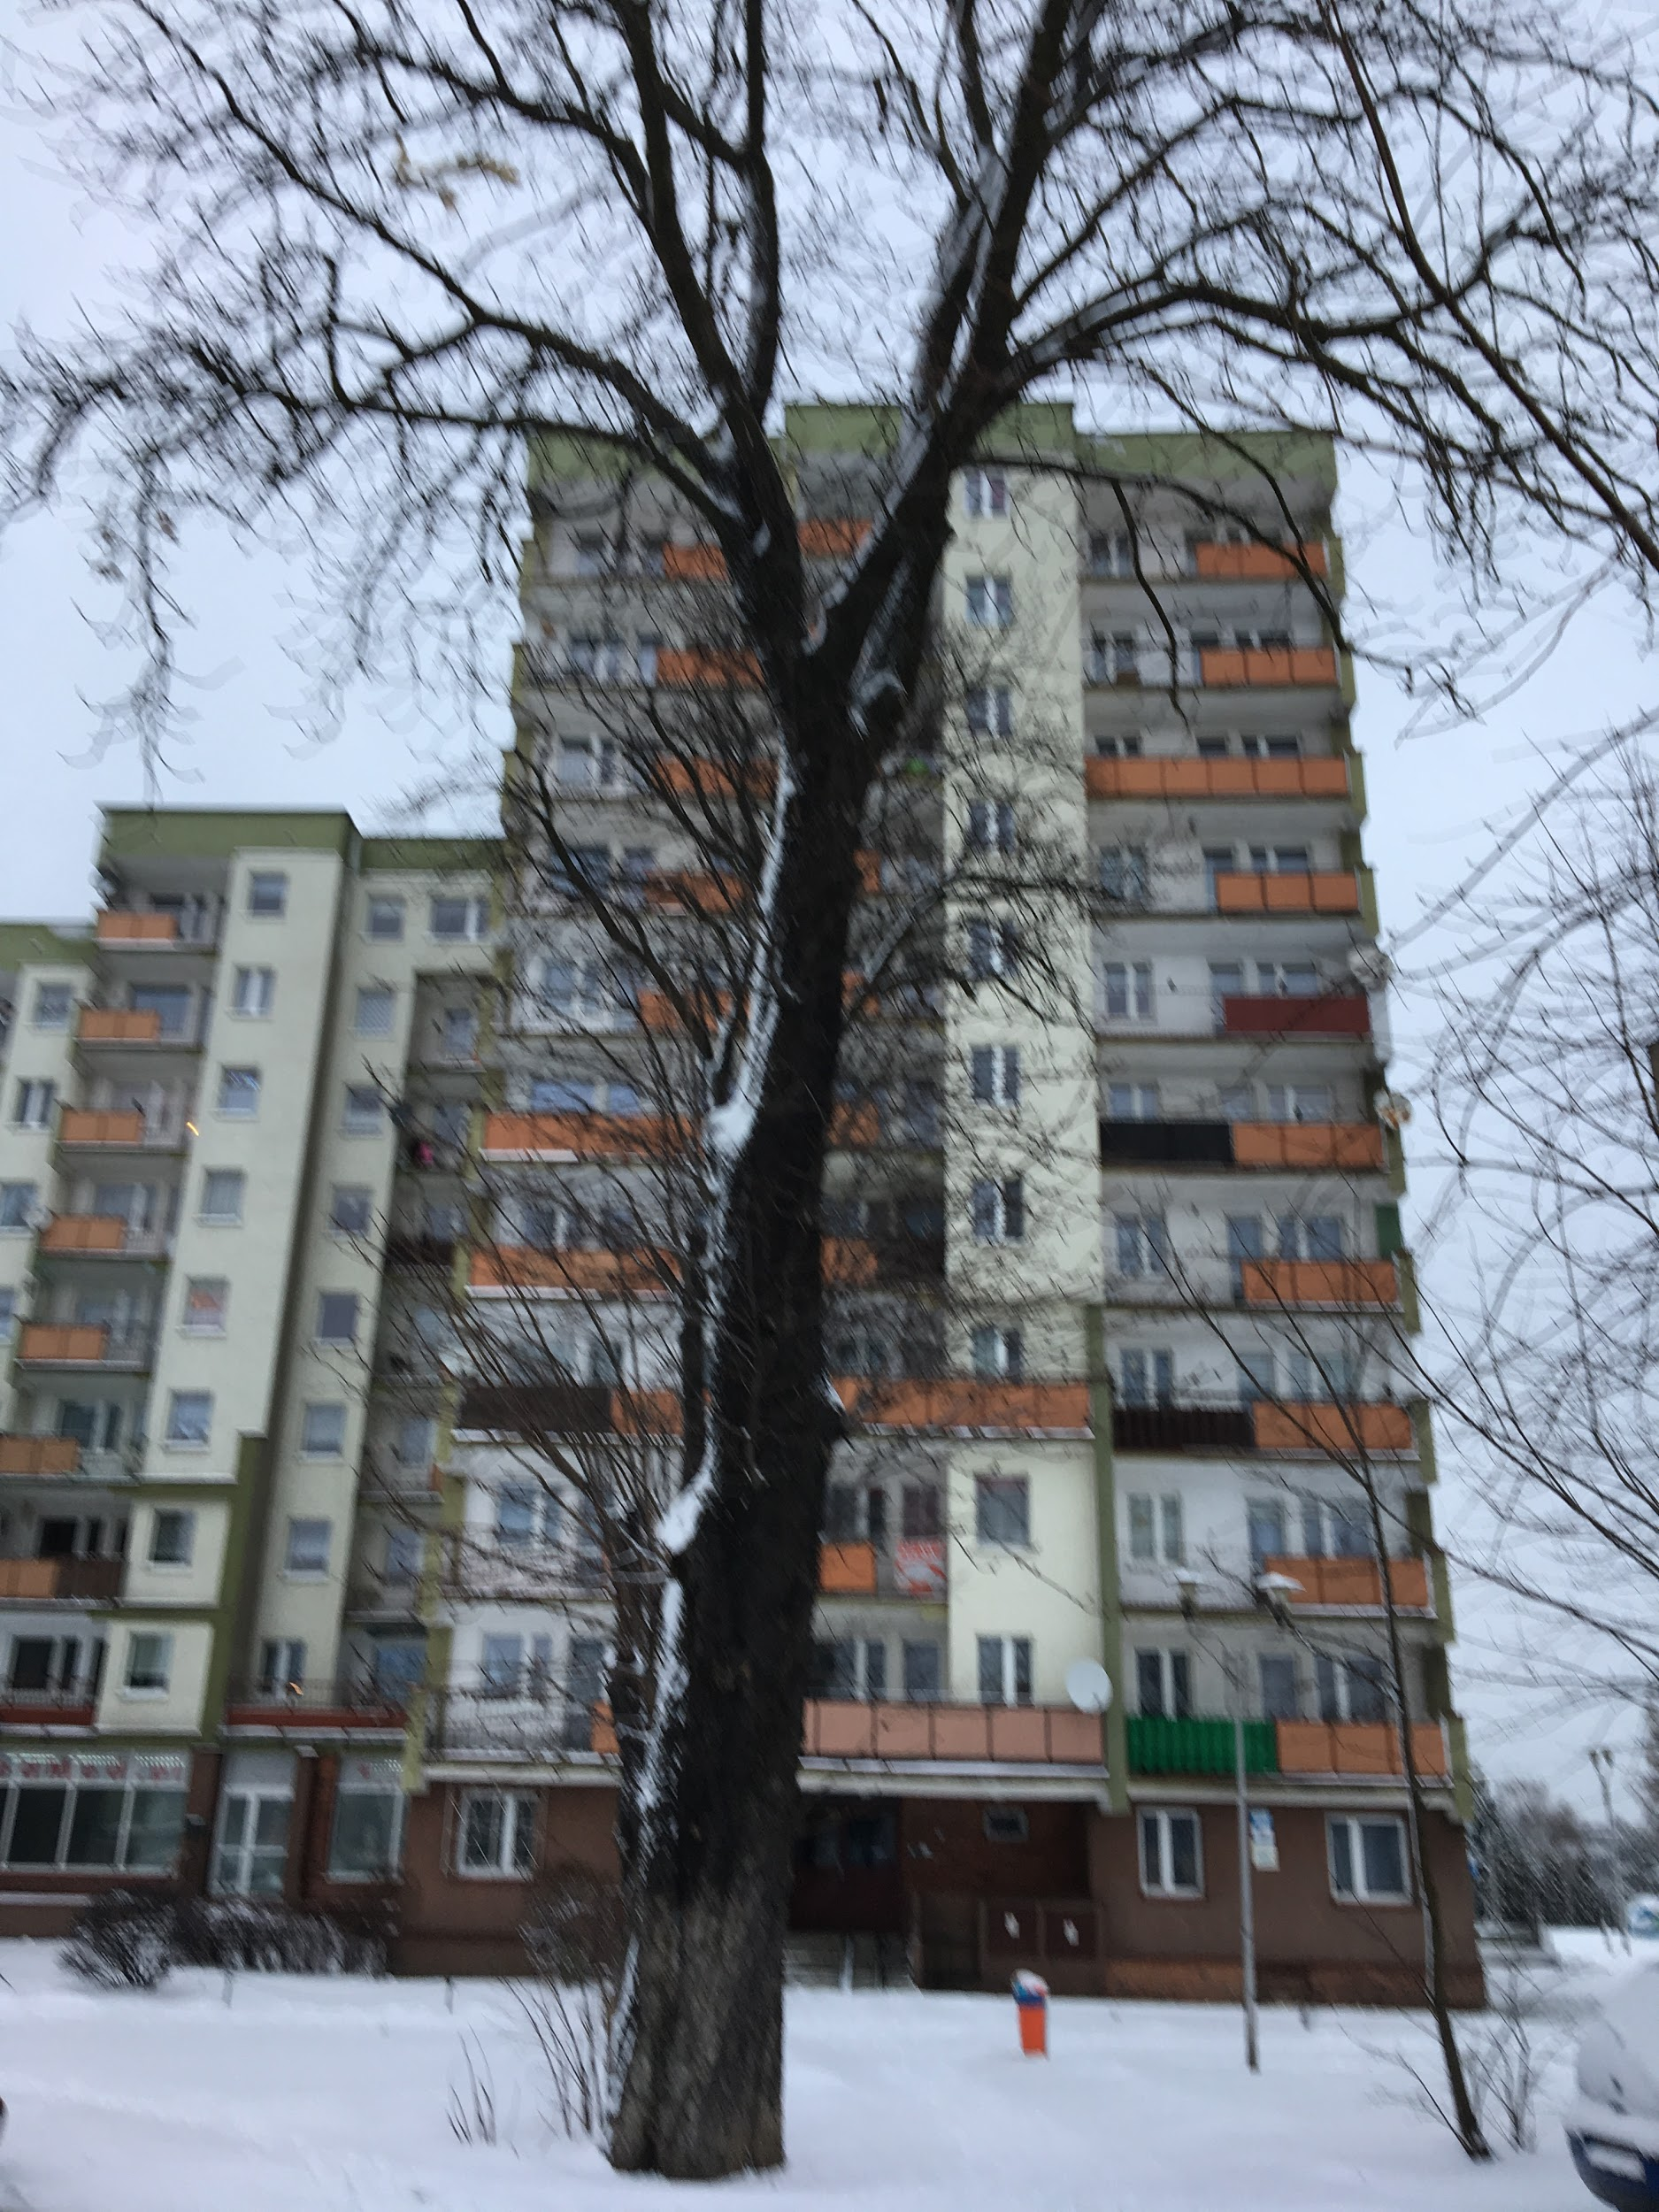
Date: 11.01.2019
Time: 13:27
Temp: -3°C

Slide 11
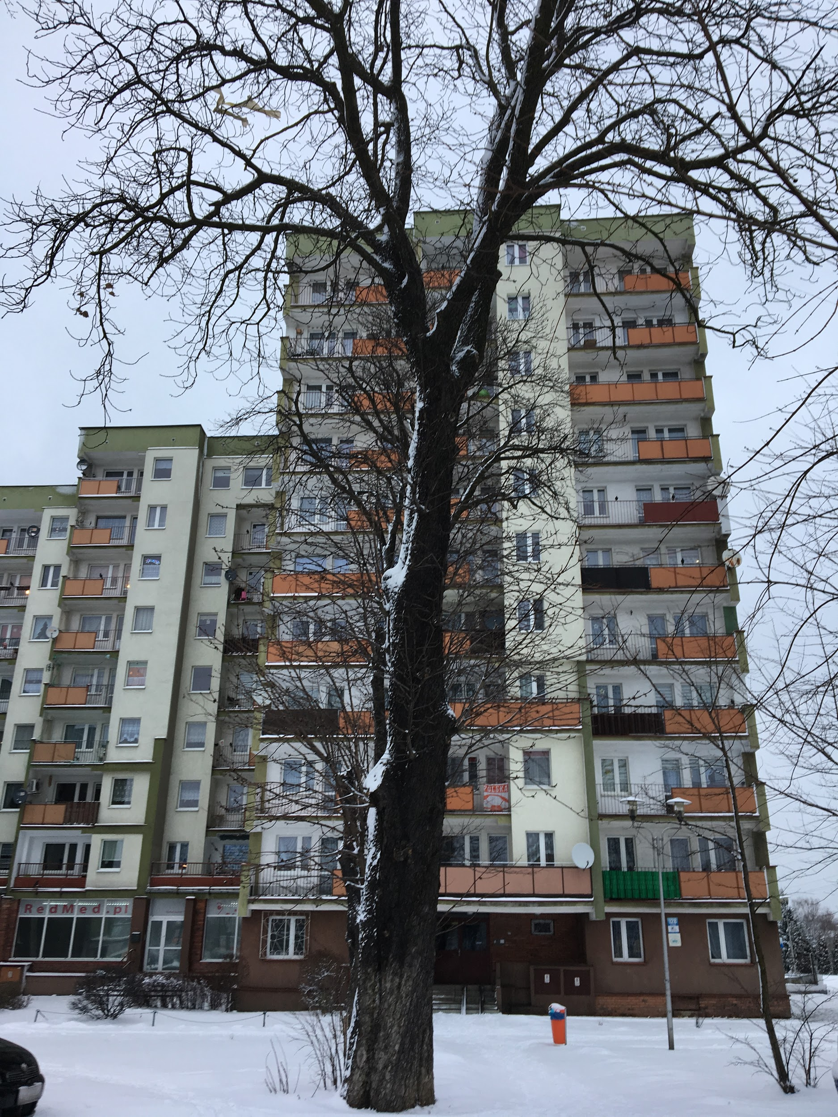
Date: 15.01.2019
Time: 15:30
Temp: -1°C

Slide 12
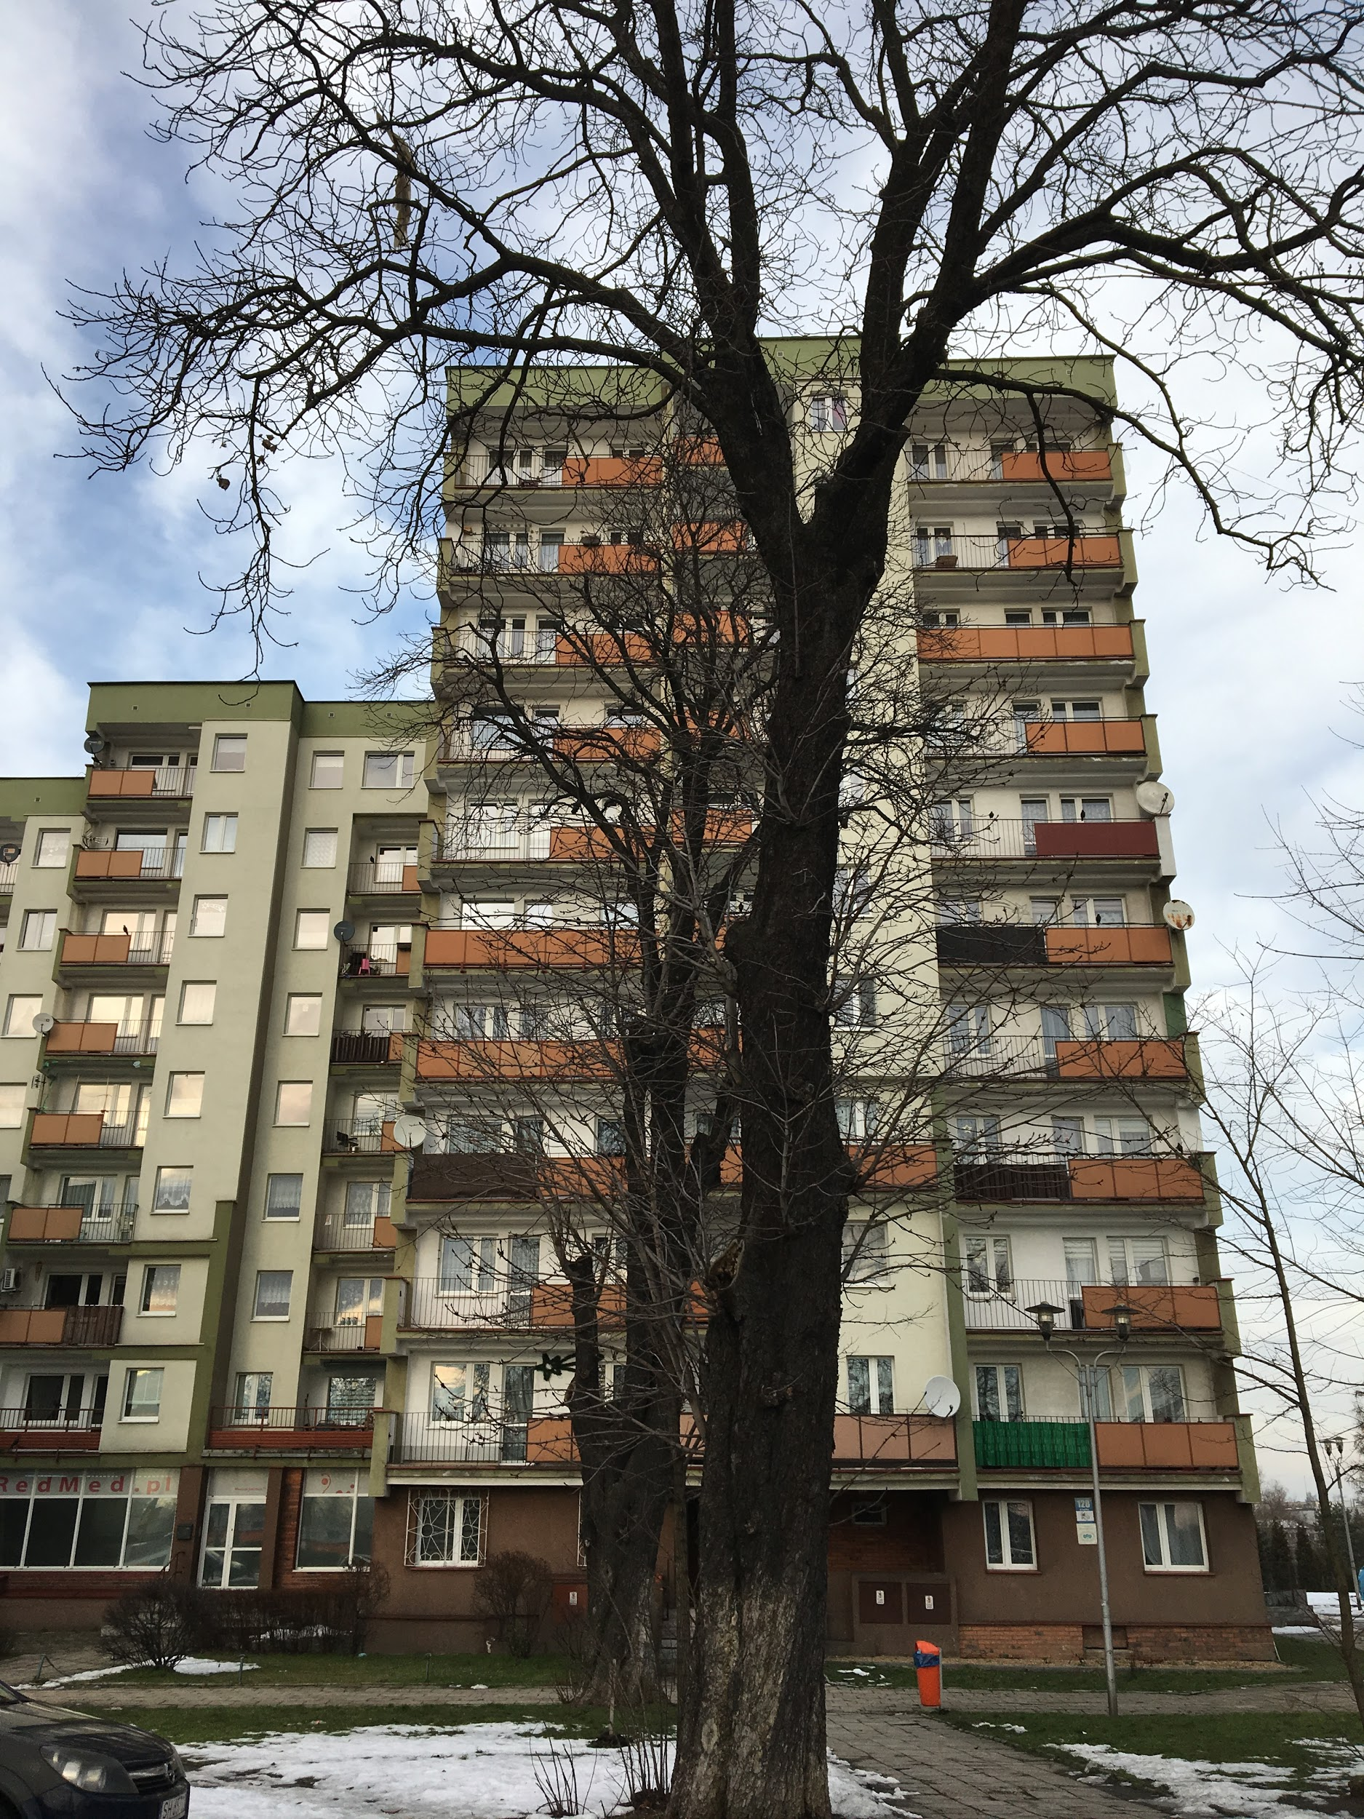
Date: 19.01.2019
Time: 14:17
Temp: 0°C

Slide 13
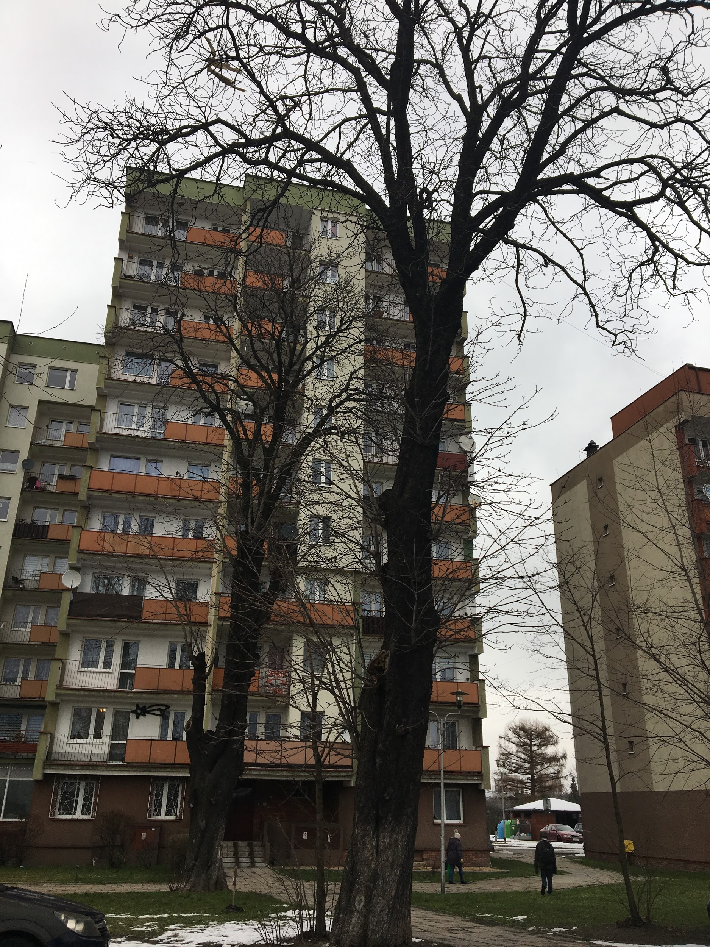
Date: 21.01.2019
Time: 15:10
Temp: -6°C

Slide 14
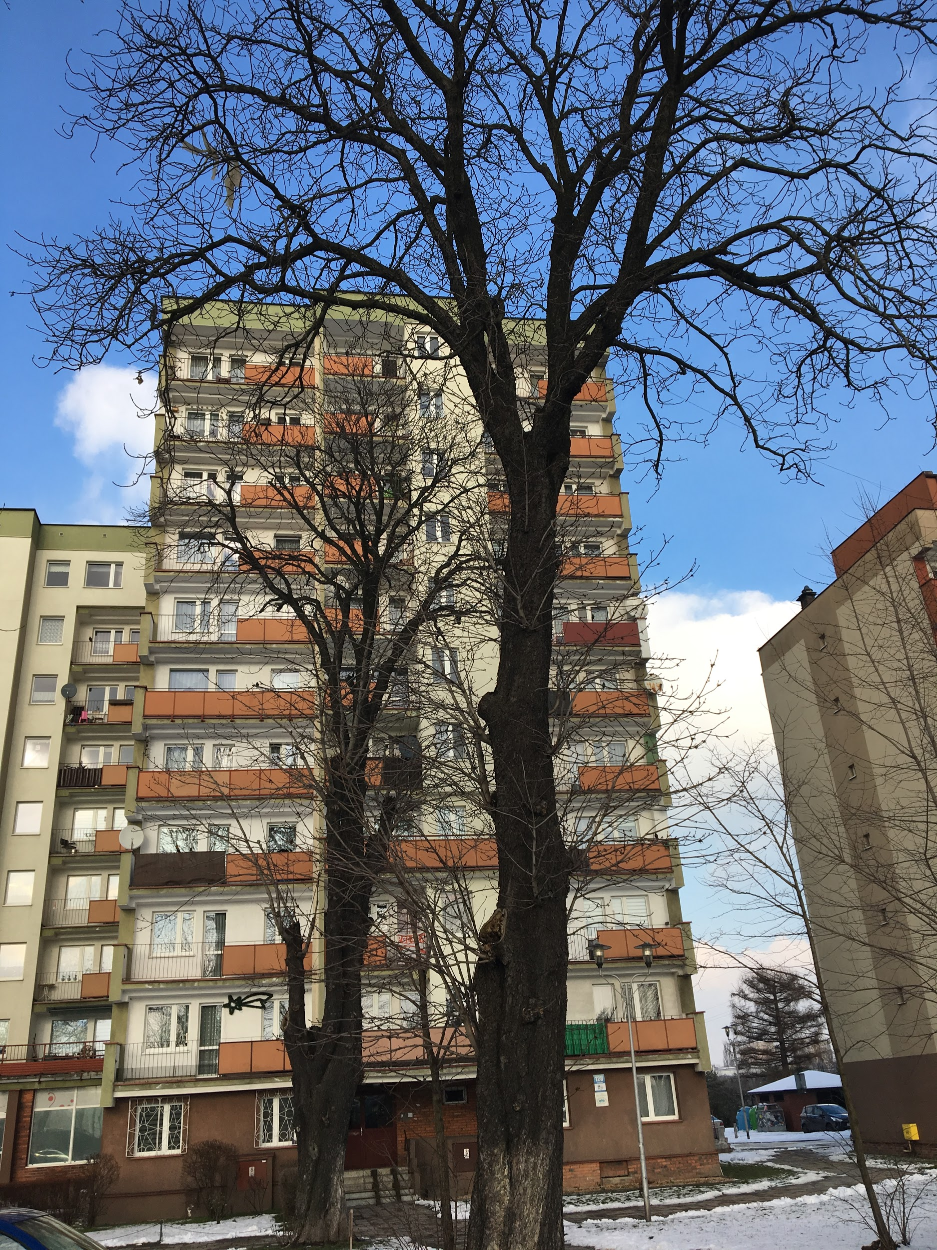
Date: 30.01.2019
Time: 13:50
Temp: 1°C

Slide 15
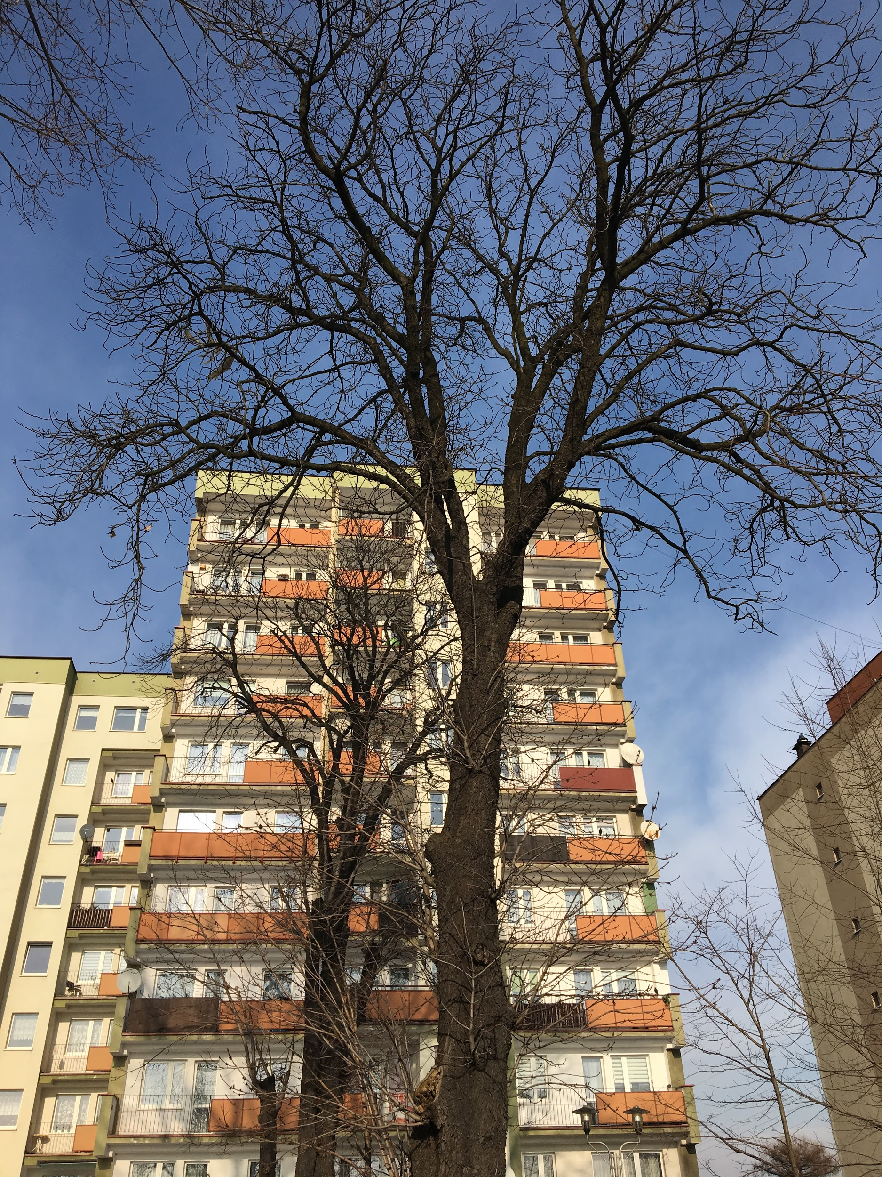
Date: 01.02.2019
Time: 13:25
Temp: 4°C

Slide 16
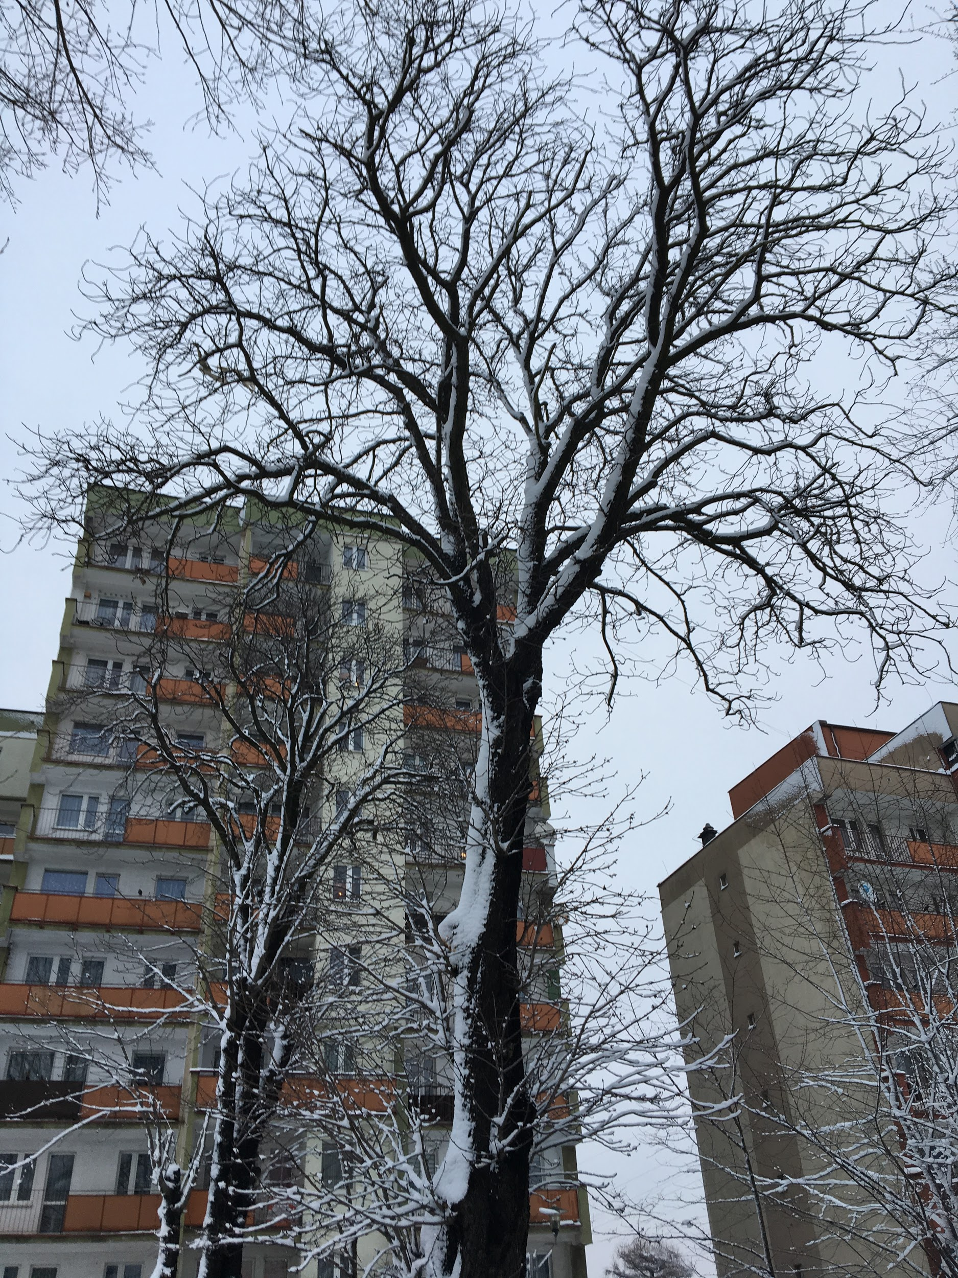
Date: 4.02.2019
Time: 16:16
Temp: 0°C

