Slide 1
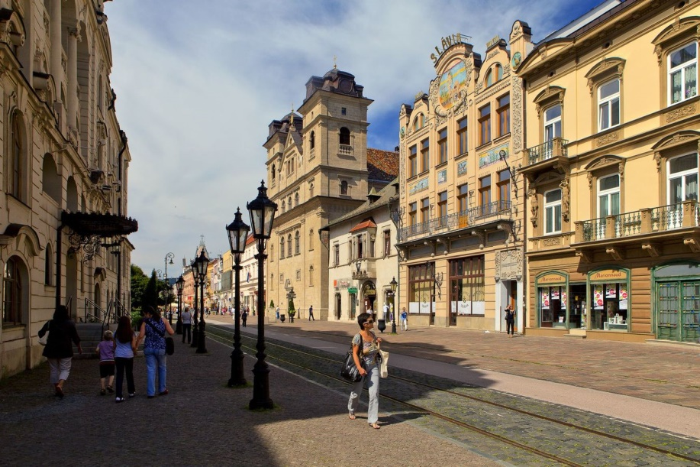
Our city - Košice

Slide 2
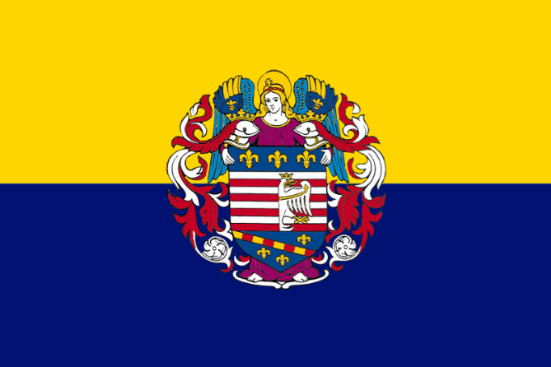
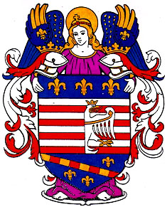
Košice
Kosice is the metropolis of Eastern Slovakia.
It is the second biggest city of our country.
The area of ​​the city is approximately 243 km².
It is located in the Košice basin in the valley of the river Hornád, which flows through the city.
In the east the town is surrounded by a mountain range - the Slanské vrchy. In the west it is surrounded by Volovské vrchy mountain range.
Coat of arms and the flag of the city of Košice

Slide 3
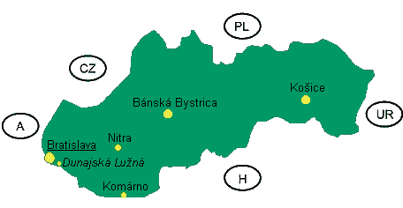
The city lies in the eastern part of Slovakia in the Košice region, near the borders with Hungary (20 km), the Ukraine (80 km) and Poland (90km). The capital city Bratislava is about 400 km from Košice.
The population of the city is approximately 240,688. Among them are Slovaks, Hungarians, Roma (Gypsies), Ruthenians, Czechs, Ukrainians and Germans.

Slide 4
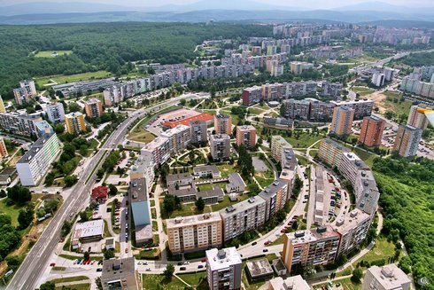
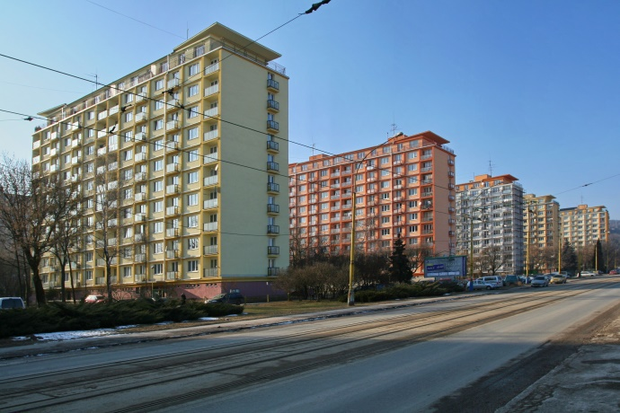
How we live
Most of people in Kosice live in blocks of flats.
Blocks of flats create whole residential areas called “sidlisko”.
Every “sidlisko” has is own infrastructure including schools, kindergartens, shops,etc.
These residential areas are connected to each other by city transport with buses and trams.
Some people live in family houses. Houses are usually placed in the suburbs or on the outskirt of the city. Many houses are around the city centre too. A few small villages are so close to Košice that they have become parts of the city. There are no blocks of flats in these villages and many young people build modern bungalow houses there.
We have a lot of green areas inside the city for example: Anicka park, Mestsky park, but most of them are on the outskirts for example Bankov, Jahodna, Cermel, and Kavecany. People use those green areas for sport activities for example: cycling, jogging and walking.

Slide 5
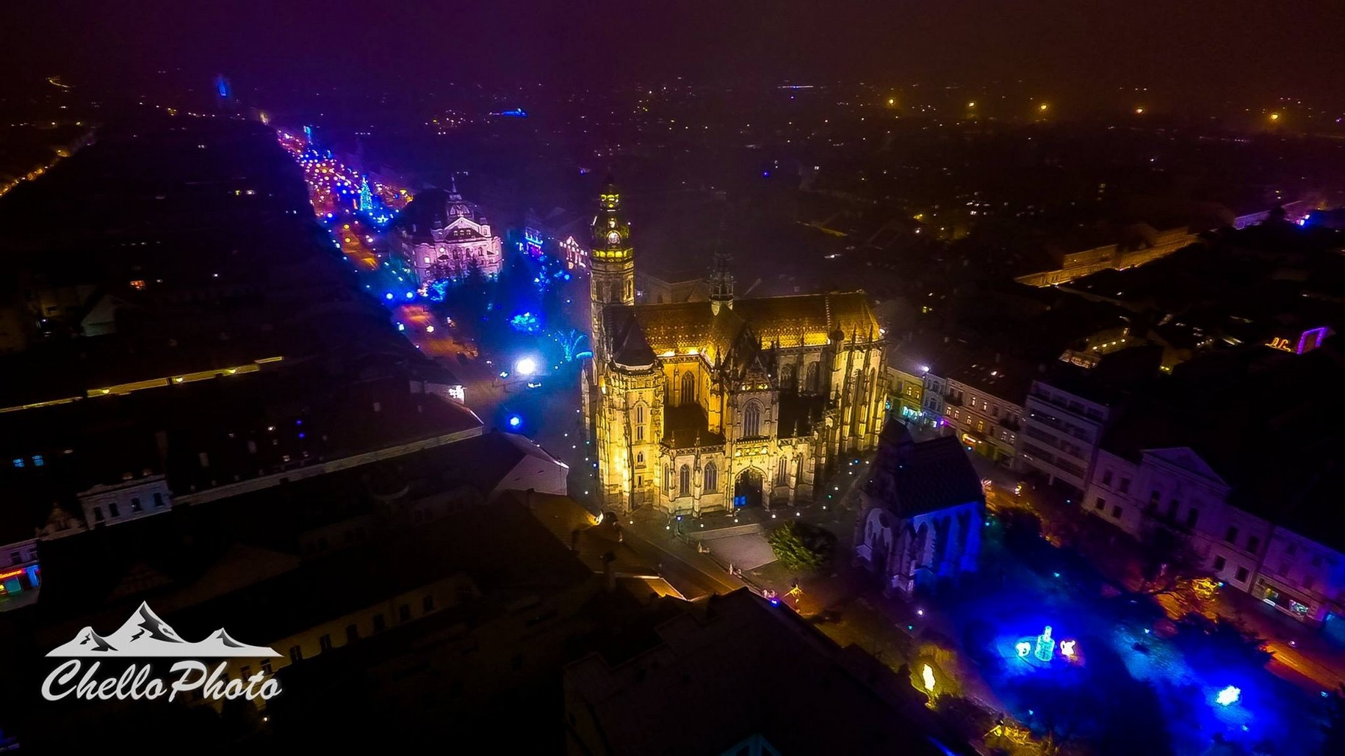
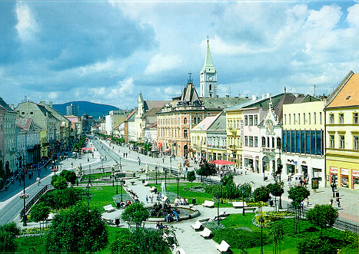
Historical centre
The historical part of Kosice is the biggest monumental reservation in our country.
The main street is only 1 200 metres long but it contains more than fifteen historical buildings which have been very important for this city since the 18th century.
In the past the historical centre was a street full of trams and cars. Nowadays the Main street is a pedestrian area with two cycling lanes.
The view of this street changed radically when President Rudolf Schuster rebuilt this street. There is a little water stream running in the middle of the street. The whole street is built from small stone cubes. It looks historical but it is not practical for faster walking.
The most important and the biggest building will be introduced separately.

Slide 6
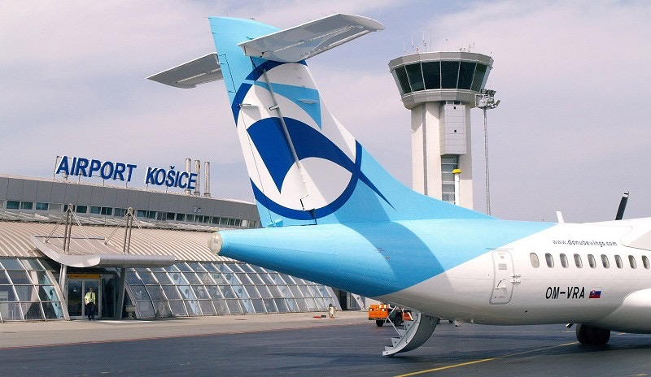
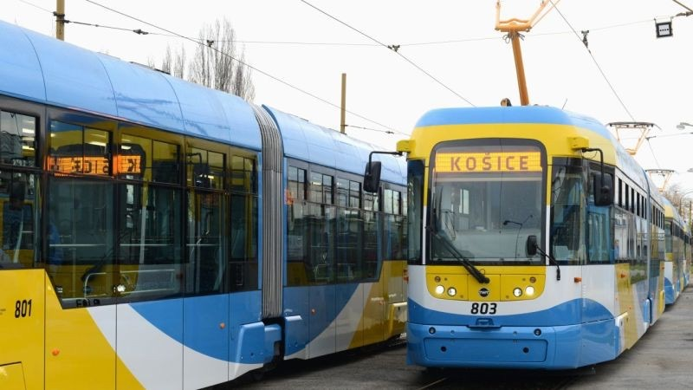
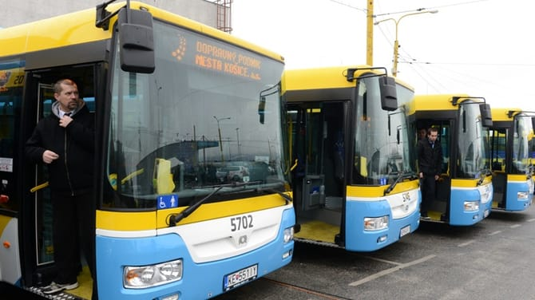
Traffic
The second biggest city in Slovakia has almost every type of traffic, we do not have a big river or sea, so there are no boats in our city. We have an international airport which is full of opportunities. You can fly to the UK, the Czech Republic, Poland, Netherland etc. This airport is mostly used in summer when people fly to the sea.
Buses and trams are very practical and environmentally friendly ways to travel in the city.
The most used types of transport are cars, but bicycles have become very popular in the recent years. We also have railways, which are used mostly by students because they have it for free.

Slide 7
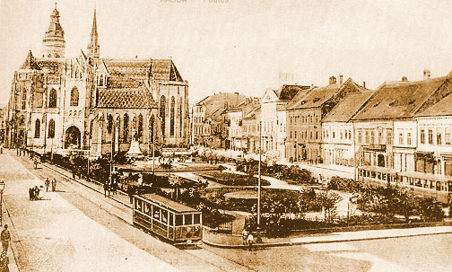
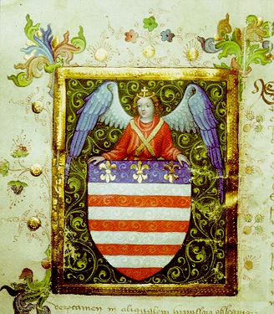
Brief history of Košice
The first written mention of Košice is in a document dated 1230, a contract for sale of land.In 1369 King Ludovicus Magnus granted Košice a coat of arms, making it absolutely the first town in Europe to use such a symbol on the basis of a royal armorial warrant. Košice in the 16th and 17th centuries experienced troubled times as a result first of the Turkish invasion, then the religious conflicts. By the end of the 19th century Košice had developed into one of the most important industrial cities in Greater Hungary. In 1918 Košice became part of the first Czechoslovak Republic, and although the wartime Hungarian occupation from 1938 to 1945 brought economic decline, at the end of the Second World War Košice for a while became the capital city of the re-established Czechoslovakia. From the 1950’s the city experienced furious growth, accelerat­ed mainly by the building of the East Slovakian Steelworks.

Slide 8
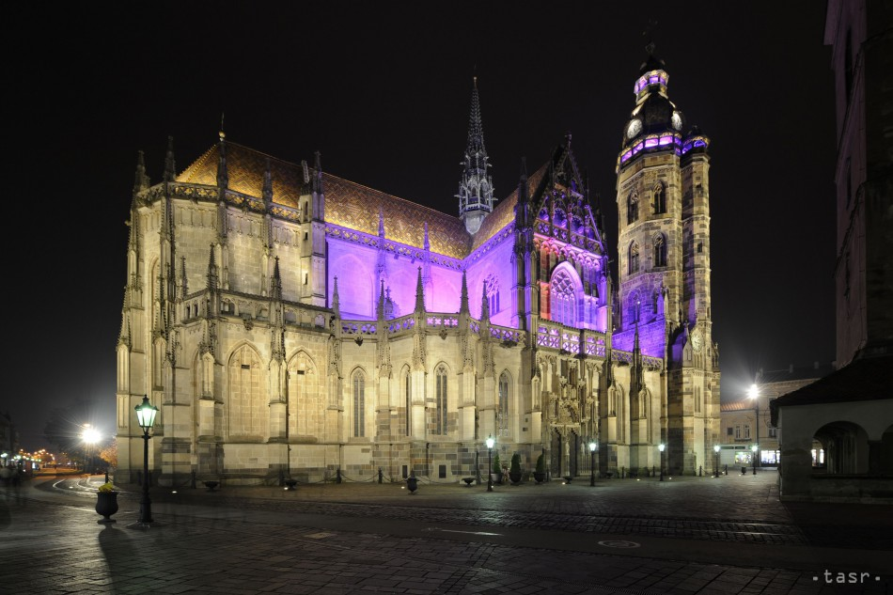
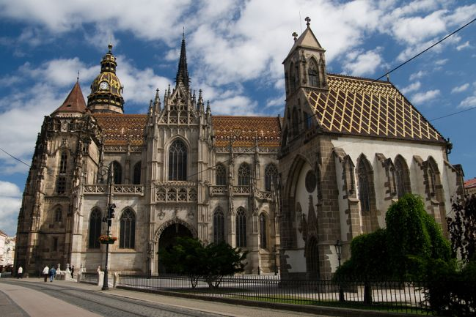
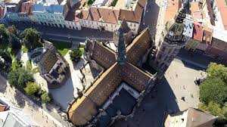
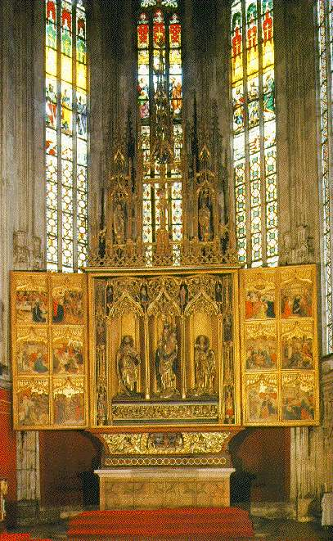
St. ELISABETH CATHEDRAL
St. Elisabeth Cathedral is the biggest church in Slovakia and one of the easternmost Gothic cathedrals in Europe.It was built between 1378 and 1508. It is located in the middle of Main Street in Košice.The cathedralwas often damaged by calamities and underwent numerous restorations in the past.The interior of the cathedral is dominated by St.Elisabeth altar.Besides this,the cathedral has nine more altars.The cathedral has a sanctuary , two towers and two chapels.The North Tower is 59 meters high and offers a beautiful view of the city.

Slide 9
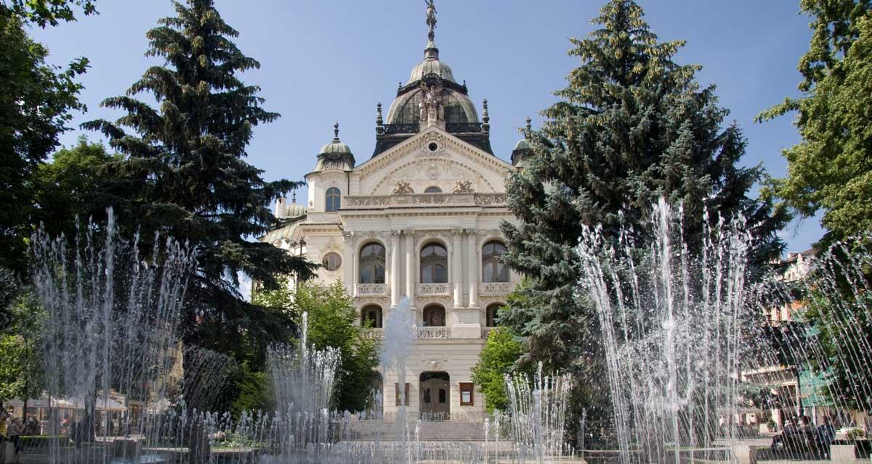
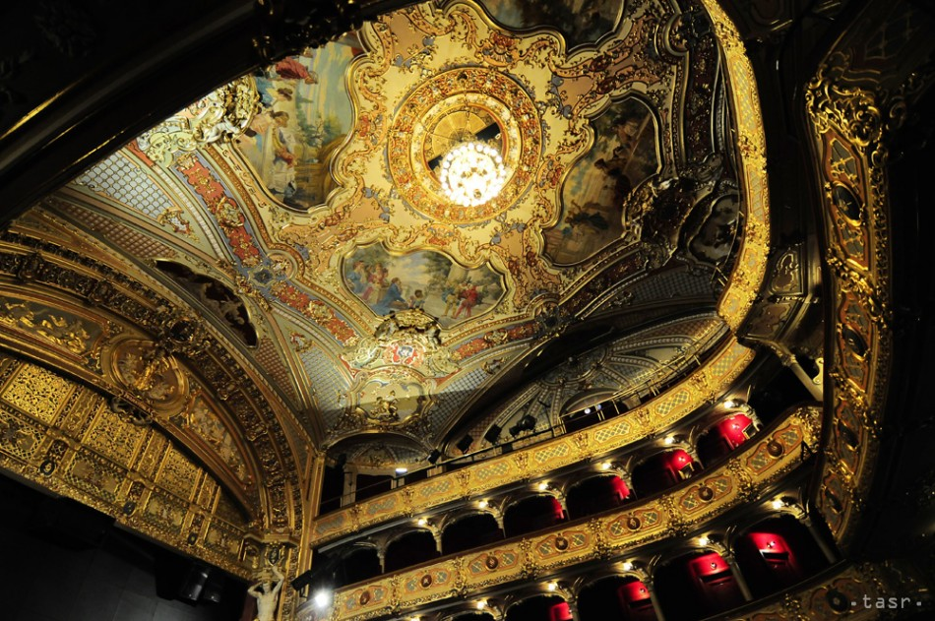
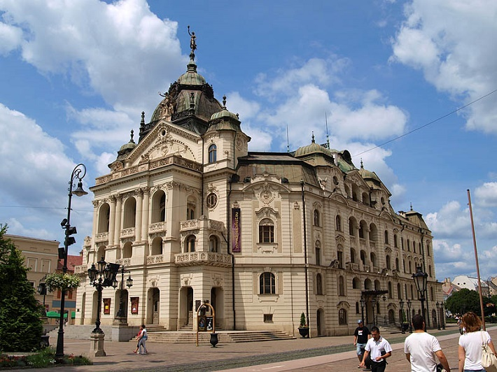
Theaters
State Theater Košice
Kosice State Theater is the home of drama, ballet, opera and operetta. The theater has two scenes, the main one is located in a historic building built in 1899, and a short walk away, in an art deco building. In the course of one theater season, there are 6 premieres of different theater genres on average. The quality of theater performances is appreciated not only by visitors but also by critics.

Slide 10
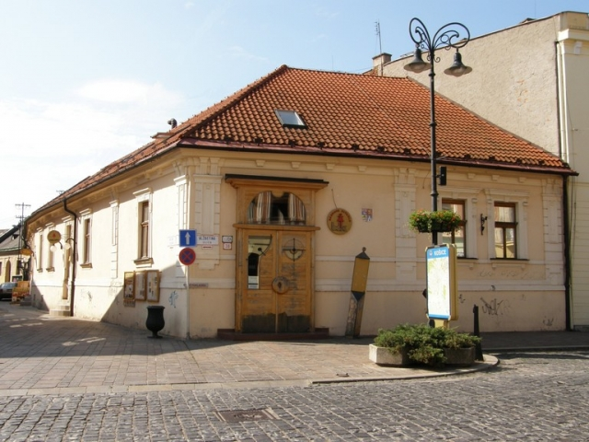
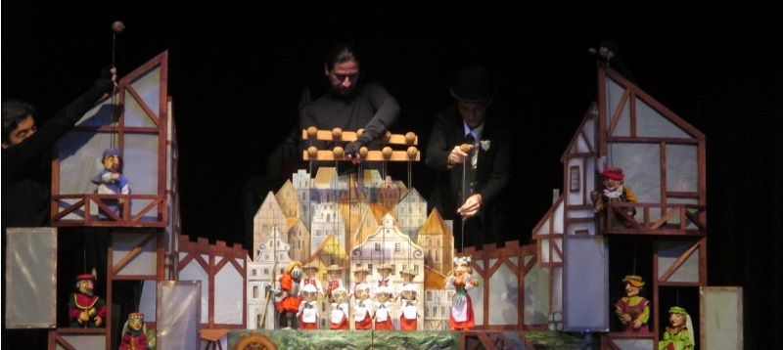
Puppet Theatre
The Puppet Theather was founded in 1959 as the fourth of its kind in Slovakia. Since then, the theater has played over 180 games with over 10,000 repeats, and is the only professional puppet theater in Eastern Slovakia.

Slide 11
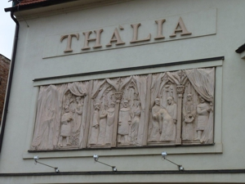
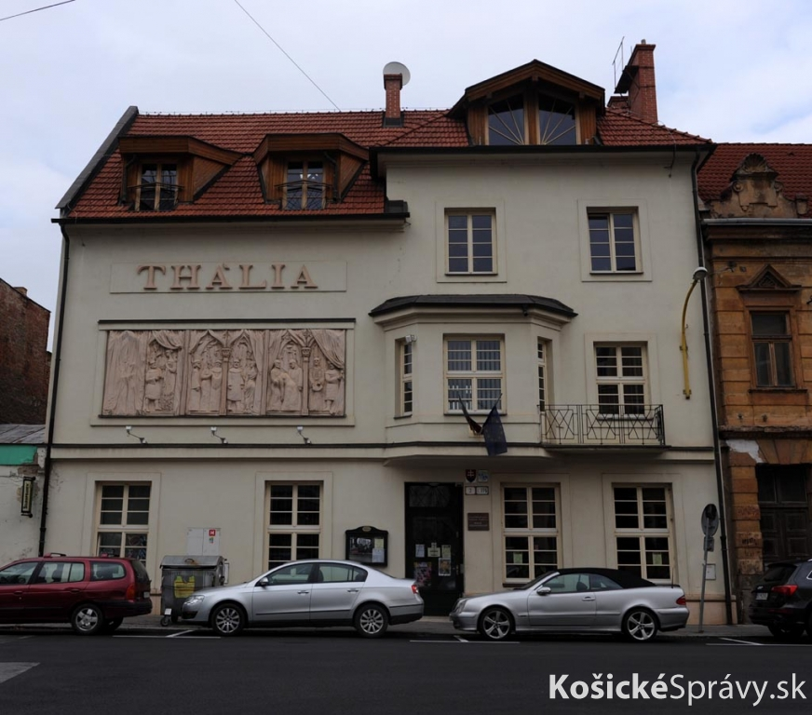
Thalia Színház Theater
The Thalia Theater acts as a touring theater. Out of 160-170 performances during the year will play about 60 in Košice, others in various locations in Slovakia. He also often hosts in Hungary. Theater Performances are mostly in Hungarian.

Slide 12
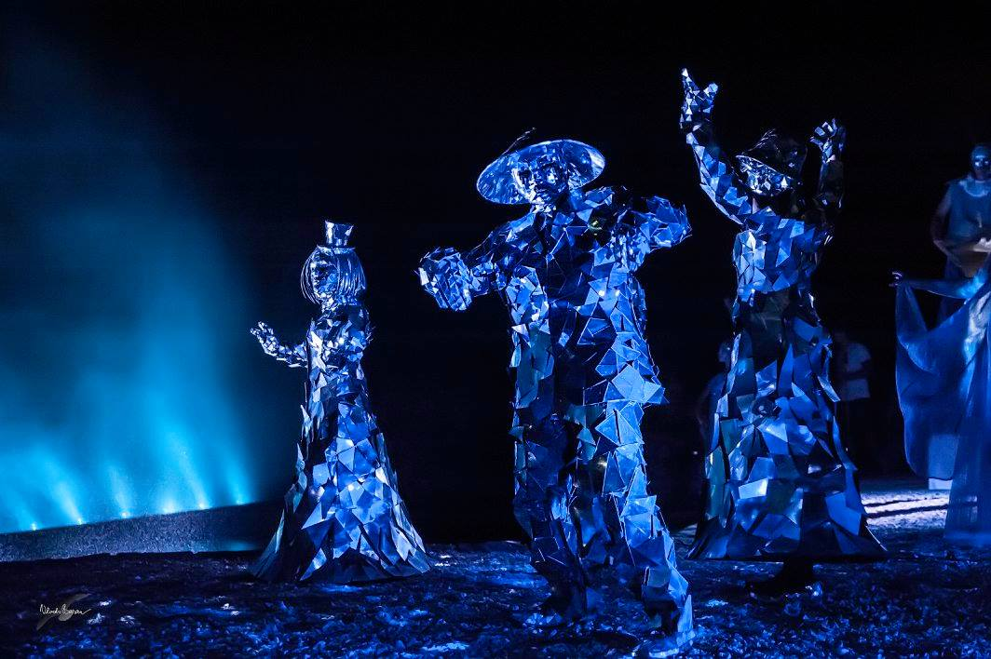
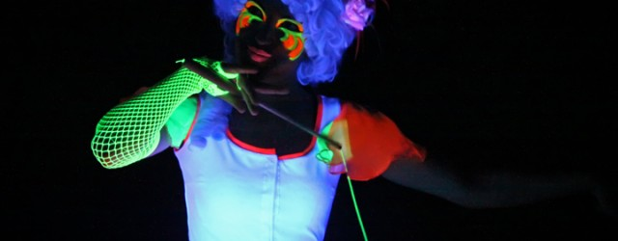
Old Town Theater
Peter Rašev Old Town Theater is a free association of artists, theater, fans and theater lovers.With their work they managed to reach out to a wide range of spectators. In addition to the original works for adults, it also created workshops for children and youth.

Slide 13
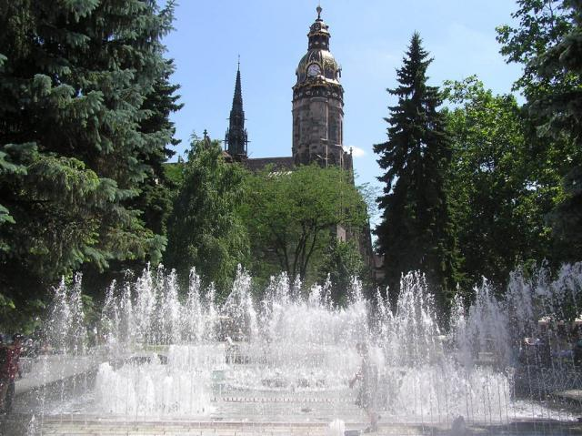
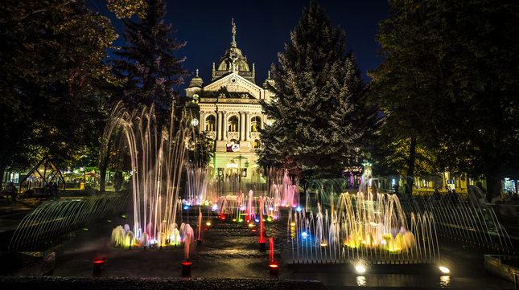
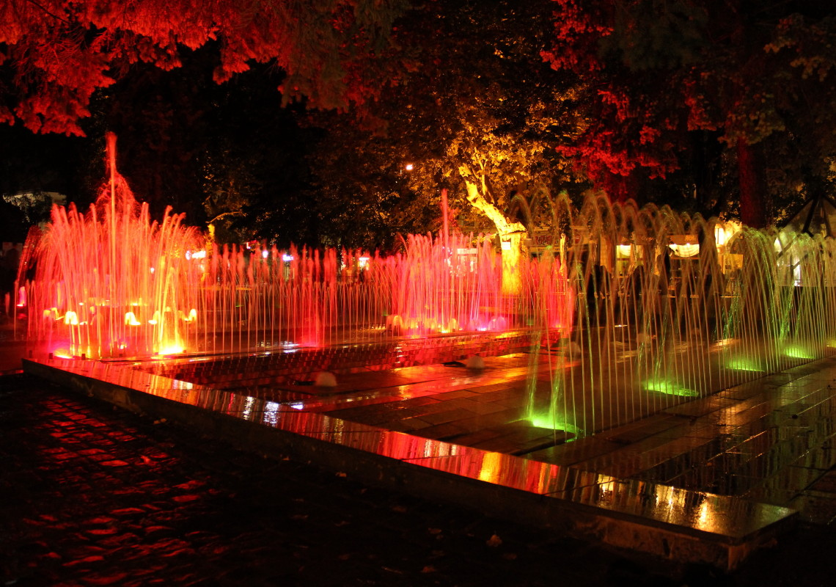
Singing Fountain
The singing fountain is a fountain on Hlavná Street in Košice. It is located between the Košice State Theater and St Elizabeth Cathedral. When playing music, water is splashing and the colorful fountain lighting is regulated based the tones of the music. It is the oldest fountain in Slovakia. In the summer it not only splashes on its own music, but every hour it splashes to the sounds of the chime that is part of the park where the fountainis. The Fountain has more than 100 songs. The chime has 22 bells, symbolising the number of urban parts of Košice, weighing almost 1.5 tons and having the shape of a column. The Fountain also responds to live music from the State Theater, that is an incredible experience for every tourist who comes to Košice. There are 750 jets in the fountain that can splash water up to a height of 19 meters. Evening visual experience complements color lighting in five colors.

Slide 14
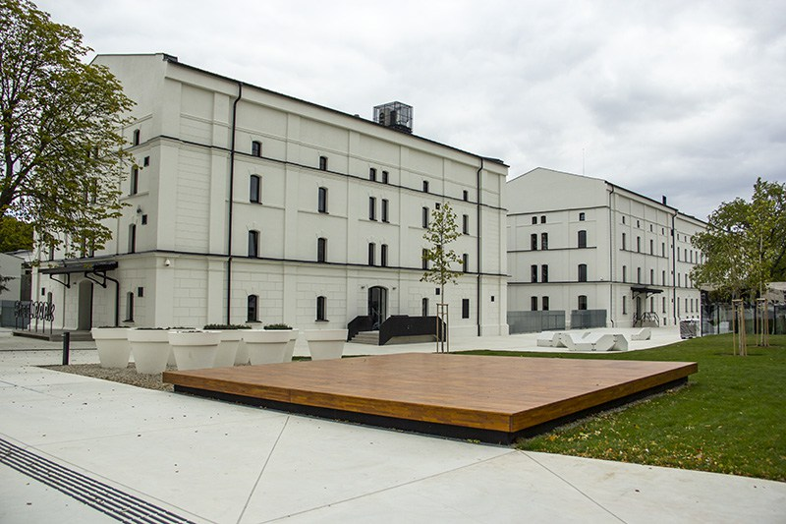
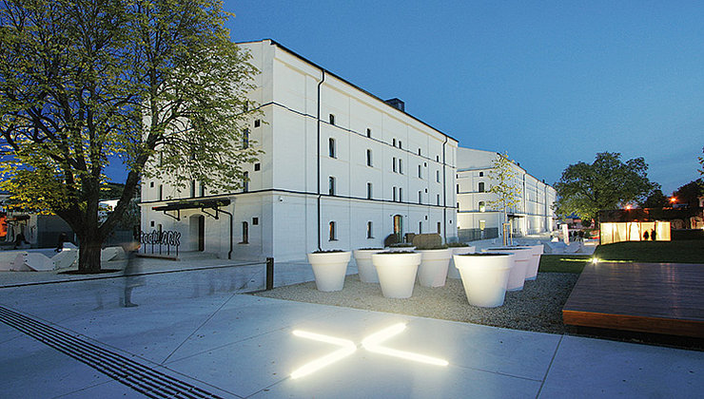
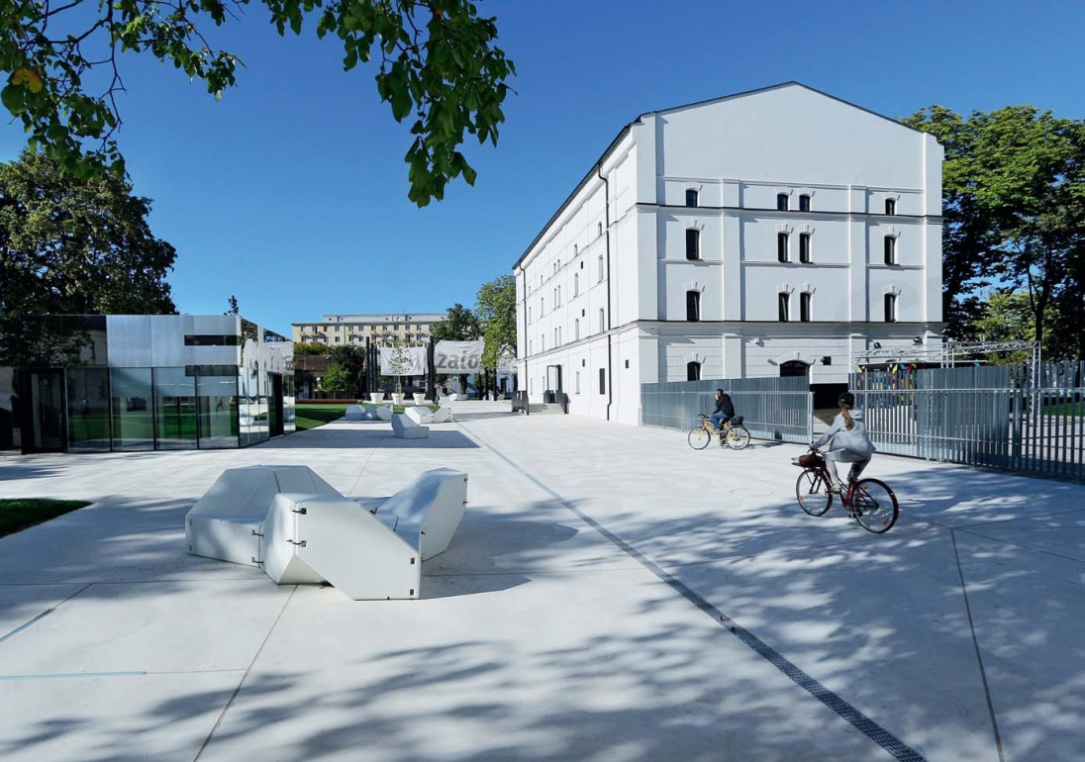
Kulturpark
KulturPark was the largest of the high investment projects of Košice as European Capital of Culture in 2013. Formerly the building complex was used as a militiary barrack in the 19th century. Today’s Kasárne KulturPark began its activity in these premises in 2008 during the pilot phase of the Košice INTERFACE 2013 project, which gave the city the title ECOC. From the original military barracks, three main buildings owned by the city remained, and eight new pavelions were added. Architect Irakli Eristavi named every building. Alfa, Bravo and Charlie. He used military international terminology. KulturPark hosts differet cultural events such as concerts, exhibitions and theare performances throughout the year.

Slide 15
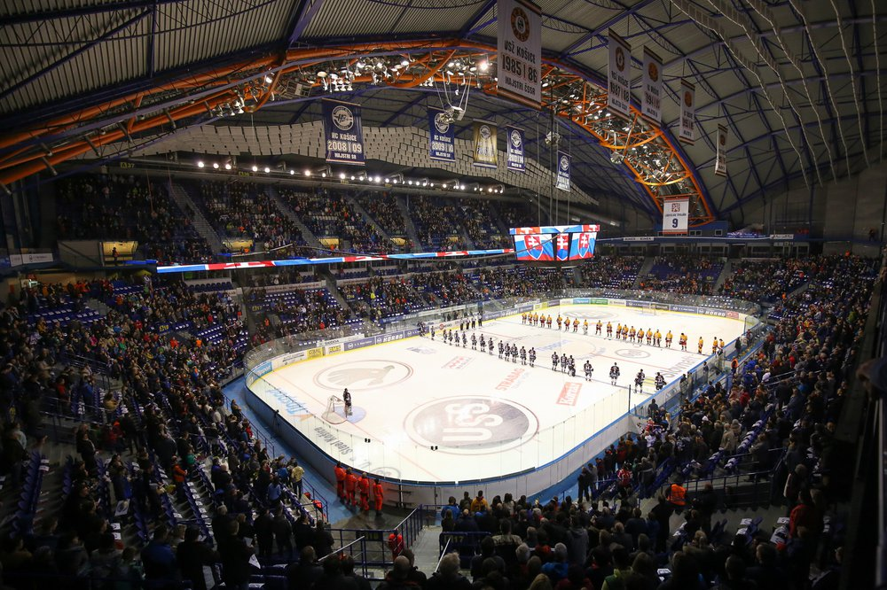
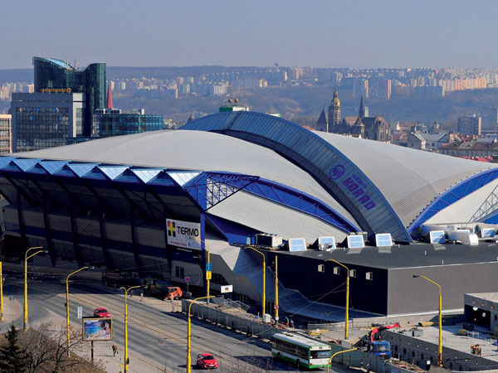
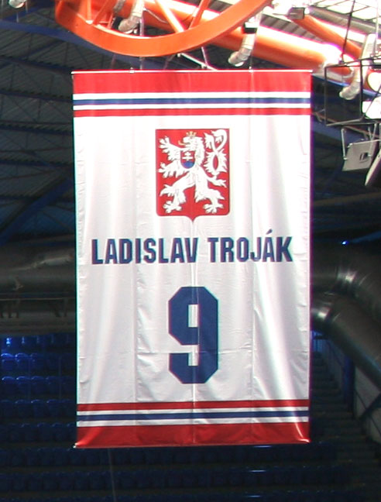
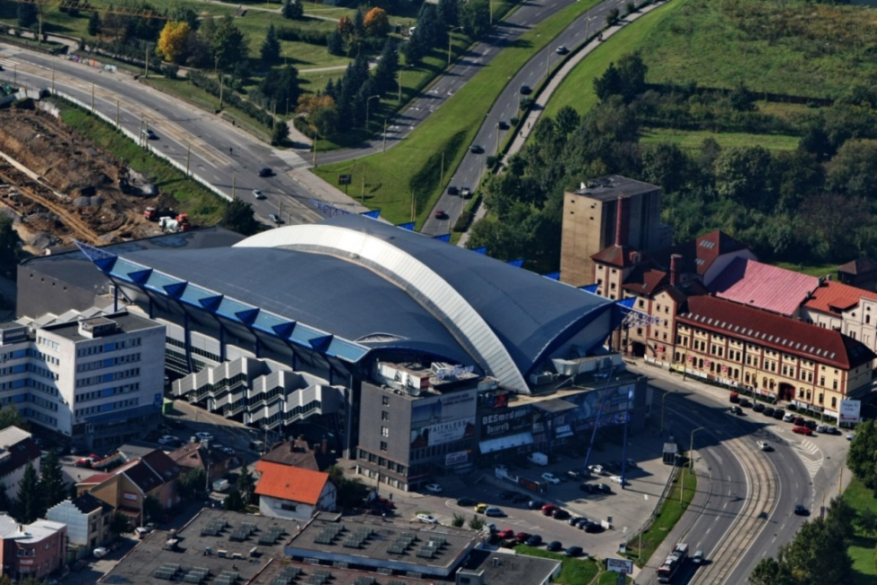
Steel Arena
Steel Arena – Ladislav Troják Stadium in Košice is the home arena of the ice hockey club HC Košice.
Its capacity is 8,343 and was named in honour of the general sponsor of the club – the U. S. Steel Košice and also in honour of Ladislav Troják, a Košice-born hockey player who was the first Slovak to win the World Championship.
Steel Arena was one of the venues for the 2011 IIHF World Championship, which was hosted by Bratislava and Košice and is going to co-host the 2019 IIHF World Championship with Bratislava again.
The arena has hosted concerts by many famous artists like 50 Cent,Bryan Adams,Andrea Bocelli,Enrique Iglesias,Elton John...
Ladislav Troják's jersey

Slide 16
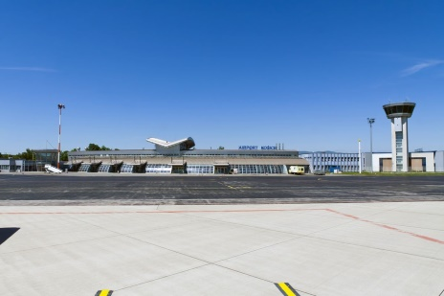
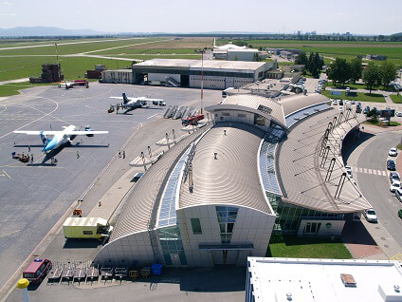
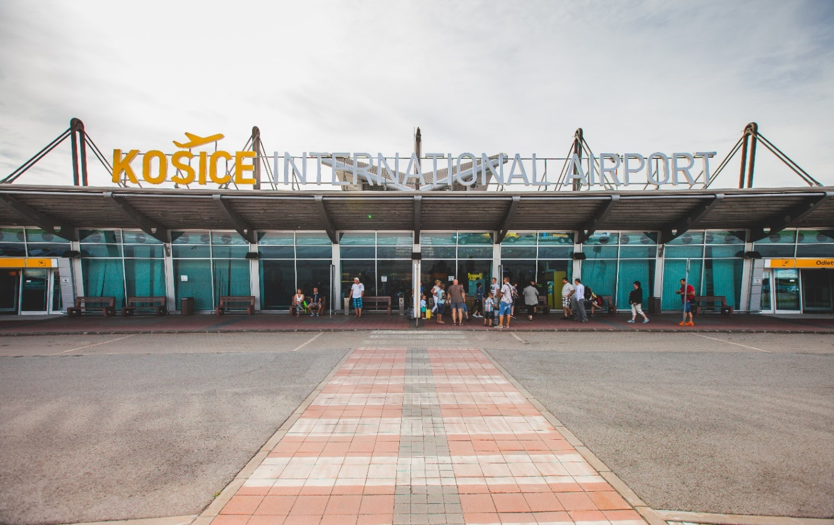
Košice International Airport
It is the second largest international airport in Slovakia.
In 1955 direct flights began between Košice and Prague.
Increasing traffic required a longer passenger terminal by the mid 1960s.
Between 1974 and 1977,the runway was extended by 1100 metres.
You can Fly to many destinations but the most common airlines are
Turkish airlines, Wizzair, LOT airlines, Austrian airlines, etc.
Summer flight schedule at Košice International Airport will bring 46 weekly flights to the 4 European hubs.

Slide 17
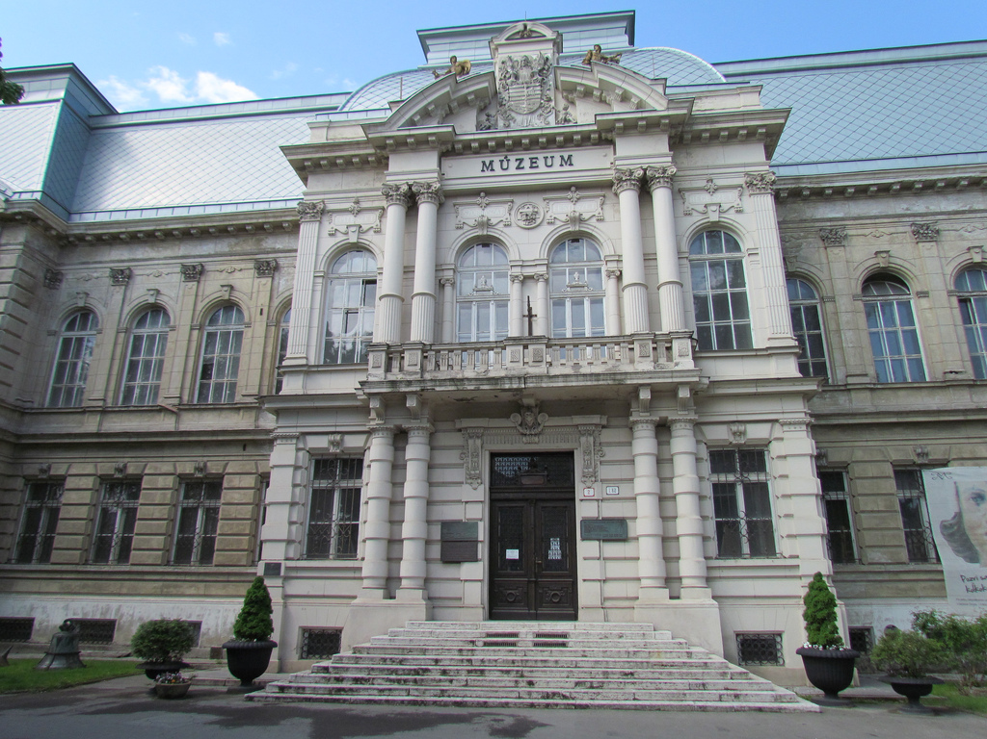
Museums of Košice
There are many museums in Košice. On Mondays they are open for free. Once a year The Night of Museums is held, when all the museums are open all night.
Eastern Slovakia Museum
It is the oldest museum in Košice and in Slovakia. There are natural and historical exhbitions there. It has three departments: historical, natural and artistic-historical. In 2002 it won the Košice Prize.

Slide 18
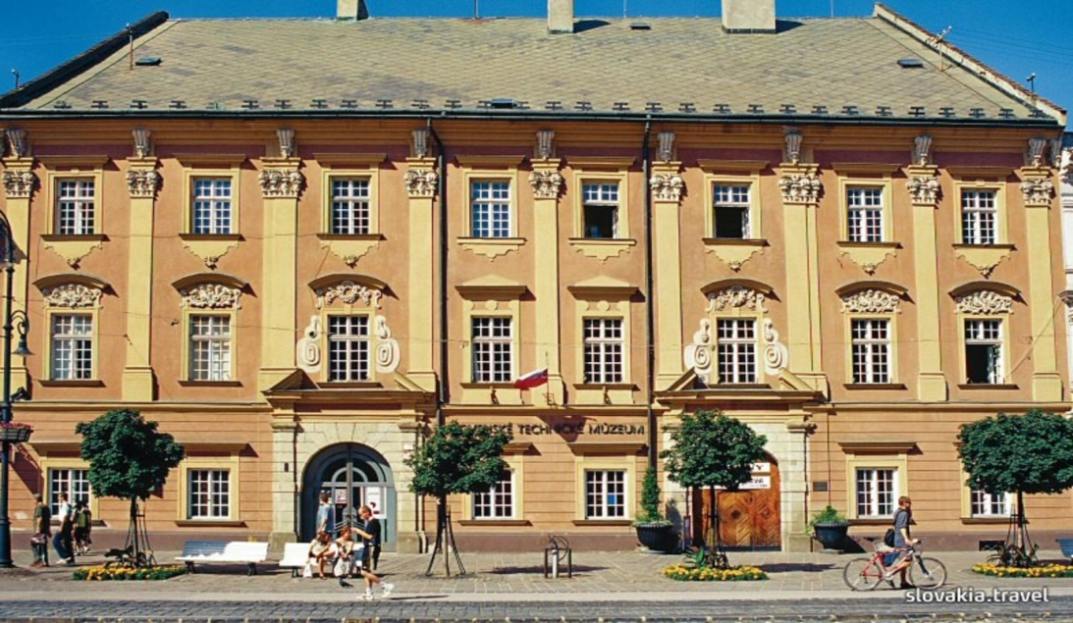
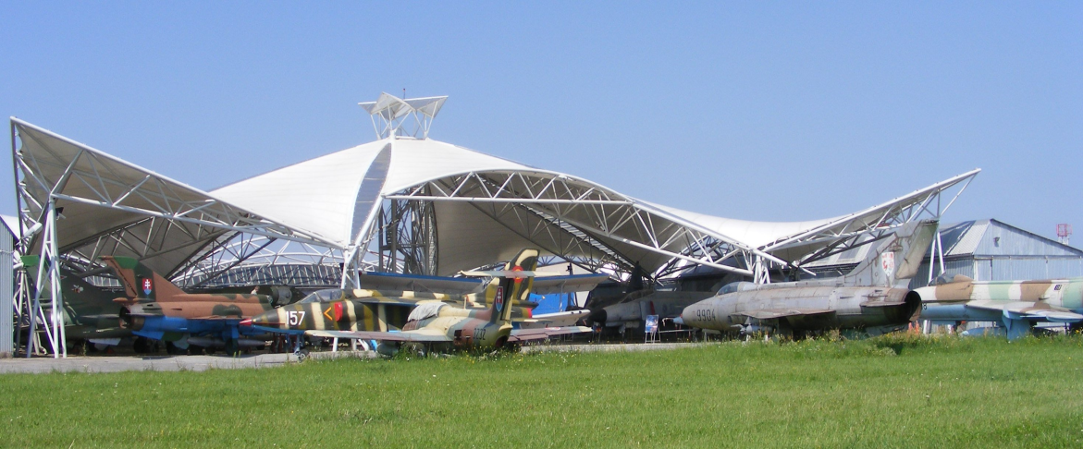
Slovak Technical Museum
The museum is focused on history, science and technology. There are more than 14 000 collections. There is also a planetarium.
Aviation Museum
Since 2002 it has been next to Košice airport. The most popular is the gallery of presidential aircrafts from European states, China and the USA.

Slide 19
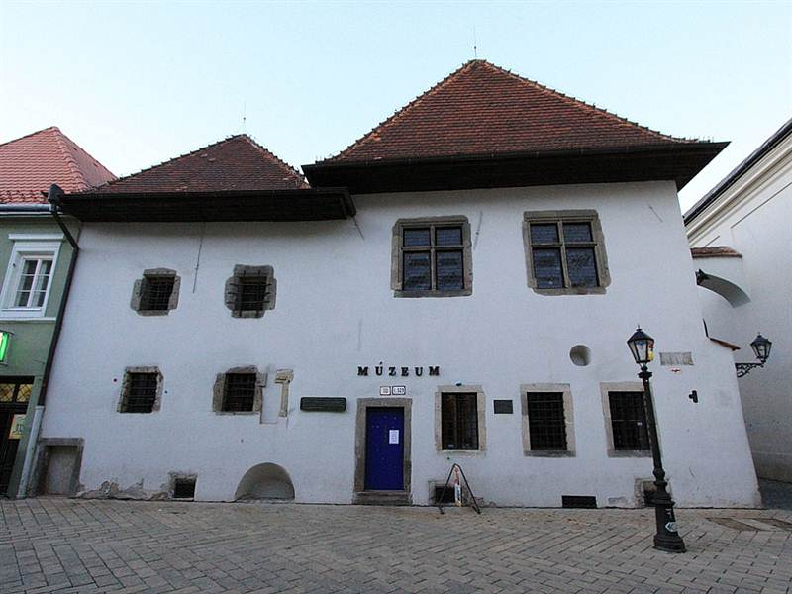
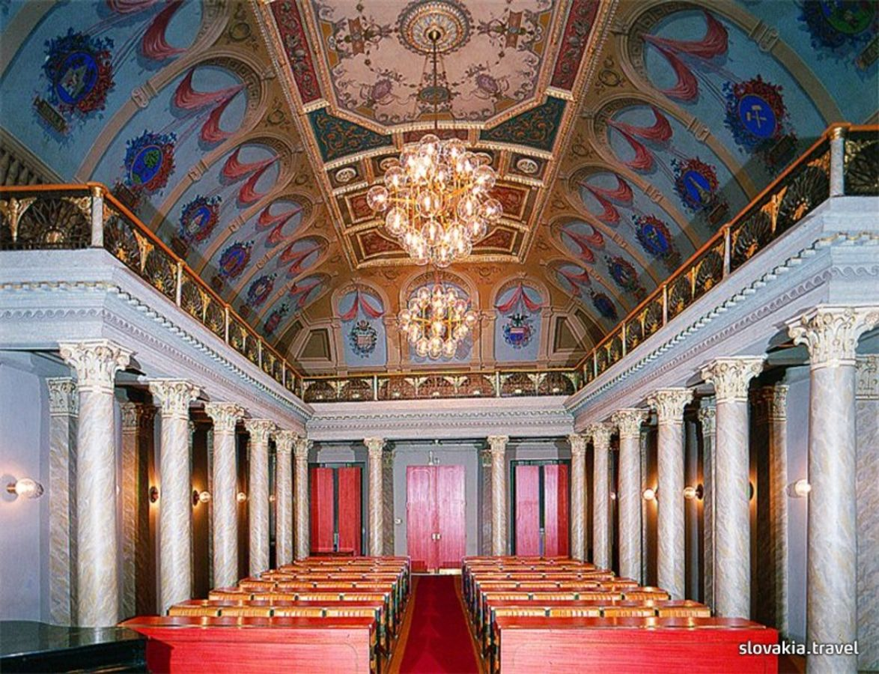
Mikluš Prison
These are two interconnected houses that were used as torture and prison at the beginning of the 17th Century. Before, these homes were inhabited and used probably as pottery houses.
East-Slovak Gallery
The institution focuses on a collection of art. Currently it owns more than 7 000 works. It organizes more than 40 exhibitions yearly.

Slide 20
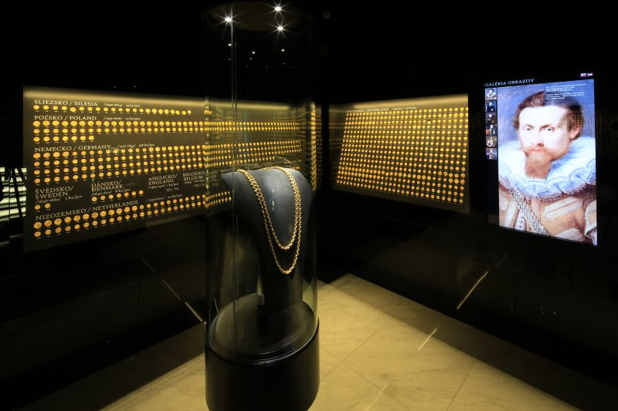
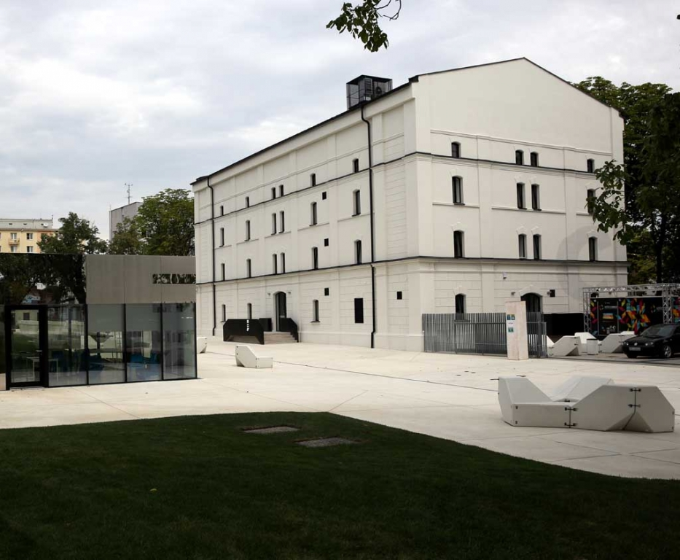
"Košický zlatý poklad" – Košice Gold Treasure
There are 2,920 gold coins, three gold medals and a golden renaissance chain. The treasure was stored in a loafed copper box. It is one of the largest golden treasures in the world. Its total value is more than seven million euros.
Steelpark
It is a creative factory for children. There are interesting expositions and laboratories. You can find more than 50 interactive exhibits.

Slide 21
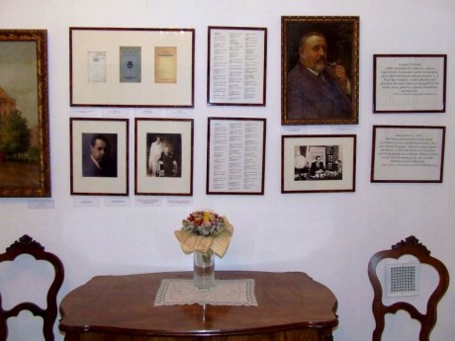
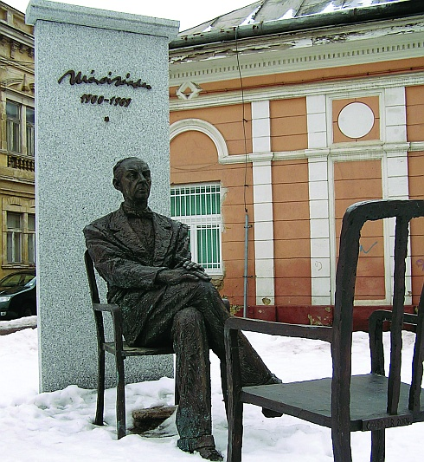
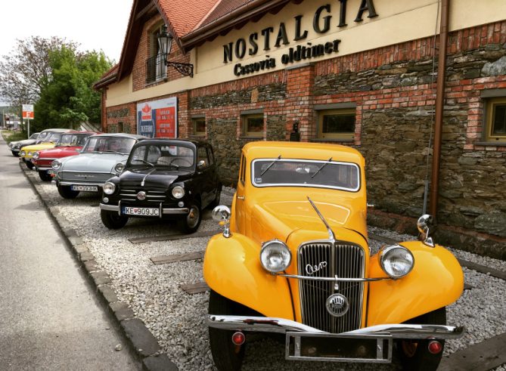
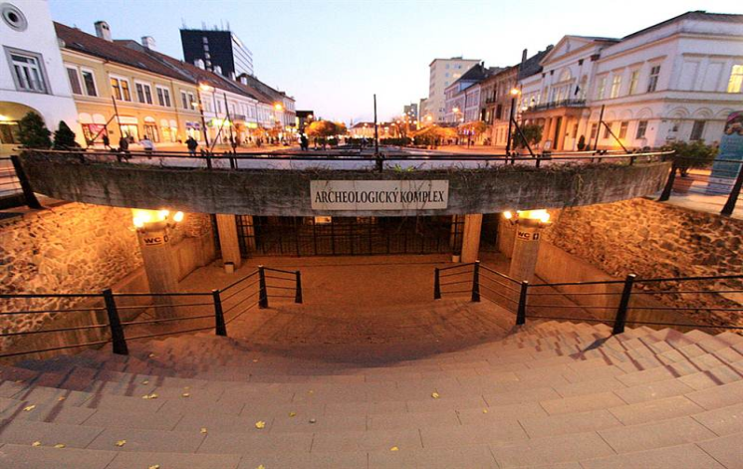
Sándor Márai Memorial Room
It is the room of one of the most read writers from Košice. Inside the house there are manuscripts, photographs, pictures and personal items.
Cassovia Oldtimer Museum
It is a museum of veterans and old cars. Cars can also be rented.
Lower Gate
Archaeological complex hiding part of the city stockade. The museum is located in the underground of Main Street.

Slide 22
Košice Peace Marathon
The Košice Peace Marathon is the oldest marathon in Europe and the second-oldest in the world. The first course was held in 1924. The marathon takes place each year on the first October Sunday. The course is flat, completely asphalted and traffic-free, two laps in the historic city center of Košice. From the very first edition it has strictly maintained the prescribed distance of 42.195 km. The course records were both set by Kenyans in 2012: Hellen Mugo ran a time of 2:29:59 while Lawrence Kimaiyo won the men's race in 2:07:01. Take part can every person that is at least 18 years old.
Memorial of the Košice Peace Marathon
at the Marathon Square
Start of the 94th marathon

Slide 23
Shopping centres
Atrium Optima is one of the largest shopping centers in Slovakia. There are more than 150 branded stores. For example, Office shoes, Pepe Jeans and Ozeta. There is a cinema, hairdressers, a fitness and wellness center and many other services. Each and every month there is a car show.
Aupark is one of the main shopping centers in Košice. It has the best location.It has the largest number of visitors daily as it is close to the railway station and the center. It is attached to a business center called Aupark Tower. There are lots of restaurants and various fast food restaurants, cafes, branded shops and many other services.

Slide 24
Galeria Shopping Center a little less popular. You can eat there and there are various supermarkets. There are various nice cafes and restaurants. The best of the whole shopping center are cafes with a splendid view of Košice.

Slide 25
ZOO Košice
The ZOO in Košice is one of the largest ZOOs in Slovakia.

Slide 26
This zoo is located in Kvečany,covers an area 228 hectares.

Slide 27
Currently the zoo is home to 142 species, and it also includes Slovakia's largest aviary.
As Slovakia's only zoo, it features a botanical instructive path. The ZOO is also successful in horse breeding.

Slide 28
The best thing is that you have food everywhere ( fries, hamburgers, kebap, icecream, pancakes, coffie...)
You can buy som food for animals in automats and you can feed some animals.

Slide 29
View Tower
A viewing tower located at the top of Hradová Hill. The tower is 21.51-meters high. It has three viewing terraces of 10.88 m, 13.6 m, 16.32 m and offers a splendid view of Košice and its vicinity.

Slide 30
Košice Castle
The Košice Castle, whose construction started in the 13th century, is an example of an unspoilt castle. There is no information or only indirect references about this castle in medieval written sources. It is situated north-west of the city of Košice in the Hradová Hill. It is a popular destination for a Sunday-afternoon walk in nature.

Slide 31
Restaurants and Cafés
There is a lot of cafes and restaurants in Košice and I think the most favourite is cafe Trieste or Fontana Cafe and Bar or Slávia.
People love it and student also, because they are special. They visit cafes and restaurants after school or whenever they want.It is nice to meet or talk there. The most favourite restaurant is Napoli or the oldest restaurant in Košice: Pivovar Hostinec.

Slide 32
Christmas Market
If you are looking for presents and dream of the lovely smell of a Christmas tree or the lovely sound of carols,Christmas markets are the best destination for the perfect Christmas feeling,everything that is related to Christmas is there
Everything starts about three weeks before Christmas and little wooden houses are built so the Christmas mood can start.
In contrast to some bigger markets across Europe,the Kosice Christmas Market is sort of familiar, which makes the whole experience more intense.
You can come with friends or family and just enjoy the presence of each other.

Slide 33
Folklore in Košice
Kroj : (Female) shawl, sling, sleeve, braid, bottom skirt, top blue-eyed skirt, coat with visor,
red topped apron, skirt, embroidered beanie
(Male) hat with a piercer, shirt, labeled (with tulips), wide trouser legs, long sleeve,
long sleeve, long sleeve, long sleeve, boots with spikes
There are many folklore ensembles, the most famous ones are Železiar, Hornád, Borievka and Čarnica.
People join these ensembles at a young age and usually continue dancing and singing for a long time.
The ensembles perform at folklore festivals both at home and abroad and they are very popular with both young and old.
It is a great way to preserve our traditions and show them to younger generations.
The East-Slovakian folk music is very lively and energetic and so i tis populary played at wedding parties and balls.

Slide 34
Schools and universities in Košice
We have a lot of high schools in Košice, between which belong our Gymnasium Kováčska 28.
High schools:
We have three health schools- Moyzesova, Kukučínova and Mäsiarska.
There are also industrial and vocational schools- Komenského, Kukučínova, Ostrovského,...
In Košice find also business academy, conservatory, hotel schools and art schools.
Gymnasium in Košice: Alejová, Opatovská, Saint Edith Stein, Saint Thomas Aquinas, Šrobárová, Poštová,...
The most famous university are the Pavol Jozef Safarik University (UPJS) and the Technical University of Košice (TUKE).
UPJS can study social sciences at the Faculty of Philosophy and Faculty of Law, humanities sciences at the Faculty of Medicine and natural sciences at the Faculty of Science.
At TUKE you can study technical sciences at the Faculty of Electrical Engineering and Computer Science, Faculty of Civil Engineering ,Faculty of Aviation and economics at the Faculty of Economics.

Slide 35
Festivals and events (2018)
Winter Food Festival 2018 (15. 1. – 25. 2.)
The Slovak culinary festival offers all gourmets a chance to try out the best that the restaurants of Košice have to offer.
Steam Fair (14. - 15. 4.)
An interesting programme featuring trains from all over Slovakia is prepared for all the train enthusiasts - old and young and includes music, fun, food and many activities for children. It offers a rare chance to explore the original water tower in the train depot.
Košice City Days (30. 4. – 8. 5.)
In the beginning of May the city lets its hair down for a celebration of the city day that involves nightly concerts in the square as well as food and beer stands, a medieval market, historical and knights’ parades and the annual reopening of the ZOO...

Slide 36
Balloon Fiesta (6. – 9. 6.)
The Balloon Fiesta is one of the most attractive events in the city, having taken place for the past 23 year. It is a celebration of fans of balloon flying, as well as citizens and visitors of the city. Take off from Košice!
Art Film Fest (15. – 23. 6.)
A whole spectrum of unique films are presented to the visitors of Art Film Fest in Košice every year with the participation of famous Slovak and international actors.
Cassovia Folkfest (20. – 24. 6.)
The festival is aimed at presenting and promoting traditional Slovak and European folklore.
Košice Wine Festival (6. – 8. 9.)
Winery tradition once so typical for Košice is still alive in Slovakia’s second largest city. Košice Wine Festival brings the best wines from both Slovakia and abroad to the people of Košice.

Slide 37
Košice Beer Fest (September)
International festival of quality beer in Košice whose aim is to promote small local breweries producing beer with a soul.
White Night / Nuit Blanche (6. 10.)
White Night is a prestigious international art project aimed at bringing near to the general public not only contemporary art forms, but also untraditional, unknown and important spots of big European cities.
New Year's Eve (31. 12.)
Every year, hundreds of people meet on Hlavná street to thank for the bygone year and welcome the following one with music, singing, dance, great fun and beautiful fireworks.

Slide 38
Thank you for your atention

